Slide 1
Perimeter and Area

Slide 2
Notes:
Ask what all of these shapes have in common.

Slide 3
Polygons
Notes:
Say that enclosed, two-dimensional shapes that only have straight lines are called polygons.

Slide 4
Polygons You Might Work With On The Job
Notes:
Say that, polygons like triangles, squares, and rectangles, are often used in construction.
Ask what the black shape is

Slide 5
At the end of this module you should be able to
Calculate the perimeter and area of polygons that are common in construction
Notes:
Review the objective.

Slide 6
Perimeter = the length around the outside of an object.
3’
6’
6’
3’
6’
+
3’
+
6’
+
3’
=
18’
Notes:
Say that perimeter is the length around the outside of an object, i.e. adding up the length of all of the sides, and is measured in inches, feet, yards, etc.
Say that the apostrophe means “feet.”
Point out how all sides, added together, equals 18 feet.

Slide 7
Notes:
Say they might need to measure the perimeter of a sheet metal box

Slide 8
Notes:
Or the perimeter of a field or a yard to determine how much fencing they’ll need.

Slide 9
Notes:
Or the perimeter of a pool to determine how much decorative tile they’ll need for the edge of the pool.

Slide 10
Notes:
Or they might need to measure the perimeter of a ceiling to determine how much crown moulding they’ll need.
Point out the crown moulding.

Slide 11
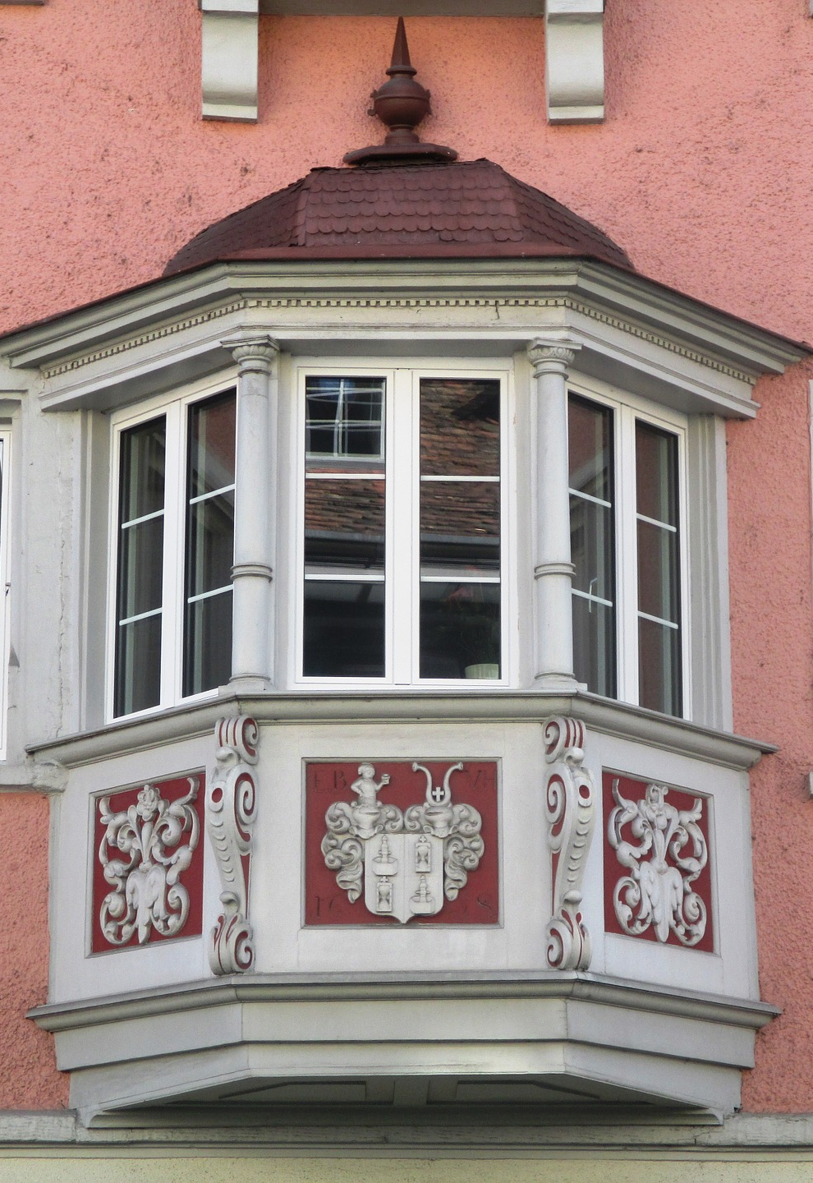
Notes:
Say that octagons are used to build bay windows so they might need to determine the perimeter of the octagon when building the window.

Slide 12
Notes:
Or they might need to measure the perimeter of an octagon to purchase materials for a gazebo, which are often octagons.

Slide 13
What is the perimeter of this ceiling?
12’
24’
24’
12’
Notes:
Ask how they would determine the perimeter of the ceiling in this slide.

Slide 14
Perimeter = length around the outside of the ceiling.
12’
24’
$\text{+}\text{24}$’
+12’
+12’
72’
24’
24’
12’
Notes:
Show how the answer was determined.
Have students correct their answers (if necessary) on their handouts.

Slide 15
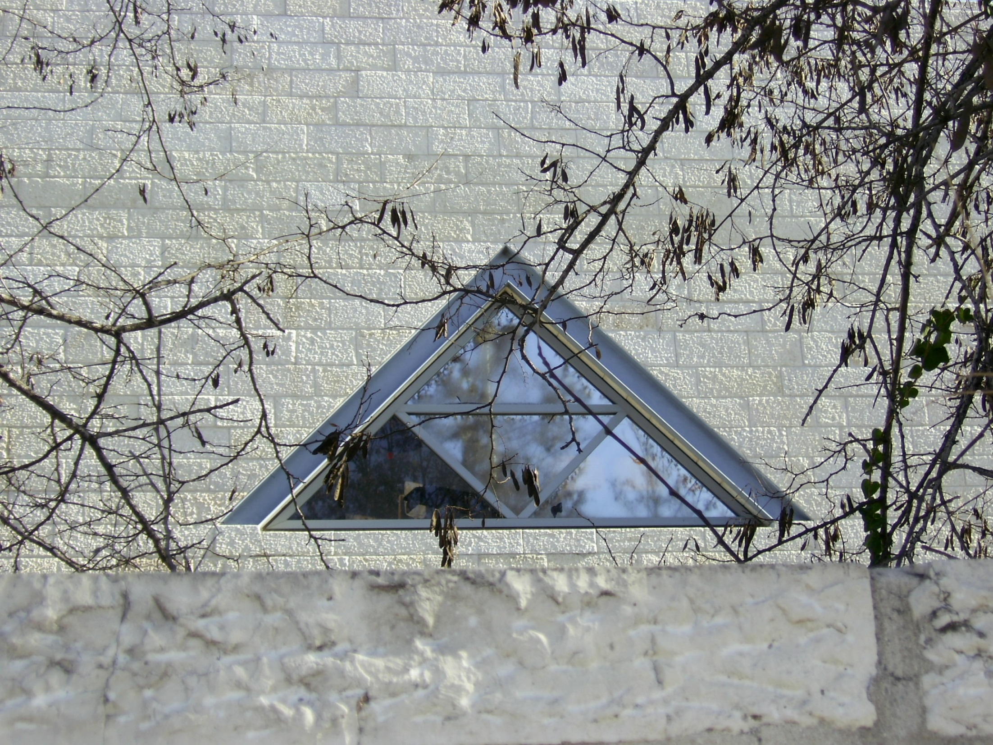
What is the perimeter of this triangular window?
3’
3’
4’
Notes:
Have students write their answer on their handout

Slide 16
What is the perimeter of this triangular window?
3’
3’
4’
3’ + 3’ + 4’ = 10’
Notes:
Show how the answer was determined.
Have students correct their answers (if necessary) on their handouts.

Slide 17
If one side of this square concrete pad is 10 feet…
… what would the perimeter of the pad be?
Notes:
Have students write their answer on their handout
Ask how they got their answer.

Slide 18
10’
10’
$\text{+}\text{10}$’
+10’
+10’
40’
10’
Pad
10’
10’
Notes:
Have students correct their answers (if necessary) on their handouts.
Ask how they could have gotten the answer without addition.

Slide 19
10’
10’
Pad
10’
10’
x 4’
40’
10’
Notes:
Say that, for squares only, they can determine the perimeter by just multiplying the length of one side by 4.
Ask students what questions they have about finding the perimeter of rectangles, squares, or triangles.

Slide 20
Notes:
Say that earlier they calculated the perimeter of a ceiling to determine how much crown moulding they would need.
Now the building owner wants to install a decorative covering for the ceiling and they need to determine how much of the covering they need for the ceiling.
The amount of space on the surface of something like a ceiling is called area and, on the job, they will often need to measure the area of something.

Slide 21
Notes:
Say for example you might have to measure the area of wood panels

Slide 22
Notes:
Or roofing materials

Slide 23
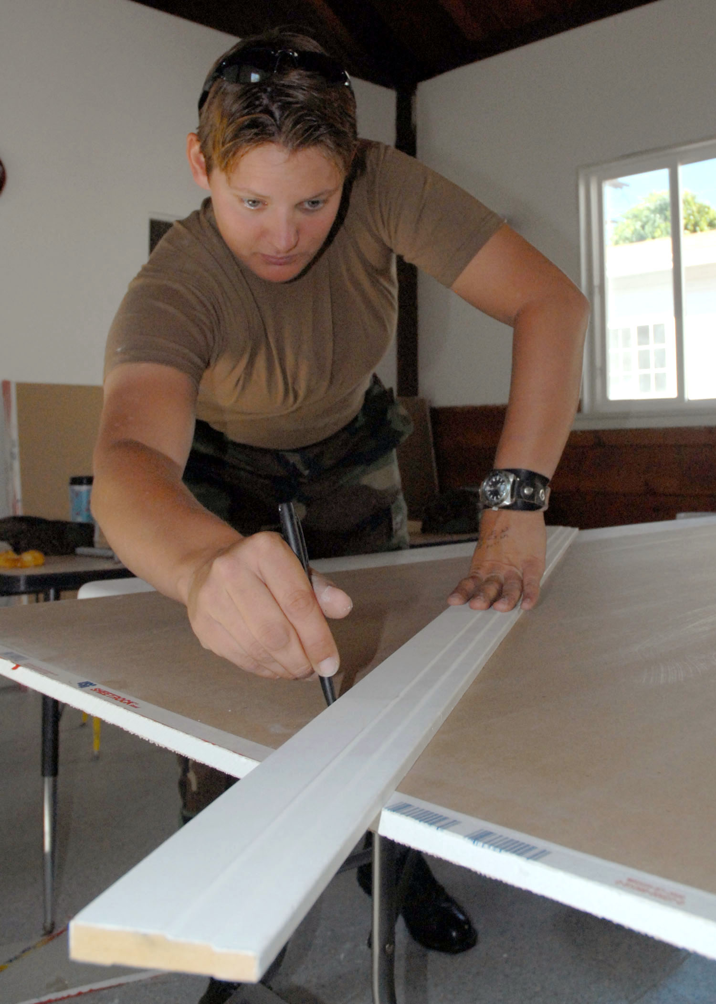
Notes:
Or drywall

Slide 24
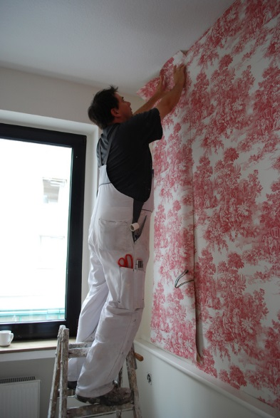
Notes:
Or wallpaper or paint

Slide 25
Notes:
Ask how they would determine how much decorative covering they would need to cover the entire ceiling.

Slide 26
Area of a rectangle or square = width x height.
h = 24’
Area = w x h
= 12’ x 24’
= 288 sq. ft.
w = 12’
Notes:
Say that to find the area of a square or rectangle, you multiple the length x width.
Area is measured in square feet, square inches, square yards, etc.

Slide 27
1 square foot
1’
h = 24’
1’
Area = w x h
= 12’ x 24’
= 288 sq. ft.
w = 12’
Notes:
Say that if they divided the ceiling into squares that were each 1 foot wide and 1 foot tall there would be 288 of those “square feet” in the ceiling.

Slide 28
If one side of this square concrete pad is 10 feet…
… what would the area of the pad be?
Notes:
Have students write their answer on their handout.
Ask how they got their answer.

Slide 29
10’
10’
10’
Pad
Area = w x h
= 10’ x 10’
10’
= 100 sq. ft.
Notes:
Have students correct their answer on their handout if necessary
Point out that all sides of a square are equal.
Ask students what questions they have about finding the area of rectangles or squares.

Slide 30
What is the perimeter of this field?
60’
25’
40’
20’
15’
40’
Notes:
Say that many polygons are not perfect rectangles or squares but it is still possible to calculate the perimeter and area.
Have students calculate the perimeter and write their answer on their handout.

Slide 31
What is the perimeter of this field?
60’
60’
$\text{+}\text{40}$’
+40’
+15’
+20’
+25’
25’
40’
20’
15’
200’
40’
Notes:
Have students correct their answer if necessary.

Slide 32
What is the area of this field?
60’
25’
40’
20’
15’
40’
Notes:
Ask how they could determine the area.

Slide 33
What is the area of this field?
60’
500 sq. ft.
25’
40’
20’
15’
Area = w x h
40’
= 20’ x 25’
= 500 sq. ft.
Notes:
Show and have students write the process on their handout.

Slide 34
What is the area of this field?
60’
1,600 sq. ft.
25’
40’
20’
15’
Area = w x h
40’
= 40’ x 40’
= 1,600 sq. ft.
Notes:
Show and have students write the process on their handout.

Slide 35
What is the area of this field?
60’
500 sq. ft.
1,600 sq. ft.
25’
40’
20’
15’
500 sq. ft.
+ 1,600 sq. ft.
40’
2,100 sq. ft.
Notes:
Show and have students write the process on their handout.
Have students correct their answer if necessary.

Slide 36
How much wood flooring would be needed to cover this entryway?
5’
9’
9’
8’
8’
Notes:
Have students write their answer on their handout.

Slide 37
How much wood flooring would be needed to cover this entryway?
45 sq. ft.
5’
9’
9’
8’
Area = w x h
8’
= 9’ x 5’
= 45 sq. ft.
Notes:
Show and have students write the process on their handout

Slide 38
How much wood flooring would be needed to cover this entryway?
5’
104 sq. ft.
9’
9’
8’ + 5’ = 13’
8’
Area = w x h
8’
= 13’ x 8’
= 104 sq. ft.
Notes:
Show and have students write the process on their handout

Slide 39
How much wood flooring would be needed to cover this entryway?
45 sq. ft.
5’
9’
9’
8’
Area = w x h
8’
= 9’ x 5’
= 45 sq. ft.
Notes:
Show and have students write the process on their handout

Slide 40
How much wood flooring would be needed to cover this entryway?
45 sq. ft.
45 sq. ft.
5’
104 sq. ft.
9’
9’
8’
45 sq. ft.
8’
+ 104 sq. ft.
+ 45 sq. ft.
194 sq. ft.
Notes:
Show and have students write the process on their handout
Have students correct their answer if necessary.
Ask students what questions they have about finding the area of rectangles and squares with irregular shapes.

Slide 41
What is the perimeter of the outside (bold line) of this figure?
What is the area of the shaded part?
5’
10’
8’
14’
Notes:
Ask students what the perimeter of the outside (bold line) of this figure would be.
Invite a student to the board to show how to calculate the area of the shaded part of this figure.

Slide 42
What is the perimeter of the outside (bold line) of this figure?
What is the area of the shaded part?
12’
6’
6’
21’
Notes:
Have students calculate the perimeter of the outside (bold line) of this figure and the area of the shaded part of this figure and write their answer on their handout.

Slide 43
Perimeter = 66’
Area of the shaded part = 216 sq. ft.
12’
6’
6’
21’
Notes:
Have students correct their answers (if necessary) on their handouts.

Slide 44
Image Credits
LisaLandscapeWorkingSmile_98A7477 by Oregon Tradeswomen, Inc.
Daniel Farrell, The fence, just about done!!!!!! swimming-pool-55736_1920 CC0 Public Domain Pixabay
swimming-pool-55736_1920 CC0 Public Domain Pixabay
ceiling-fan-558988_1920 CC0 Public Domain Pixabay
architecture-283732_1920 CC0 Public Domain
Vega,_TX_gazebo_IMG_4906 Billy Hathorn Wikimedia Commons Creative Commons Attribution-ShareAlike 3.0 Unported
Talissa Decor Faux tin ceiling by TalissaDecor CC by 2.0 Generic
ValerieRoofSawing898A5787 by Oregon Tradeswomen, Inc.
RosaStripsRoofing_98A7663CMYK by Oregon Tradeswomen, Inc.
US Navy 070911-N-8547M-027 Builder 3rd Class Tabitha E. Ball, of Naval Mobile Construction Battalion (NMCB) 5^rsquo,s air detachment, marks sheetrock during a construction project that battalion Seabees volunteered to carry out.jpg Wikimedia Commons Public Domain
Wallpapering, Cologne Hotel Domspitzen Köln Wikimedia Commons CC by 2.0 Generic
4278675568_b406567f85_o (Triangular Window) zeevveez CC by 2.0 Generic
Tradeswomen by Oregon Tradeswomen, Inc.

