Slide 1
How can you multiply two positive numbers and get a result that is smaller than either of the two numbers you are multiplying?
Notes:
Ask how they could multiply two positive numbers and get a result that is smaller than either of the two numbers they are multiplying.
Say that the answer is in this module.

Slide 2
At the end of this part of the module, you should be able to
multiply fractions
Notes:
Review the objective.

Slide 3
Notes:
Say that they will often have to multiply fractions, like when they are calculating how much material they will need.

Slide 4
Notes:
Or when they need to calculate the height of something, like a staircase.

Slide 5
Notes:
Or when you are trying to cost out a job.

Slide 6
Think of multiplication like this:
5 x 2 | Five groups of two
3 x 9 | Three groups of nine
3 x 14 | Three groups of fourteen
12 x 7 | Twelve groups of seven
Notes:
Say that when they see a multiplication problem, it can be helpful to think of it as “___ groups of ___.”

Slide 7
Five groups of four
Notes:
Ask how they would say 5 x 4.
Ask if multiplying 5 x 4 would produce a result that is greater or less than 5.
Say that visualizing problems like these can be helpful. CLICK
Point out the five groups of four.
Ask what 5 x 4 = .
Point out the 20 objects.

Slide 8
Two groups of nine
Notes:
Ask how they would say 2 x 9.
Ask if multiplying 2 x 9 would produce a result that is greater or less than 2. CLICK
Point out the two groups of nine.
Ask what 2 x 9 = .
Point out the 18 objects.
Say that thinking about multiplication like this will help them understand multiplication of fractions.

Slide 9
Five groups of one-half
Notes:
Ask how they would say 5 x 1/2 (five groups of 1/2). CLICK
Ask how many halves there are.
Point out the five, one-halves.
Ask if multiplying 5 by 1/2 will produce a result that is greater or less than 5.
Ask why it is less

Slide 10
Notes:
Point out the difference between 5 and 5/2 on the slide
NOTE – WILL WORK ON SIMPLIFYING FRACTIONS LATER

Slide 11
Five groups of one-half
Notes:
Say that, when multiplying fractions, you can just multiply the two top numbers and the two bottom numbers.
Ask what the bottom number would be for 5. CLICK
Point out the 1.
Say to remember that any whole number can be written as itself over 1.

Slide 12
Three groups of five-eighths
Notes:
Ask how they would say 3 x 5/8.
Ask if multiplying 3 by 5/8 will produce a result that is greater or less than 3.
Ask why it will be less. CLICK
Ask how many eighths there are.

Slide 13
Three groups of five-eighths
Notes:
Say that three groups of 5/8ths = 15/8ths.
Point out the fifteen eighths.

Slide 14
Four groups of two-thirds
Notes:
Ask students how they would say 4 x 2/3. CLICK
Invite a student to come to the board to draw what 4 groups of 2/3 would look like, write it out as numbers, (e.g. 4 x 2/3), and find the answer.
Have the other students write their own answer on their handout.
Review and correct the answer as necessary.

Slide 15
Six groups of three-sixteenths
Notes:
Ask how they would say 6 x 3/16. CLICK
Ask what the bottom number would be for 6. CLICK
Point out the 1.

Slide 16
If you run $\frac{\text{1}}{\text{2}}$ mile every day for 6 days…
… what is the total distance you have run?
Notes:
Ask how they would say this using the “groups” phrase (six groups of 1/2 miles).
Invite a student to come to the board to draw what 6 groups of 1/2 would look like, write it out as numbers, and find the answer.
Have the other students write their own answer on their handout.
Review and correct the answer as necessary.
Point out the importance of labeling their answer (e.g. miles).

Slide 17
You need to paint the trim in seven rooms of a house. You estimate that each room will take of a gallon of paint. How many gallons do you need?
Notes:
Ask how they would say this using the “groups” phrase (7 groups of 1/3 gallons).
Ask if they will need more or less than seven gallons of paint, and why.
Invite a student to come to the board to draw the 7 groups of 1/3, write it out as numbers, and find the answer.
Have the other students write their own answer on their handout.
Review and correct the answer as necessary.
Be sure they label their answer (e.g. gallons).

Slide 18
Imagine that, after a party, there is of a cake left. Your roommate then eats of the leftover cake. How much of the entire cake did your roommate eat?
Notes:
Invite a student to come to the board to write this out in numbers and find the answer.
Have the other students write their own answer on their handout.
Review and correct the answer as necessary.
Be sure they label their answer (e.g. how much of the cake).

Slide 19
If it takes of a gallon of paint to cover the trim in one room, how much paint do you need to paint of the trim in one room ?
Notes:
Ask whether they will need more than 1/3 of a gallon or less than 1/3, and why.
Have students write out the problem and their answer on their handout.

Slide 20
If it takes of a gallon of paint to cover the trim in one room, how much paint do you need to paint of the trim in one room ?
of a gallon
Notes:
Have students correct their answer if necessary.

Slide 21
If of your work crew are carpenters and of the carpenters are female, how many female carpenters are on your work crew?
Notes:
Ask whether more than 5/8 are female carpenters or less than 5/8 are female carpenters, and why.
Have students write out the problem and their answer on their handout.

Slide 22
are female carpenters
Notes:
Have students correct their answer if necessary.

Slide 23
At the end of this part of the module, you should be able to,
convert between improper fractions & mixed numbers
Notes:
Review the objective.

Slide 24
Notes:
Ask how these five halves could be combined. CLICK
Show how the halves were combined to make two wholes.
Ask how they would write the newly-combined visual as numbers. CLICK

Slide 25
Notes:
Say to remember that one way to think about a fraction is as division of the top number by the bottom number.

Slide 26
Improper fraction
Mixed Number
Notes:
Say that if the top number is larger or equal to the bottom number it is an “improper fraction.” CLICK
Say that if the number is a whole number + a proper fraction it is called a “mixed number.” CLICK

Slide 27
Improper fraction
Notes:
Say to remember that any number divided by itself = 1

Slide 28
Notes:
Invite a student to the board to draw how these 8/3rds could be combined.
Have the other students write their own answer on their handout.
Review and correct the answer as necessary.

Slide 29
Improper fraction
Mixed Number
Notes:
Show how 8/3 converts to 2 2/3

Slide 30
How could these be combined?
Notes:
Have students write the shapes and answer on their handout.

Slide 31
equals
Notes:
Have students correct their answer (if necessary) on their handout.

Slide 32
Improper fraction
Mixed Number
Notes:
Show how 15/8 converts to 1 7/8.

Slide 33
How could these be combined?
Notes:
Have students write the shapes and answer on their handout.

Slide 34
equals
Notes:
Have students correct their answer (if necessary) on their handout.

Slide 35
How could you multiply these two numbers?
Notes:
Ask how they could multiply these two numbers.

Slide 36
Notes:
Say to remember that 2 1/2 is the same as 5/2. CLICK
Say that, to multiply mixed numbers, you need to first convert the mixed number back to an improper fraction.

Slide 37
To convert from a mixed number to an improper fraction, multiply the whole number by the bottom number of the fraction then add that amount to the top number.

Slide 38
Notes:
Show how the mixed number 2 1/2 was changed to CLICK
(4+1)/2 and how that was changed to CLICK
5/2.

Slide 39
Is the same as
Notes:
Point out that 2 1/2 is the same as 5/2.

Slide 40
Is the same as
Notes:
Show how 5/2 x 1/4 equals 5/8.

Slide 41
What is the result of multiplying these two numbers?
Notes:
Say to remember that 3 3/8 is a single number.
Invite a student to come to the board to demonstrate how to solve this.
Have the other students write their own answer on their handout.
Review and correct the answer as necessary.
Ask how the answer (an improper fraction) would be written as a mixed number.
Review and correct the answer as necessary.

Slide 42
What is the result of multiplying these two numbers?
Notes:
Have students write the answer on their handout.

Slide 43
Is the same as
Notes:
Show how to get from 4 3/16 to 67/16. CLICK
Show how 1/2 x 67/16 = 67/32. CLICK
Show how 67/32 = 2 3/32. CLICK
Point out that 1/2 x 4 3/16 = 2 3/32
Have students correct their answer (if necessary) on their handout.

Slide 44
What is the result of multiplying these two numbers?
Notes:
Have students write the answer on their handout.

Slide 45
Is the same as
Notes:
Show how to get from 2 2/3 to 8/3. CLICK
Show how to get from 5 3/4 to 23/4. CLICK
Show how 8/3 x 23/4 = 184/12. CLICK
Show how 184/12 = 15 4/12. CLICK
Point out that 2 2/3 x 5 3/4 = 15 4/12
Have students correct their answer (if necessary) on their handout.

Slide 46
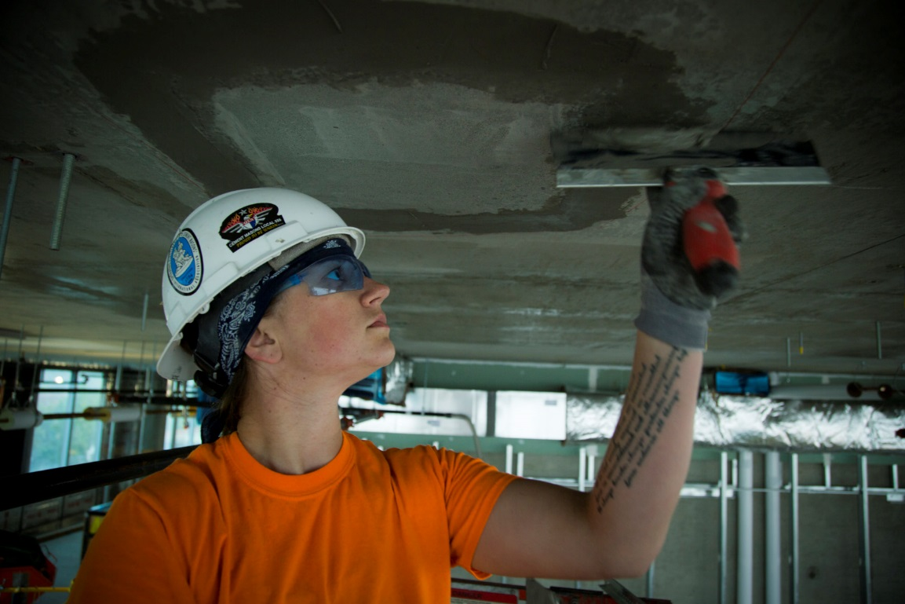
If it takes gallons of patching compound to patch the average ceiling in this building, how many
gallons will be needed to patch six average ceilings?
Notes:
Have students write the answer on their handout.

Slide 47
Is the same as
Notes:
Say to remember that 6 is the same as 6/1.
Show how to get from 10 1/2 to 21/2. CLICK
Show how 6/1 x 21/2 = 126/2. CLICK
Show how 126/2 = 63. CLICK
Point out that 6 x 10 1/2 = 63
Have students correct their answer (if necessary) on their handout.

Slide 48
At the end of this part of the module, you should be able to
simplify fractions
Notes:
Review the objective.

Slide 49
You can write any number many different ways.
Notes:
Say to remember that any number can be written in many different ways.
Point out that these are all the same number.

Slide 50
Notes:
Point out how all these ways of writing the fraction are really the same number (same amount).

Slide 51
All of these numbers are the same.
Which version would you rather work with?
Notes:
Show how each is the same.
Ask, if they were measuring or calculating something, which version of this number they would want to work with.
Ask which is the simplest.

Slide 52
To simplify a fraction, find the largest number you can divide the top and bottom number by to get a whole number.
Notes:
Say that to simplify a fraction you need to divide the top and bottom by the same number.
Note – do not refer to simplifying fractions as “reducing” them. “Reducing” can give students the impression that the simplified fraction is smaller than the original.

Slide 53
To simplify a fraction, find the largest number you can divide the top and bottom number by to get a whole number.
Can be divided by 1, 2, 3, 6
Can be divided by 1, 2, 3, 4, 6, 12
Notes:
Point out that 6 is the largest number that can be divided into both the top and bottom number to get a whole number. CLICK

Slide 54
To simplify a fraction, find the largest number you can divide the top and bottom number by to get a whole number.
Notes:
Show how dividing both the top and bottom by 6 will simplify the fraction to 1/2.

Slide 55
It is OK if you do not find the largest common number the first time.
Notes:
Say that it is OK if they don’t find the largest common number the first time, they might just need to simplify it more than once.
Show how the original fraction needed to be divided twice to simplify it.

Slide 56
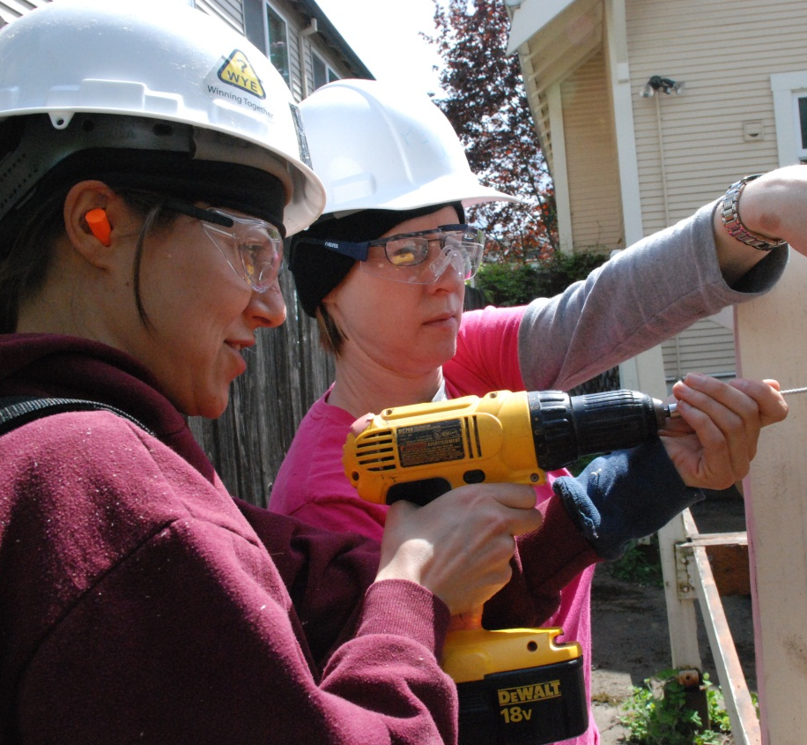
Not all fractions can be simplified.
Notes:
Point out that this cannot be simplified.

Slide 57
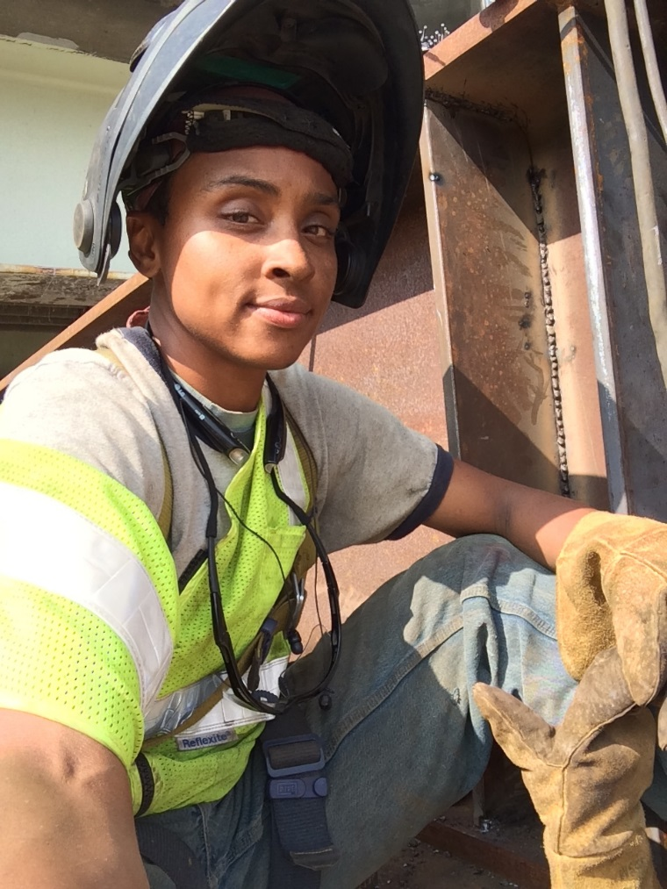
Notes:
Invite a student to come to the board to demonstrate how to simplify this.
Have the other students write their own answer on their handout.
Review and correct the answer as necessary.

Slide 58
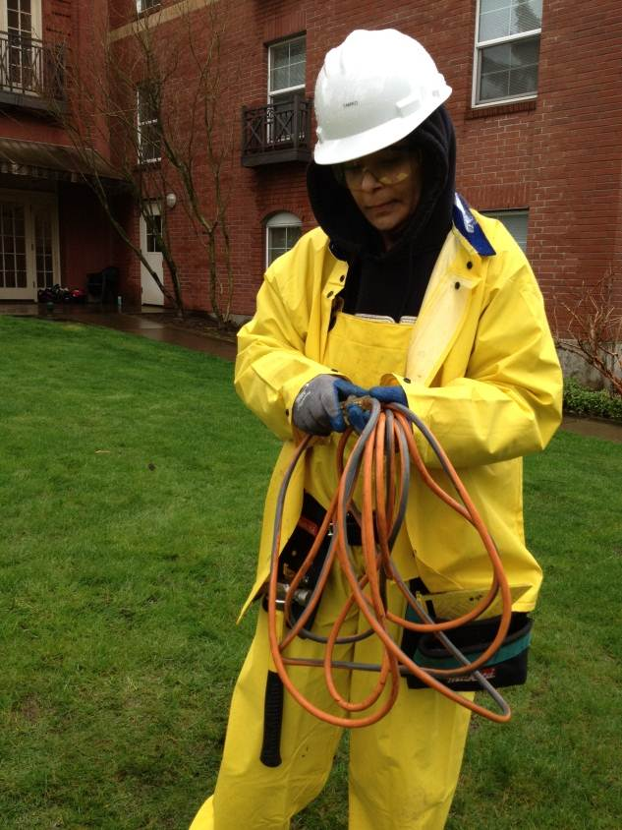
Notes:
Have students write the simplified version of this fraction on their handout.

Slide 59
Notes:
Show how 10/64 is simplified to 5/32.
Have students correct their answers if necessary.

Slide 60
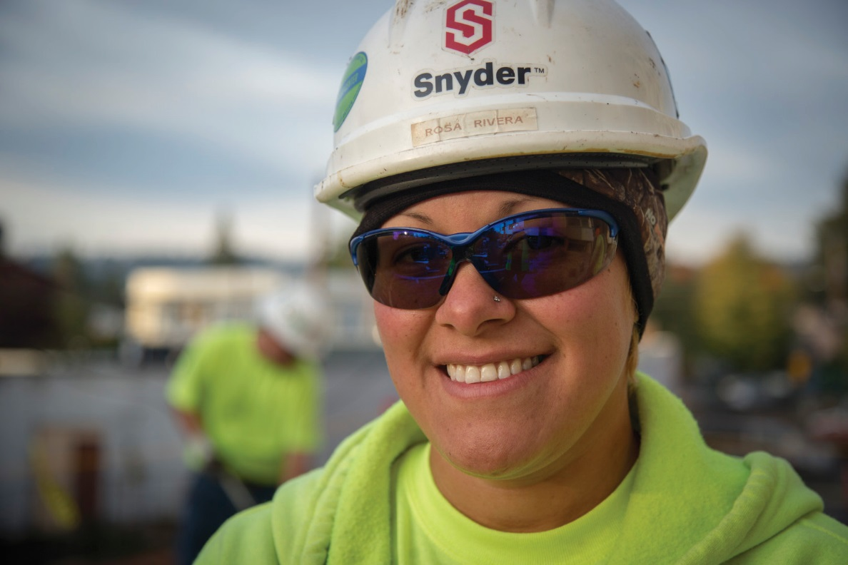
Notes:
Have students write the simplified version of this fraction on their handout.

Slide 61
Notes:
Have students correct their answers if necessary.

Slide 62
If a correct answer is not in the simplest form it is still correct!
Notes:
Point out that 6/12 is correct CLICK
But1/2 is easier to work with.

Slide 63
Image Credits
Jalaine Digs Thru Romex Landscape_98A6153CMYK by Oregon Tradeswomen, Inc.
Yellow-cedar lumber. by nmai.si.eu Wikimedia Commons Creative Commons 1.0 Public Domain
View down the spiral staircase in Haldon Belvedere, a folly on Haldon Hill, near Exeter, Devon. By Nilfanion (Own work) CC BY-SA 3.0 via Wikimedia Commons
ErinLooksAtCam898A6927 by Oregon Tradeswomen, Inc.
Running women with braided hair by Peter van der Sluijs CC BY-SA 3.0
Tradeswoman by Oregon Tradeswomen, Inc.
StephStandsSmilesMS_98A6732 by Oregon Tradeswomen, Inc.
Olivia Works Medium Landscape_98A5946 by Oregon Tradeswomen, Inc.
VanessaConcreteForm_98A6503 by Oregon Tradeswomen, Inc.
Tradeswoman by Oregon Tradeswomen, Inc.
Tradeswoman by Oregon Tradeswomen, Inc.
Tradeswoman by Oregon Tradeswomen, Inc.
RosaSmilesAtCamCU_98A7553CMYK

