Slide 1
What is the answer for each of the following?
Notes:
Ask what the answer is for each problem.
Point out that, for each, the answer is smaller than the number being divided.

Slide 2
Is it possible to divide a positive number by another positive number and get a result that is larger than the number being divided (the first number)? If so, how?
Notes:
Ask how it might be possible to divide a positive number by another positive number and get a result that is larger than the number being divided.
Say that the answer is in this module.

Slide 3
At the end of this module, you should be able to divide fractions.
Notes:
Review the objective.

Slide 4
Notes:
Say that there will be many times when they will need to be able to divide fractions, such as when they have to determine how many pieces of material they can get out of a larger piece.

Slide 5
Notes:
Or when they have to space things at certain distances along a wall.

Slide 6
Notes:
Or when they have to determine how much material they’ll need for a job.

Slide 7
Think of division like this:
6 ÷ 3 | How many 3s fit into 6?
15 ÷ 5 | How many 5s fit into 15?
32 ÷ 8 | How many 8s fit into 32?
Notes:
Say that when they see a division problem, it can be helpful to think of it as “How many ___ (the second number) fit into _____ (the first number).”

Slide 8
How many threes fit into 6?
Notes:
Ask how they would say 6÷3 CLICK
Point out the 6 objects. CLICK
Point out the 2 sets of 3 that fit in 6. CLICK

Slide 9
How many fives fit into 15?
Notes:
Ask how they would say 15÷5 CLICK
Point out the 15 objects. CLICK
Point out the 3 sets of 5 that fit in 15. CLICK

Slide 10
How many twos
fit into 9?
Notes:
Ask how they would say 9÷2 CLICK
Point out the 9 objects. CLICK
Point out the 4 sets of 2 that fit in 9 with a remainder of 1. CLICK

Slide 11
How many fourths fit into 5?
Notes:
Point out the 5 objects. CLICK
Point out the twenty 1/4s that fit in 5. CLICK

Slide 12
How many s fit in ?
One Whole
Notes:
Point out the 1/2 CLICK
Point out the 8ths.
Point out that 4 1/8ths fit in 1/2.

Slide 13
To divide two fractions, flip the top and bottom numbers after the division sign, then multiply the two top numbers and the two bottom numbers.
Notes:
Say that to divide two fractions, flip the top and bottom numbers after the division sign, then multiply the two top numbers and the two bottom numbers.

Slide 14
To divide two fractions, flip the top and bottom numbers after the division sign…
Notes:
Ask students what the bottom number is for 5. CLICK
Say that only the fraction after the division sign is changed. The fraction before the division sign is unchanged.
Point out how the fraction flipped.

Slide 15
…then multiply the two top numbers and the two bottom numbers.
Notes:
Show how 5/1 x 4/1 = 20/1.
Say to remember that any number over 1 = itself.

Slide 16
Notes:
Ask whether the answer will be greater or less than 15.

Slide 17
Notes:
Show how 15 is the same as 15/1 CLICK
Show how 7/8 was changed to 8/7 CLICK
Show how 15/1 x 8/7 = 120/7 CLICK
Show how 120/7 = 17 1/7
Point out that the answer is greater than 15.

Slide 18
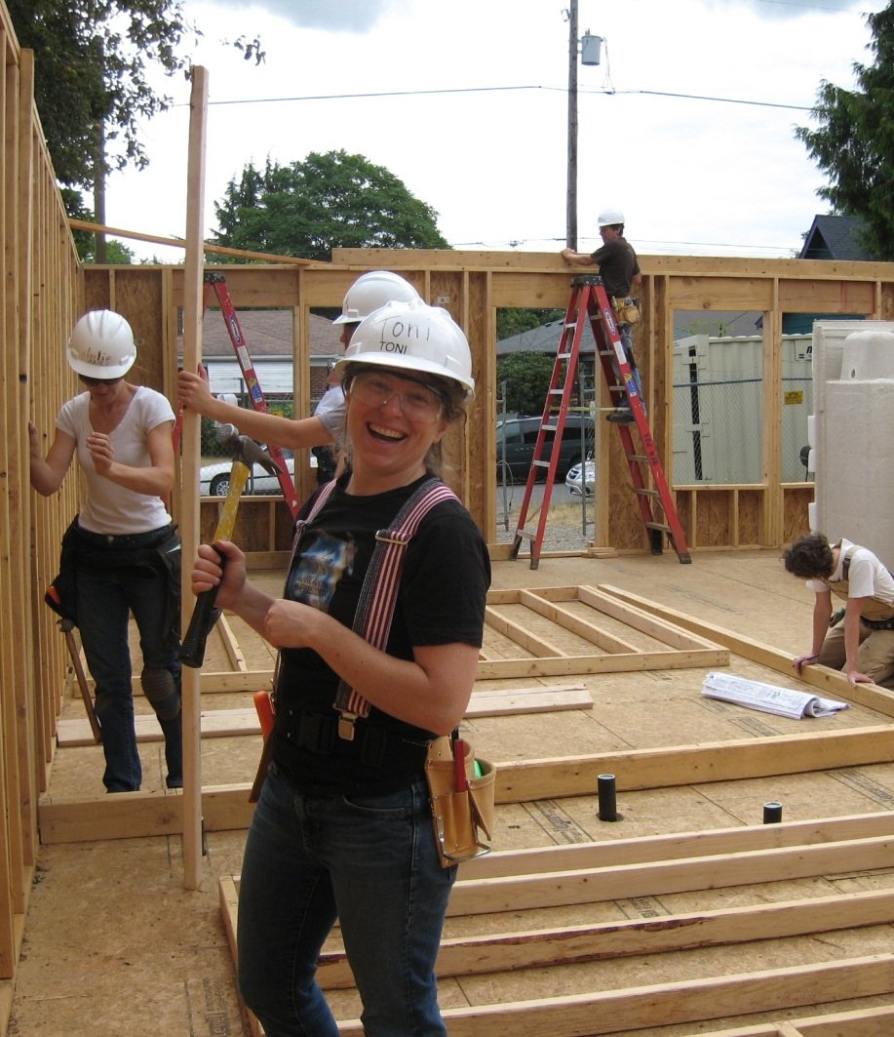
Notes:
Ask whether the answer will be greater or less than 7 3/8ths.
Invite a student to the board to work out the problem.
Have the other students write their own answer on their handout.
Review and correct the answer as necessary.

Slide 19
Notes:
Ask whether the answer will be greater or less than 11 9/16ths.
Have students write the answer on their handout.

Slide 20
Notes:
Show how 11 9/16 is the same as 185/16 and 4 is the same as 4/1 CLICK
Show how 4/1 was changed to 1/4 CLICK
Show how 185/16 x 1/4 = 185/64 CLICK
Show how 185/64 = 2 57/64
Point out that the result is less than 11 9/16.
Have students correct their answers (if necessary) on their handout.

Slide 21
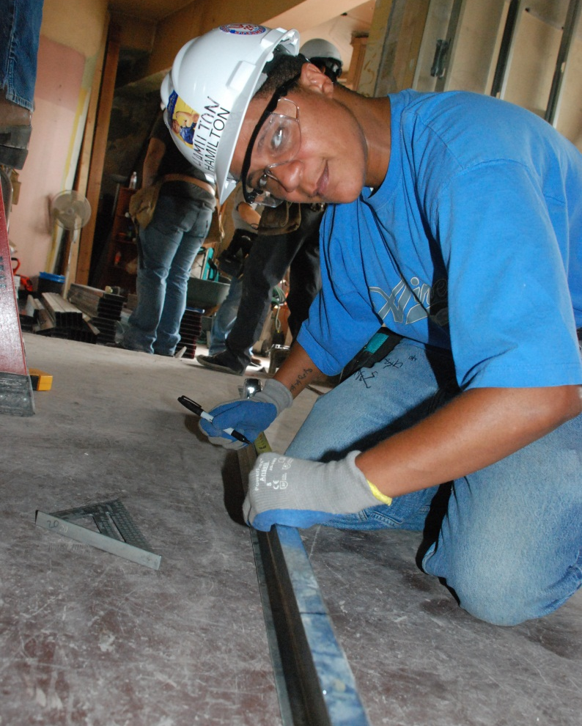
You have a metal bar that is ft. long.
If you cut it into six even pieces, how long, in feet, would each piece be?
Notes:
Invite a student to the board to work out the problem.
Have the other students write their own answer on their handout.
Review and correct the answer as necessary.

Slide 22
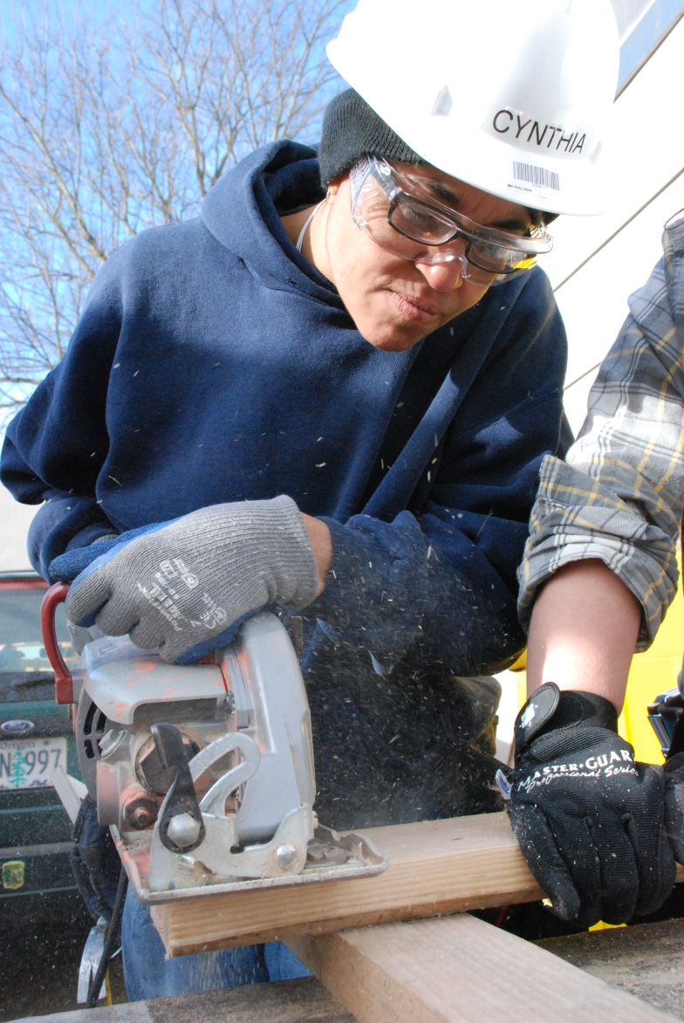
You need pieces of wood that are inches long. How many can you get from a board that is 12’ long?
Notes:
Have students write out the problem and their answer on their handout.

Slide 23
Notes:
Say that the first step is to convert feet to inches so all calculations will be in the same unit.
Show how 144 ÷ 4 1/4 is the same as 144/1 ÷ 17/4 CLICK

Slide 24
Notes:
Show how 17/4 was changed to 4/17 CLICK
Show how 144/1 x 4/17 = 576/17 CLICK
Show how 576/17 = 33 15/17, so they could get thirty three, 4 1/4 pieces out of the board.
Point out that the 15/17ths is 15/17ths of 4 1/4.

Slide 25
Notes:
Say that one way they might use division is when they need to find the center of a wall, like when tiling a wall.
Pass out the Finding the Center of a Wall handout and walk through the example on the board.
Have students work with a partner and use the Finding the Center of a Wall handout to find the centers of walls that are:
19’ 2 1/4”
14’ 8”
21’ 1/2”

Slide 26
Image Credits
Johnetta Abraham898A6035 by Oregon Tradeswomen, Inc.
ValerieRoofSawing898A5798 by Oregon Tradeswomen, Inc.
ErinDrillsConcrete898A6762 by Oregon Tradeswomen, Inc.
Block Concrete forms by Wall-Tiles and Forms CC BY 2.0
Tradeswoman by Oregon Tradeswomen, Inc.
Tradeswoman by Oregon Tradeswomen, Inc.
Tradeswoman by Oregon Tradeswomen, Inc.
Tradeswoman by Oregon Tradeswomen, Inc.
Tradeswoman by Oregon Tradeswomen, Inc.
Tiling in kitchen above stove and countertop.jpg by Tomwsulcer (Own work) [Public domain], via Wikimedia Commons

