Slide 1
A
Fraction
is just an amount of something
Notes:
Say that no one got a whole bar, each got a fraction of a bar. CLICK
Say that a fraction is just an amount of something.

Slide 2
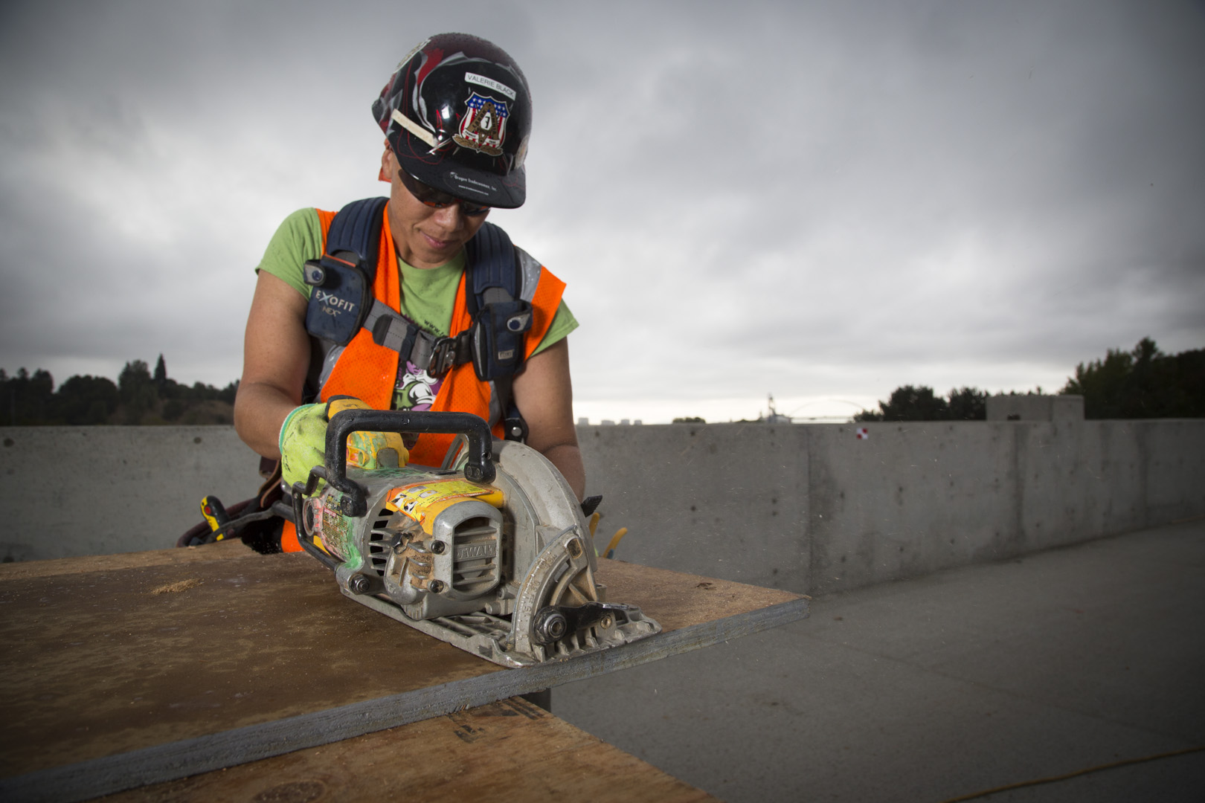
At the end of this part of the module, you should be able to explain what a fraction is
Notes:
Say that, in construction, they will be measuring amounts all the time: length, weight, perimeter, area, volume, etc. CLICK
Review the objective.

Slide 3
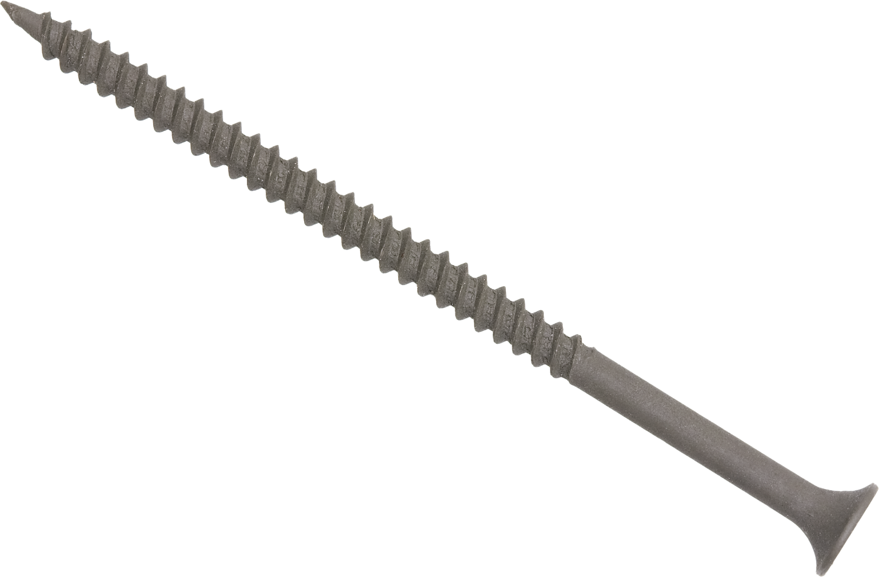
Notes:
Say that whole numbers work well if the thing being measured is equal to a whole number. Like this drywall screw, which is exactly two inches long.
Point out the symbol for inches.

Slide 4
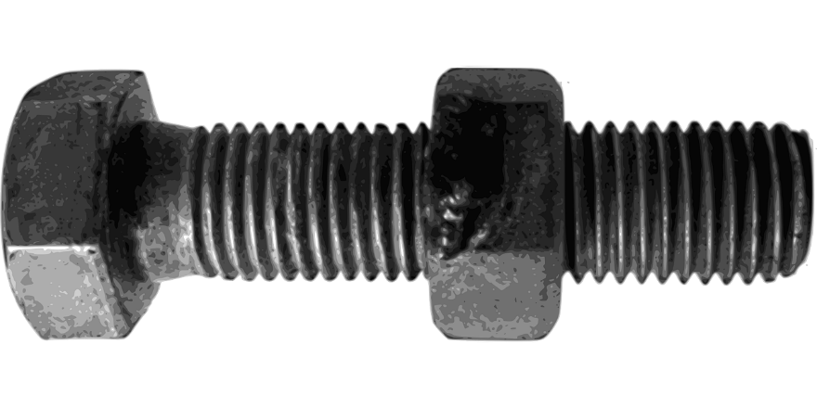
Notes:
Or this bolt, which is exactly one inch long

Slide 5
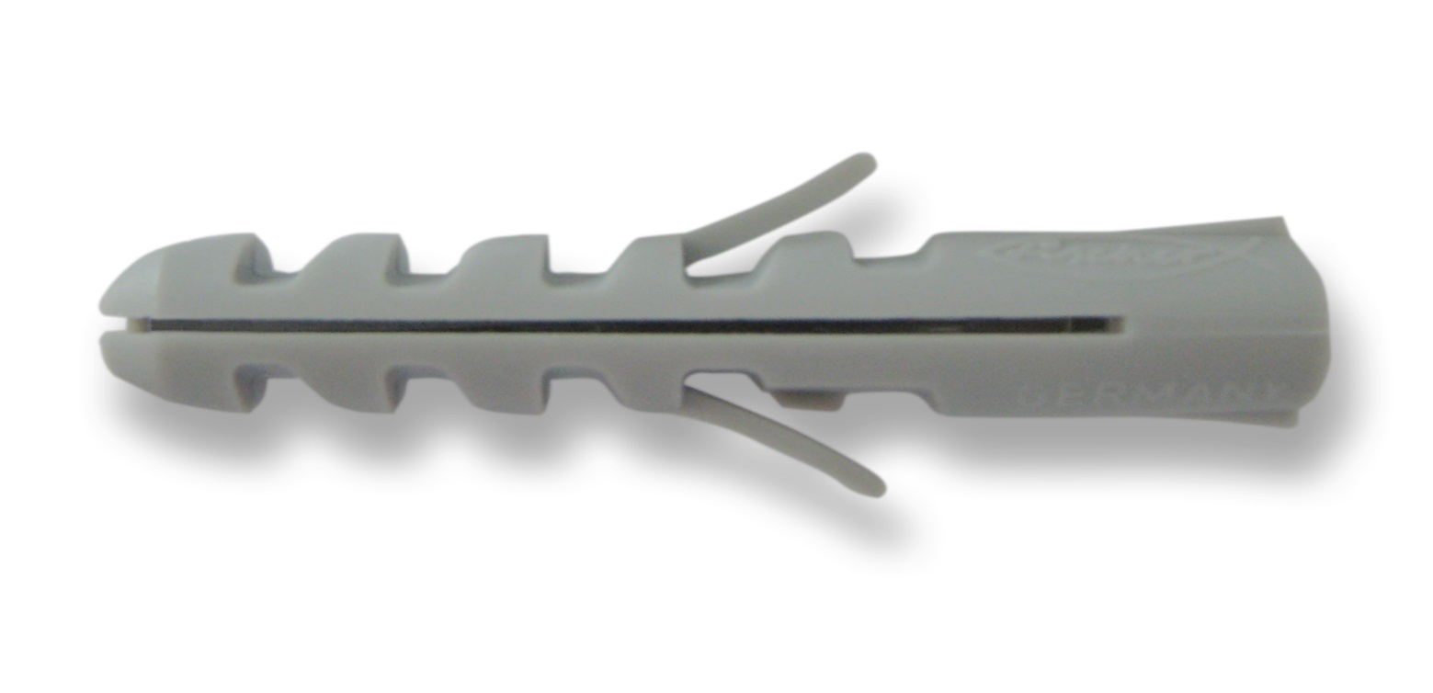
Notes:
But what if you had to measure the length of this screw anchor?
Point out that it is longer than one inch but shorter than two inches.

Slide 6
Notes:
Or the thickness of this piece of drywall?
Point out that it is less than one inch.

Slide 7
One whole Hershey’s bar
Less than one whole Hershey’s bar
Notes:
Say that fractions allow us to measure things that are not exactly whole numbers. Like a piece of dry wall that is less than an inch thick or a piece of a Hershey’s bar that is less than one whole Hershey’s bar.

Slide 8

How much chocolate am I getting?
Notes:
Ask - if you have to split a Hershey’s bar with other people and you like chocolate and are hungry, what are you going to want to know about the pieces of the Hershey’s bar? – (e.g., How much am I going to get? How much will others get? What fraction of the whole piece will I get?).

Slide 9
How many of those pieces will I get?
How many pieces will the chocolate bar be broken into?
Notes:
Say that they be interested in two numbers:
1. How many equal pieces will the chocolate bar be broken into? CLICK
2. How many of those pieces will I get?

Slide 10
How many pieces each person got
How many pieces the bar is broken into
Notes:
Ask the group with two students how many pieces their regular Hershey’s bar was broken into. CLICK
Ask the group how many of those pieces each person received. CLICK
Say that each person in this group got one half of a regular Hershey’s bar.

Slide 11
How many pieces each person got
How many pieces the bar is broken into
Notes:
Ask a group with four students how many pieces their regular Hershey’s bar was broken into. CLICK
Ask the group how many of those pieces each person received. CLICK
Say that each person in this group got one fourth of a regular Hershey’s bar.

Slide 12
How many pieces each person got
How many pieces the bar is broken into
Notes:
Ask the group with three students (if there is one) how many pieces their regular Hershey’s bar was broken into. CLICK
Ask the group how many of those pieces each person received. CLICK
Say that each person in this group got one third of a regular Hershey’s bar.

Slide 13
Notes:
Note: Delete the 1/3 example if you don’t have a group of three students.
Say that these amounts are fractions of a whole regular Hershey’s bar.
Say that a fraction is just an amount. Like, 1, 2, 3, 15, etc. it is a single amount, but the amount is written with two numbers so you can understand how much the amount is.

Slide 14
How many pieces I got
How many pieces the bar is broken into
Notes:
Ask how much of a regular Hershey’s bar you would have if you could get two members from a group of four to give you their pieces. CLICK
Say that the bar would still be broken into 4 pieces and you would have 2 of them so you would have 2/4ths.

Slide 15
How many pieces I got
How many pieces the bar is broken into
Notes:
Have students write, on their handout, how much of a regular Hershey’s bar you would have if you could get three members from a group of four to give you their pieces. CLICK
Have students correct their answers (if necessary) on their handout.

Slide 16
How many pieces I got
How many pieces the bar is broken into
Notes:
(If there is a group of three students) Have students write, on their handout, how much of a regular Hershey’s bar you would have if you could get two members from a group of three to give you their pieces. CLICK
Have students correct their answers (if necessary) on their handout.

Slide 17
How many of those things there are
What is being counted
Notes:
Say that another way to think about fractions is that the bottom number tells you what is being counted. CLICK
and the top number tells you how many of those things there are. In this example, the things begin counted are fourths and there are three of them, so 3/4ths.

Slide 18
There are five
Eighths
Notes:
Have students write, on their handout, what is being counted and how many of them there are. CLICK
Have students correct their answers (if necessary) on their handout.

Slide 19
There are seven
Sixteenths
Notes:
Have students write, on their handout, what is being counted and how many of them there are. CLICK
Have students correct their answers (if necessary) on their handout.

Slide 20

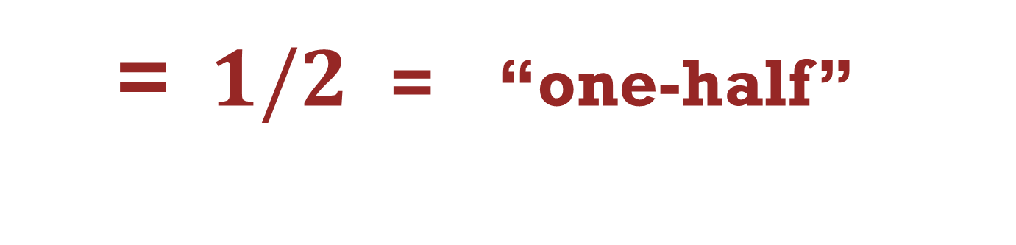
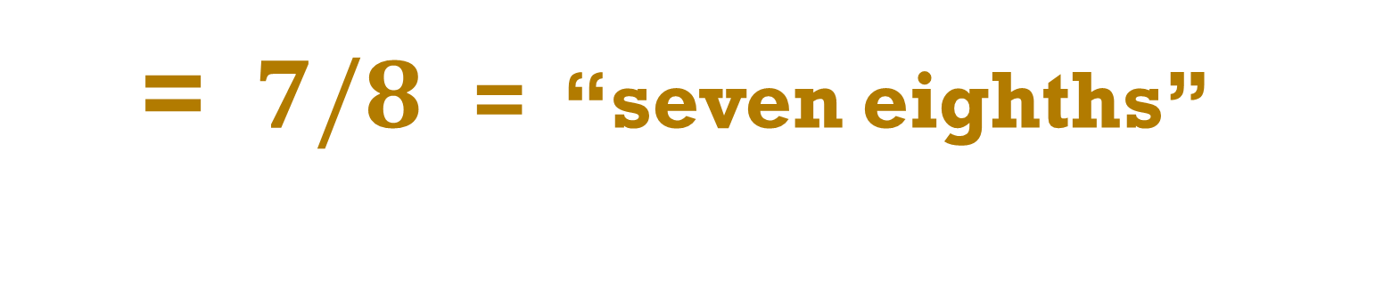

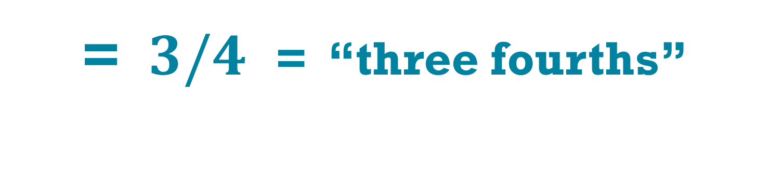

$\frac{1}{2}$
= $1/2$ = “one-half”
$\frac{3}{4}$
= $3/4$ = “three fourths”
$\frac{7}{8}$
= $7/8$ = “seven eighths”
Notes:
Point out that there are many ways to state the same fraction. Like this example. Or CLICK
Or CLICK

Slide 21
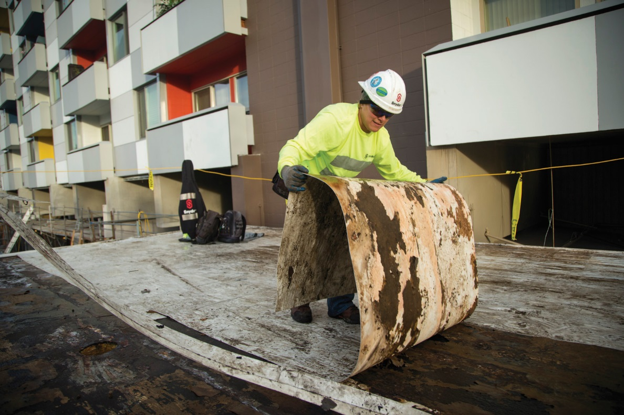

$$\frac{1}{2}$$
How many halves ( s) make up one whole?
Notes:
Have students work in pairs and use their fraction strips to figure out how many halves make up one whole and write their answer on their handout.

Slide 22

$$\frac{1}{2}$$
How many halves ( s) make up one whole?
one whole
$$\frac{1}{2}$$
$$\frac{1}{2}$$
Two halves equals one whole
Notes:
Point out the two halves and how the top and bottom numbers relate to the picture (e.g. halves are being counted and there are two of them).
Have students correct their answers (if necessary) on their handout.

Slide 23
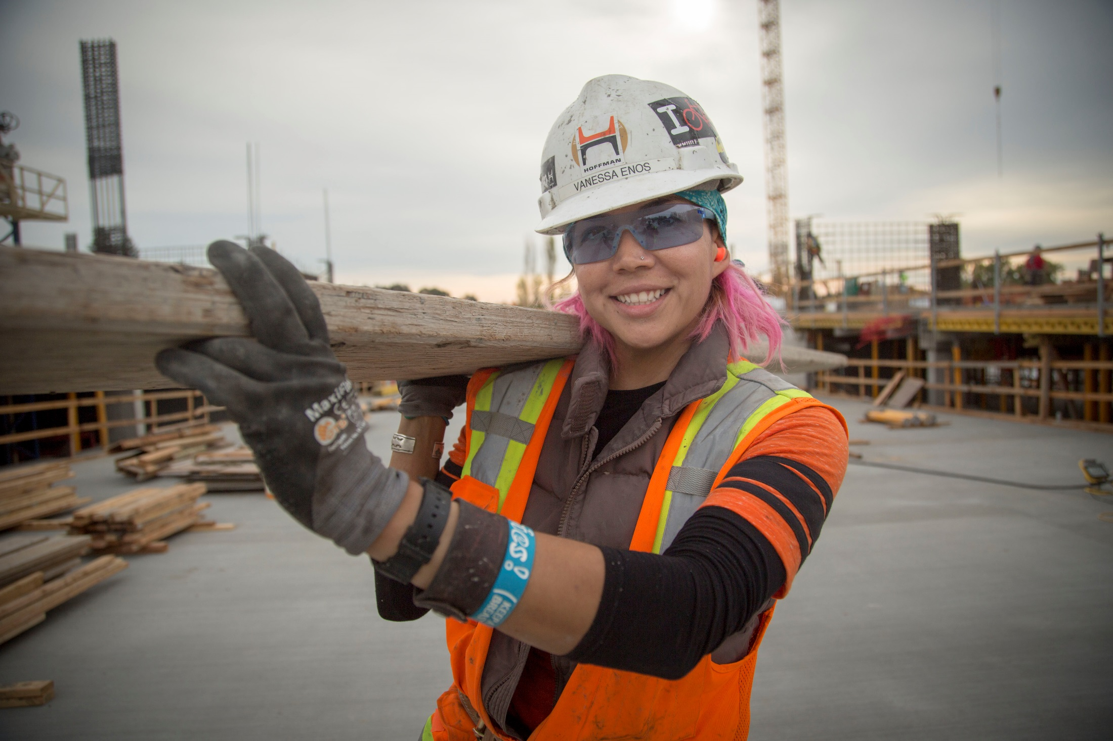

$$\frac{1}{4}$$
How many fourths ( s) make up one whole?
Notes:
Have students work in pairs and use their fraction strips to figure out how many fourths make up one whole and write their answer on their handout.

Slide 24

How many fourths ( s) make up one whole?
$$\frac{1}{4}$$
one whole
$$\frac{1}{4}$$
$$\frac{1}{4}$$
$$\frac{1}{4}$$
$$\frac{1}{4}$$
Four fourths equals one whole
Notes:
Point out the four fourths and how the top and bottom numbers relate to the picture (e.g. fourths are being counted and there are four of them).
Have students correct their answers (if necessary) on their handout.
Ask students to predict how many eighths would make up one whole and how many sixteenths would make up one whole.
Have students use their fraction strips to verify or confirm their predictions if necessary.

Slide 25
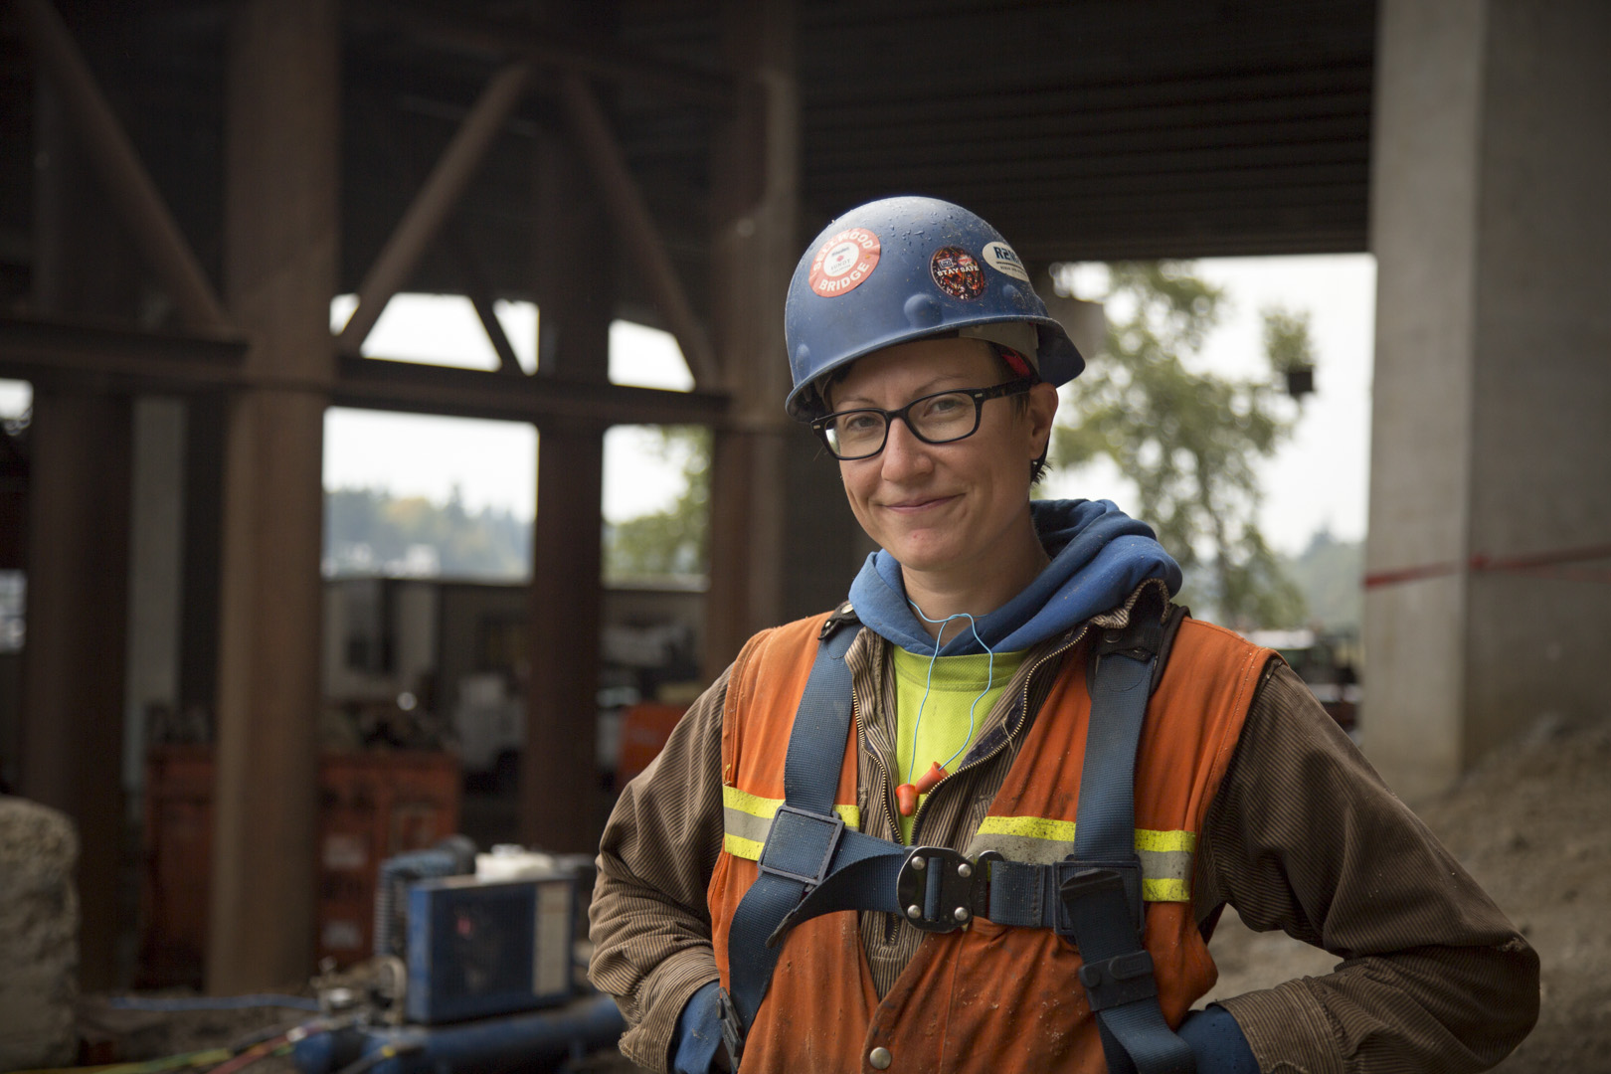
Would you rather have one half or two fourths
of a piece of
chocolate?
Notes:
Have students work in pairs and use their fraction strips to determine whether they would rather have: 1/2 or 2/4.

Slide 26
$$\frac{1}{2}$$
$$\frac{1}{2}$$
$$\frac{1}{4}$$
$$\frac{1}{4}$$
$$\frac{1}{4}$$
$$\frac{1}{4}$$
Notes:
Point out that 1/2 and 2/4 are the same amount.

Slide 27
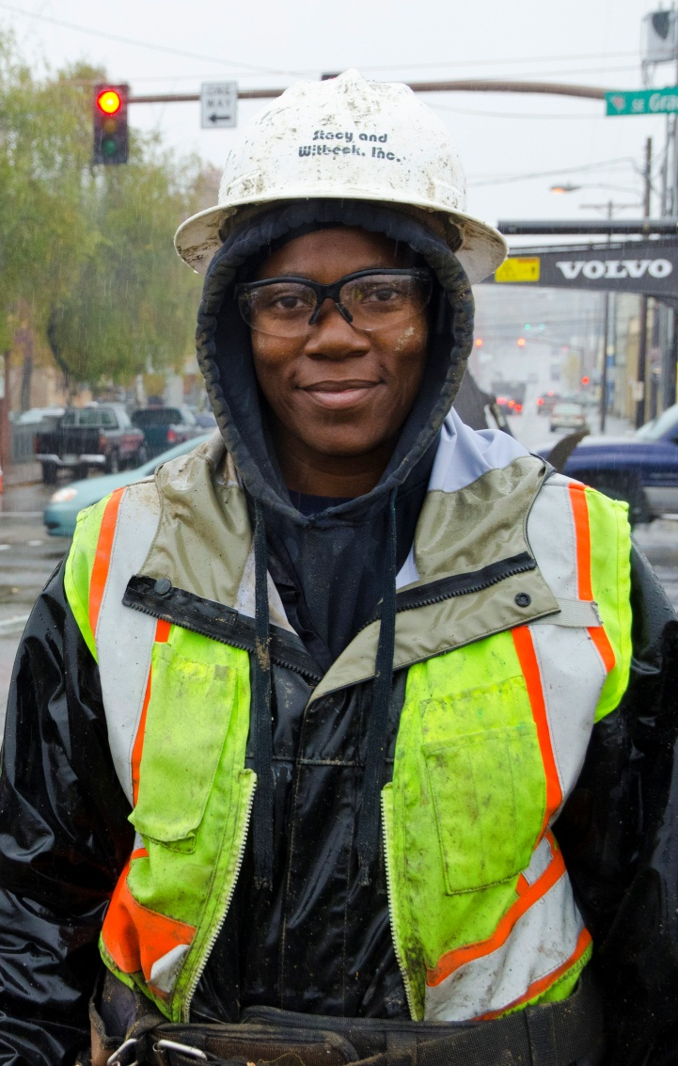
How many eighths are the same amount as one-half?
How many sixteenths?
Notes:
Have students use their fraction strips to determine how many eighths would be the same amount as 1/2 and how many sixteenths would be the same amount as 1/2.

Slide 28






$$\frac{1}{2}$$
$$\frac{1}{4}$$
$$\frac{1}{4}$$
$$\frac{1}{8}$$
$$\frac{1}{8}$$
$$\frac{1}{8}$$
$$\frac{1}{8}$$
$$\frac{1}{16}$$
$$\frac{1}{16}$$
$$\frac{1}{16}$$
$$\frac{1}{16}$$
$$\frac{1}{16}$$
$$\frac{1}{16}$$
$$\frac{1}{16}$$
$$\frac{1}{16}$$
Notes:
Have students correct their answers (if necessary) on their handout.
Point out that even though the numbers in each fraction are the different, these are all the same amount and any fraction can be written many different ways.

Slide 29
Notes:
Ask how many small, individual pieces make up a regular Hershey’s bar when you take it out of the package (12).
Ask how you would write and say one of those pieces. CLICK
Point out the 1/12 and how there are 12 of them in a regular Hershey’s bar.
Have students write, on their handout, how many 12ths would equal 1/2, 1/4, and 1/3* of a Hershey’s bar.
*Skip the 1/3 if you did not have a group of three for the Hershey’s bar activity.

Slide 30
Notes:
Point out how 6/12ths is the same amount as 1/2. CLICK
Point out how 3/12ths is the same amount as 1/4.
Have students correct their answers (if necessary) on their handout.

Slide 31
Notes:
Point out how 4/12ths is the same amount as 1/3.
Have students correct their answers (if necessary) on their handout.

Slide 32




$$\frac{1}{8}$$
$$\frac{1}{2}$$
$$\frac{1}{8}$$
$$\frac{1}{2}$$
Notes:
Refer students to the blank number line in their handout.
Have students work in pairs to use their fraction strips to mark where all of the halves, fourths, eighths, sixteenths would go on the number line.
Say to draw a long, vertical line to mark where the 1/2 would go, slightly shorter lines to mark the 1/4s, etc. (as in the answer key on the next slide), and label each half, fourth, eighth, and sixteenth.
Demonstrate, using this slide or a sketch you draw on the board, how to draw different the lines of different lengths for each fractions.
Point out that the 1/8 fraction strip is placed over the 1/2 in the slide.
Have students check each other’s work and ask questions if they have any.
Check in with pairs as they work to answer questions and ensure that all are on the right track. It is critical that students construct an accurate number line.

Slide 33





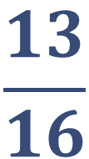









$$\frac{1}{16}$$
$$\frac{3}{16}$$
$$\frac{5}{16}$$
$$\frac{7}{16}$$
$$\frac{9}{16}$$
$$\frac{11}{16}$$
$$\frac{13}{16}$$
$$\frac{15}{16}$$
$$\frac{1}{8}$$
$$\frac{3}{8}$$
$$\frac{5}{8}$$
$$\frac{7}{8}$$
$$\frac{1}{4}$$
$$\frac{3}{4}$$
$$\frac{1}{2}$$
Notes:
Have students correct their answers (if necessary) on their number line.

Slide 34


A
$$\frac{1}{8}$$
C
E
$$\frac{2}{16}$$
D
B
Notes:
Point out how 1/8 is the same as 2/16.
Have students write, on their handout, what fractions A – E are, writing them as many different ways as possible using halves, quarters, eighths, and sixteenths.

Slide 35



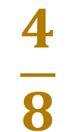
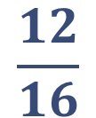

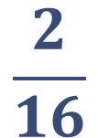

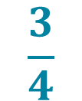
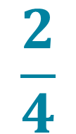
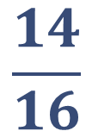


B
D
$$\frac{5}{16}$$
$$\frac{11}{16}$$
A
E
$$\frac{1}{8}$$
$$\frac{7}{8}$$
$$\frac{2}{16}$$
C
$$\frac{3}{4}$$
$$\frac{14}{16}$$
$$\frac{6}{8}$$
$$\frac{1}{2}$$
$$\frac{2}{4}$$
$$\frac{4}{8}$$
$$\frac{8}{16}$$
$$\frac{12}{16}$$
Notes:
Point out the correct answers, especially where there are equivalent fractions.
Have students correct their answers, if necessary, on their handout.

Slide 36
What is the smallest possible fraction of a whole Hershey’s bar?
Notes:
Ask students what the smallest possible fraction of a regular Hershey’s bar would be.

Slide 37
Notes:
Point out that the smallest piece the bar is divided into when unwrapped is 1/12.
Ask whether it is possible to divide the 1/12 piece into two. CLICK
Ask whether it would be possible to divide those two pieces into smaller pieces. CLICK
Ask whether it would be possible to divide those pieces into smaller pieces, CLICK
Ask whether it would be possible to divide those pieces into smaller pieces.
Point out that each smaller piece represents a smaller fraction of the whole Hershey’s bar.

Slide 38
$$\frac{1}{16}$$
Notes:
Ask students if there is a fraction smaller than 1/16.

Slide 39

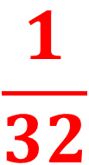

$$\frac{1}{32}$$
$$\frac{1}{16}$$
$$\frac{1}{8}$$
0
Notes:
Say that this is what the number line would look like if you zoomed in on it.
Ask students if they know what fraction the red line would be. CLICK
Ask if there is a fraction smaller than 1/32. CLICK
Point out that there can always be a smaller fraction.

Slide 40
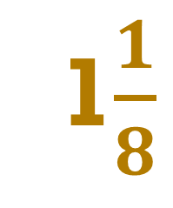
A
B
E
1$\frac{1}{8}$
D
C
Notes:
Say that, until now, all of the fractions you have been working with have been less than 1, but there are fractions between every whole number.
Point out that this number line goes from 1 to 2 and A is 1 1/8.
Have students write, on their handout, what fractions A – E are

Slide 41

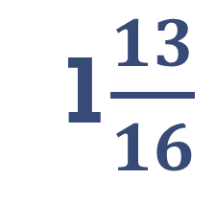
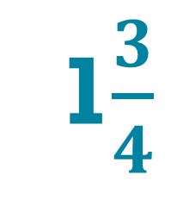
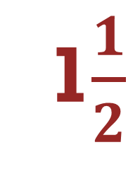
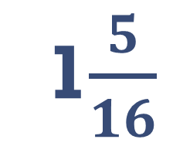
1$\frac{5}{16}$
1$\frac{13}{16}$
B
E
1$\frac{1}{8}$
A
1$\frac{3}{4}$
1$\frac{1}{2}$
D
C
Notes:
Have students correct their answers (if necessary) on their handout.

Slide 42
F
J
H
G
I
Notes:
Have students write, on their handout, what fractions F – J are.

Slide 43
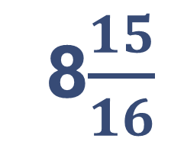
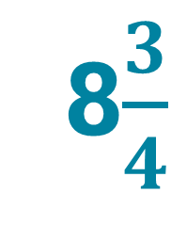
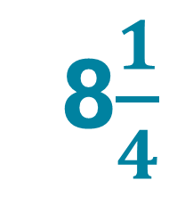
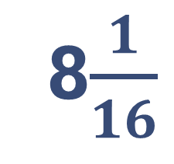
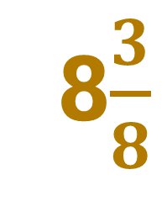
8$\frac{1}{16}$
8$\frac{15}{16}$
F
8$\frac{3}{8}$
J
8$\frac{1}{4}$
H
8$\frac{3}{4}$
G
I
Notes:
Have students correct their answers (if necessary) on their handout.
Note: If students need more practice locating fractions larger than one, and if time allows, you could do one or both of the following:
Have students practice creating fractions larger than one with their fraction strips
Cover the 0 and 1 on the Enlarged Number Line with other consecutive numbers (e.g. 1 & 2; 23 & 24. etc.) and give students new index cards, labeling them with mixed numbers (e.g. 1 5/8; 23 1/4) and have students practice locating those fractions on the number line.

Slide 44
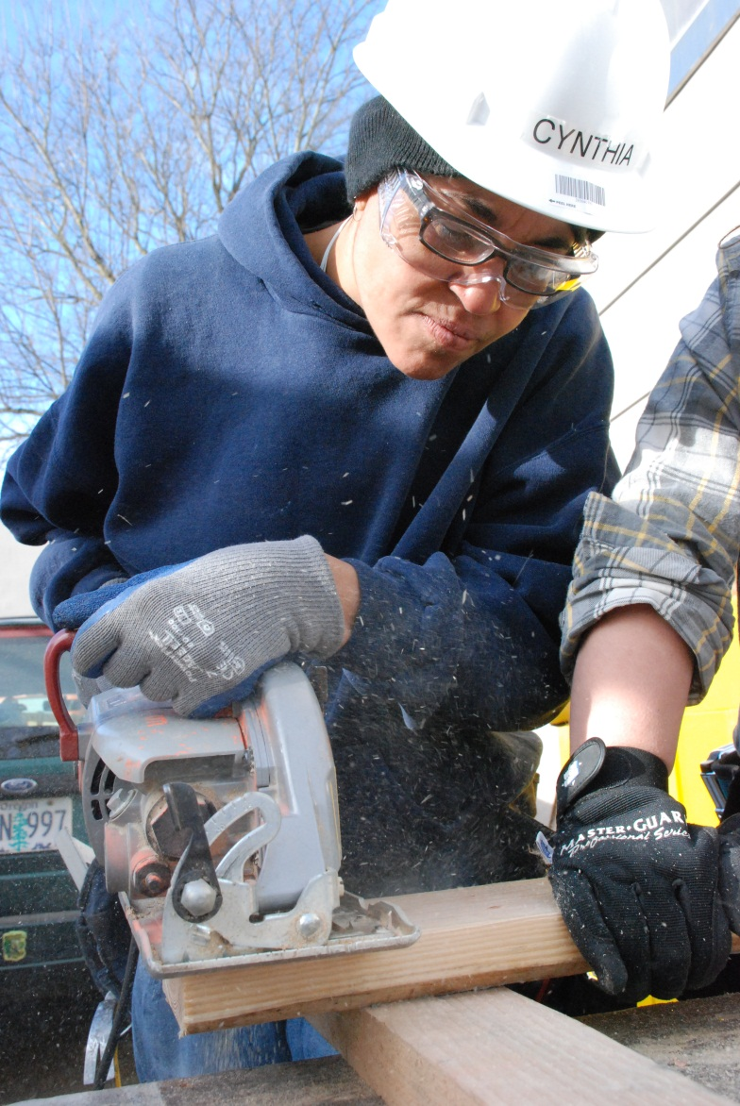
At the end of this part of the module, you should be able to determine which of two fractions is the largest
Notes:
Review the objective

Slide 45






Which is larger?
$$\frac{1}{2}$$
$$\frac{1}{4}$$
$$\frac{1}{2}$$
$$\frac{3}{16}$$
or
or
$$\frac{5}{8}$$
$$\frac{3}{4}$$
$$\frac{9}{16}$$
$$\frac{7}{8}$$
or
or
Notes:
Say to imagine that their fraction strips are Hershey’s bars.
Ask, if you like chocolate and are hungry, would you rather have 1/2 of a Hershey’s bar or 1/4?
Ask why (because it’s larger.) CLICK
Have students use their fraction strips to determine which of the other sets of fractions is larger.

Slide 46

Which is larger?
$$\frac{1}{2}$$
$$\frac{1}{4}$$
$$\frac{1}{2}$$
$$\frac{5}{16}$$
or
or
$$\frac{5}{8}$$
$$\frac{3}{4}$$
$$\frac{9}{16}$$
$$\frac{7}{8}$$
or
or
Notes:
Have students correct their answers (if necessary) on their handout.

Slide 47







Which is larger?
$$\frac{5}{16}$$
$$\frac{3}{8}$$
$$\frac{2}{8}$$
$$\frac{1}{4}$$
or
or
$$\frac{1}{8}$$
$$\frac{1}{2}$$
$$\frac{7}{16}$$
$$\frac{7}{8}$$
or
or
Notes:
Have students use their fraction strips to determine which of the other sets of fractions is larger.

Slide 48
Which is larger?
$$\frac{5}{16}$$
$$\frac{3}{8}$$
$$\frac{2}{8}$$
$$\frac{1}{4}$$
or
or
$$\frac{1}{8}$$
$$\frac{1}{2}$$
$$\frac{7}{16}$$
$$\frac{7}{8}$$
or
or
Notes:
Have students correct their answers (if necessary) on their handout.
Point out that 2/8 and 1/4 are the same amount.

Slide 49
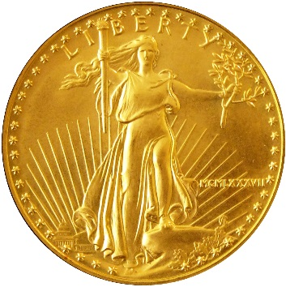
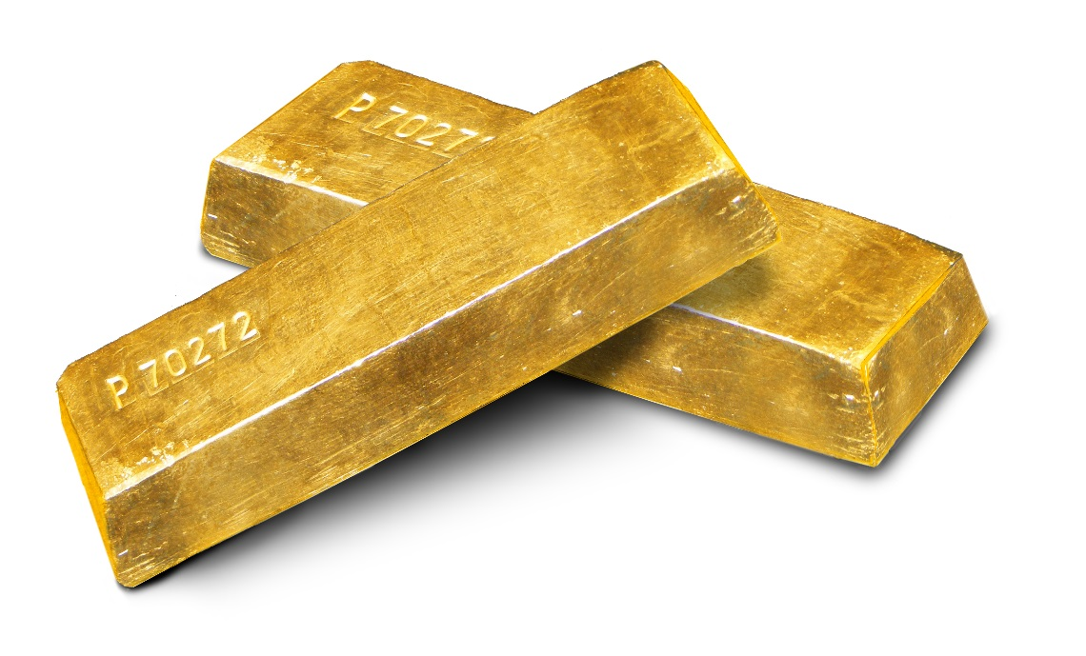
of an ounce of gold
3/4
or
of a pound of gold
1/4
Notes:
Ask students which is the larger amount, 1/4 or 3/4. CLICK
Ask students which amount they would rather have.
Point out that, by themselves, fractions do not have any meaning - you always have to know what units you are talking about, an ounce or a pound. A quart or a gallon.
Say that, in construction, two of the most common units are inches and feet.
Ask what tool is most often used to measure inches and feet.

Slide 50
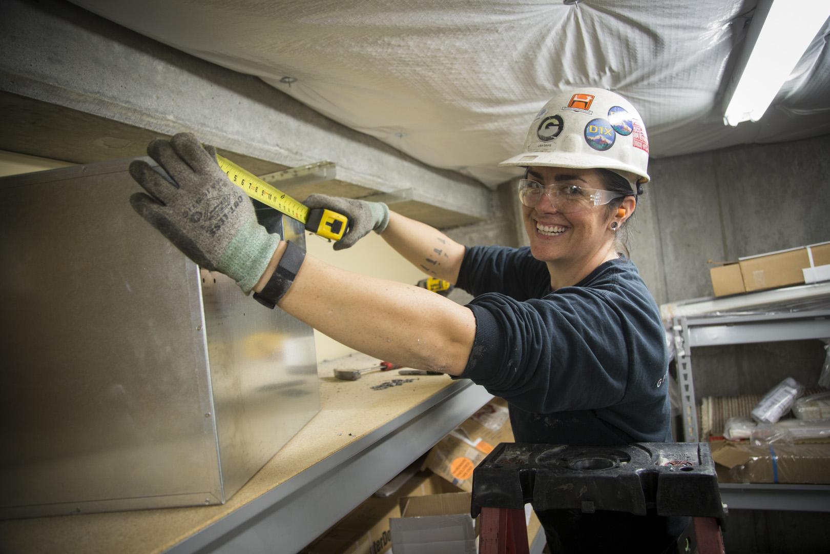
At the end of this part of the module, you should be able to
measure length using a tape measure.
Notes:
Review the objective.

Slide 51
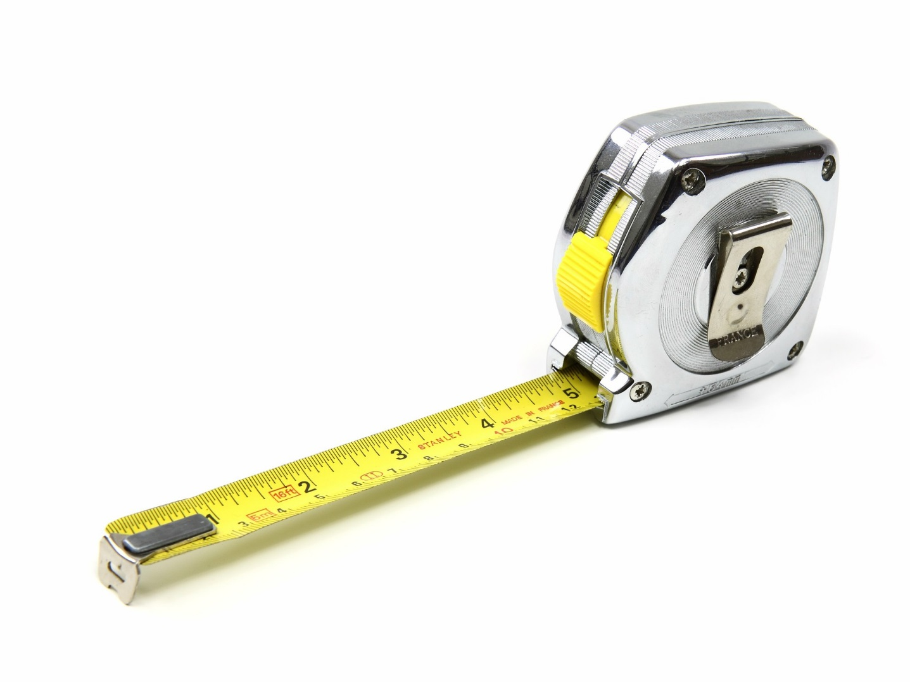
Body of tape
Blade lock
Blade
Sliding hook
Notes:
Review the Measuring Your Success pages in the handout, using the image in this slide to review the parts of a tape measure.

Slide 52
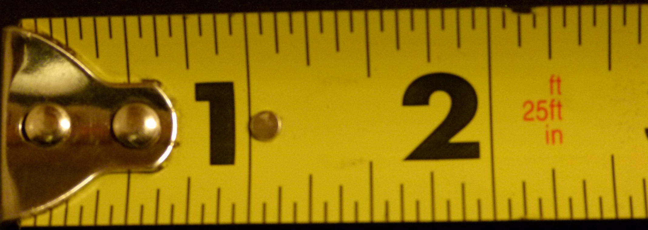
Notes:
Point out how a tape measure is just a number line like the ones you have been working with.

Slide 53

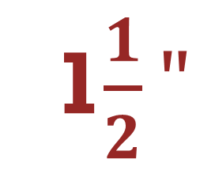
1$\frac{1}{2}"$
A
B
C
D
E
Notes:
Point out the 1 1/2” mark and the importance of including the units in the measurement.
Point out how some of the sliding hook covers part of the first inch.
Have students write, on their handout, what the lengths of objects A – E would be if measured from zero.

Slide 54
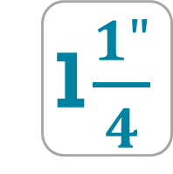
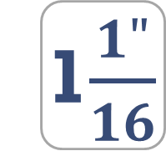


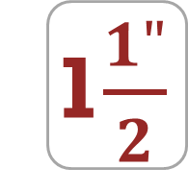
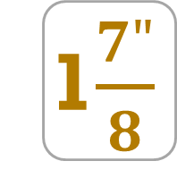
$$\frac{1"}{2}$$
$$\frac{3"}{4}$$
1$\frac{1"}{16}$
1$\frac{1"}{4}$
1$\frac{1"}{2}$
1$\frac{7"}{8}$
Notes:
Have students correct their answers (if necessary) on their handout.
Note: The boxes are only meant to help separate the fractions from one another.

Slide 55
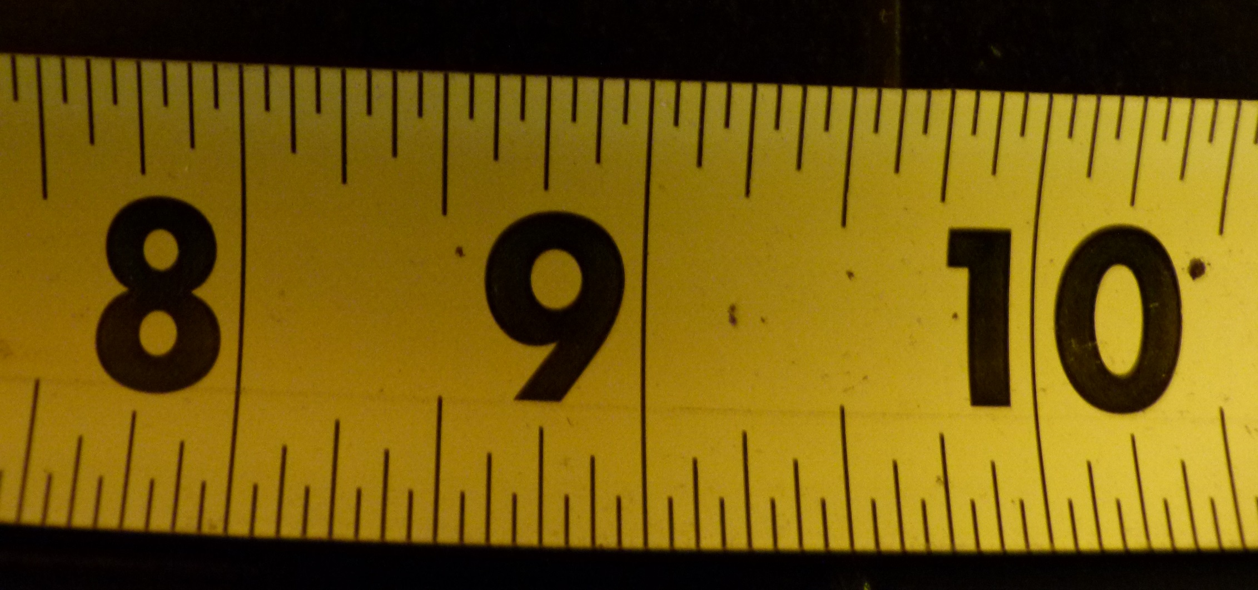
F
G
H
I
J
Notes:
Have students write, on their handout, what the lengths of objects F – J would be if measured from zero.

Slide 56
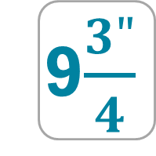
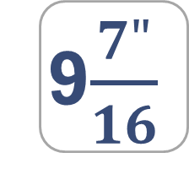
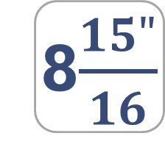
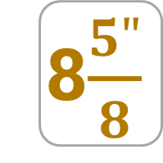
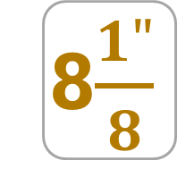
8$\frac{1"}{8}$
8$\frac{5"}{8}$
8$\frac{15"}{16}$
9$\frac{7"}{16}$
9$\frac{3"}{4}$
Notes:
Have students correct their answers (if necessary) on their handout.

Slide 57
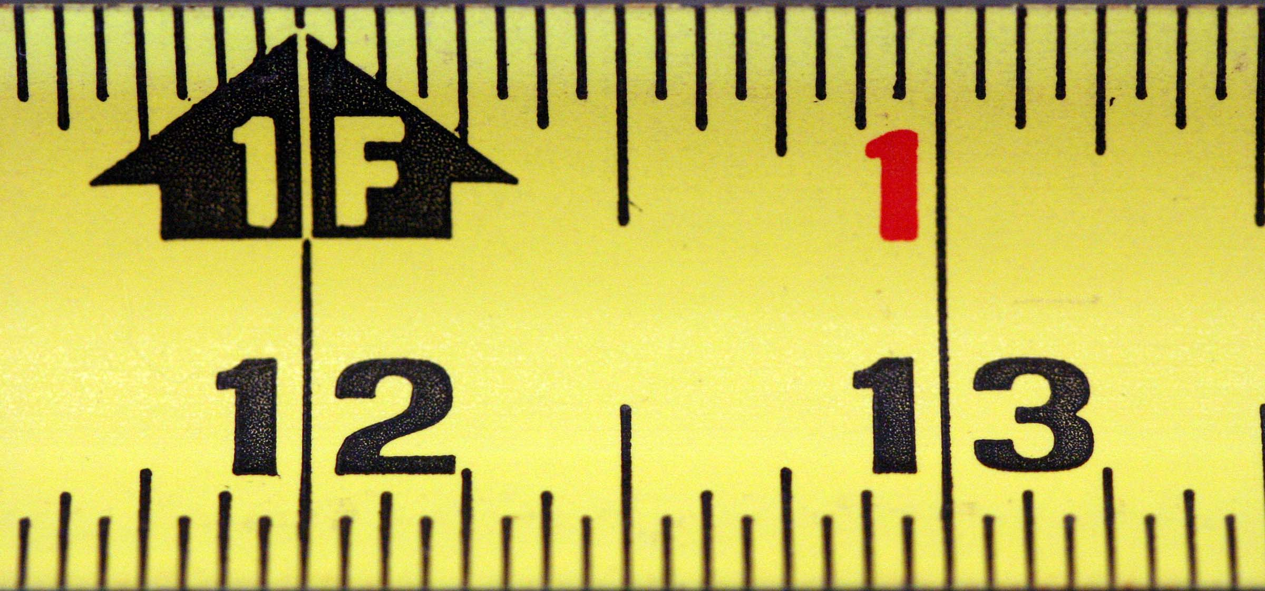
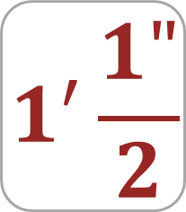
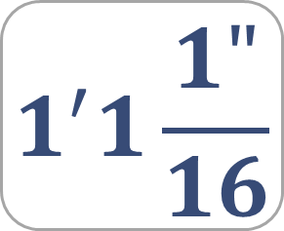
$$1^{′}\frac{1"}{2}$$
K
$$1^{′}1\frac{1"}{16}$$
M
L
Notes:
Point out that, in addition to inches, a tape measure displays feet and, often, measurements will be in a combination of feet, inches, and fractions of an inch.
Show how to read a tape measure that shows both feet + inches, and total inches.
Point out that 12 inches = 1 foot.
Point out the 1’ 1/2” and the 1’ 1 1/6” marks and explain how a measurement consisting of feet, inches, and fractions of an inch are written.
Have students write, on their handout, what the lengths of objects K – M would be, in feet & inches, if measured from zero.

Slide 58
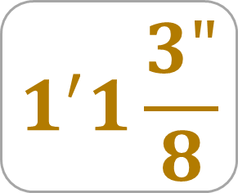




$$1^{′}\frac{1"}{2}$$
$$1^{′}1\frac{3"}{8}$$
$$1′$$
$$1^{′}1\frac{1"}{16}$$
$$1^{′}\frac{1"}{4}$$
Notes:
Have students correct their answers (if necessary) on their handout.

Slide 59


12$\frac{1"}{2}$
K
$$13\frac{1"}{16}$$
M
L
Notes:
Show how to read this tape measure in inches alone.
Point out the 12 1/2” and the 13 1/6” marks
Have students write, on their handout, what the lengths of objects K – M would be, in inches alone, if measured from zero.

Slide 60





$$12\frac{1"}{2}$$
$$13\frac{3"}{8}$$
$$12"$$
$$13\frac{1"}{16}$$
$$12\frac{1"}{4}$$
Notes:
Have students correct their answers (if necessary) on their handout.

Slide 61
P
N
O
Q
Notes:
Have students write, on their handout, what the lengths of objects N – Q would be, in feet & inches, if measured from zero.

Slide 62




$$1^{′}\frac{1"}{8}$$
$$1^{′}1\frac{1"}{4}$$
$$1^{′}1\frac{1"}{8}$$
$$1^{′}\frac{7"}{16}$$
Notes:
Have students correct their answers (if necessary) on their handout.

Slide 63
P
N
O
Q
Notes:
Have students write, on their handout, what the lengths of objects N – Q would be, in inches alone, if measured from zero.

Slide 64




$$12\frac{1"}{8}$$
$$13\frac{1"}{4}$$
$$13\frac{1"}{8}$$
$$12\frac{7"}{16}$$
Notes:
Have students correct their answers (if necessary) on their handout.

Slide 65
Image Credits
ValerieRoofSawing898A5798 by Oregon Tradeswomen, Inc.
Drywall Screw Photography by User: MrX CC BY-SA 3.0, via Wikimedia Commons
Bolt-152911_1280 Creative Commons 0 Public Domain via Pixabay
S-Plug_8mm by User:Hungryjabberwock (Own work) Public domain, via Wikimedia Commons
Jalaine ArmsCrossed NoSmile Landscape_98A6281CMYK by Oregon Tradeswomen, Inc.
RosaStripsRoofing_98A7663CMYK by Oregon Tradeswomen, Inc.
VanessaPlankCloserBEST_98A6484 by Oregon Tradeswomen, Inc.
StephStandsSmilesMS_98A6732 by Oregon Tradeswomen, Inc.
Tradeswoman by Oregon Tradeswomen, Inc.

Slide 66
Image Credits
Tradeswoman by Oregon Tradeswomen, Inc.
3302597972_528b9a8965_o U.S. gold five dollar 1987 by Kevin Dooley CC by 2.0 via Wikimedia Commons
Gold_Ingots_on_white_background By Szaaman [Public domain], via Wikimedia Commons
LisaLandscapeWorkingSmile_98A7477 by Oregon Tradeswomen, Inc.
Tape Measure CC0 Public Domain via Pixabay
Tape Measure by George Reese Instructional Design & Training, LLC
Untitled photo_978_20060201 (tape measure) by Chance Agrella via free range stock photos

