Slide 1
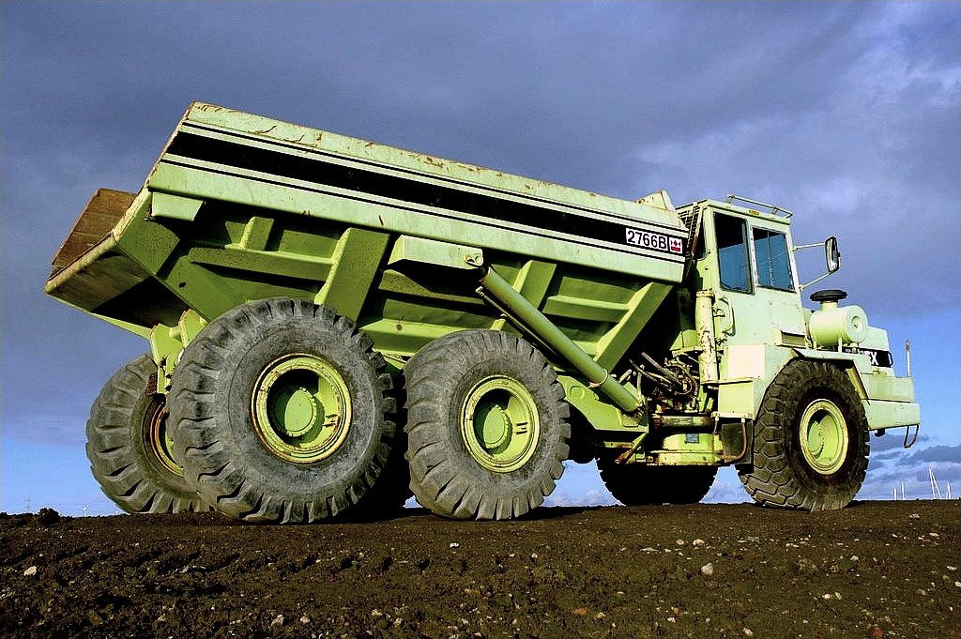
Weight in = 45 ¾ tons
Weight out = 23 ¼ tons
Notes:
Say that they are hauling a load of scrap to a transfer station. Their total weight entering the transfer station is 45 3/4 tons. Leaving the transfer station the weight is 23 1/4 tons.
Ask how much scrap they dumped.
Say that, to answer this question, and often on the job, they will have to be able to subtract fractions.

Slide 2
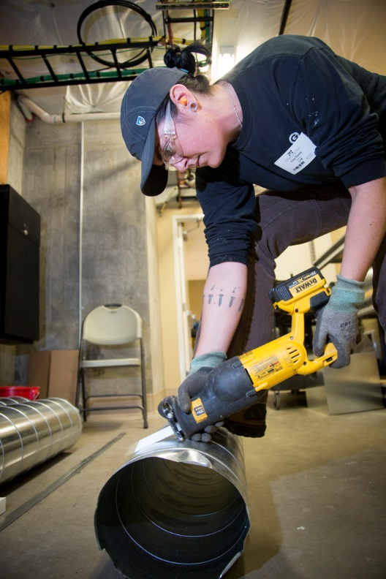
At the end of this module, you should be able to subtract fractions
Notes:
Review the objective.

Slide 3
When subtracting fractions, treat the bottom numbers the same way you do for addition.
Notes:
Say that when subtracting fractions, the bottom numbers are treated the same way they are for addition.

Slide 4
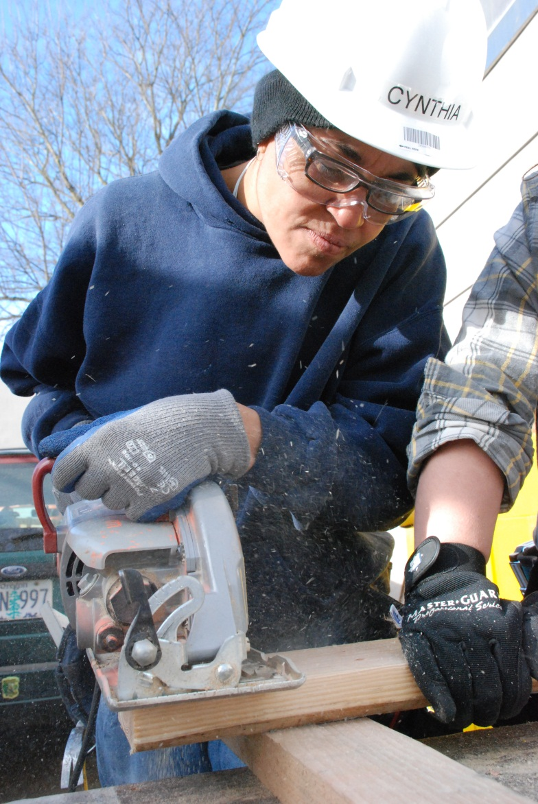
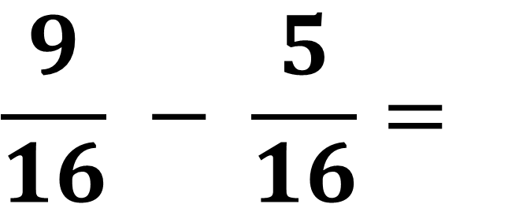
$$\frac{9}{16} − \frac{5}{16}=$$
Notes:
Have students use their fraction strips and the number line in their handout (the image of the slide) to subtract these fractions, simplify their answer if necessary, and write their answer on their handout.

Slide 5



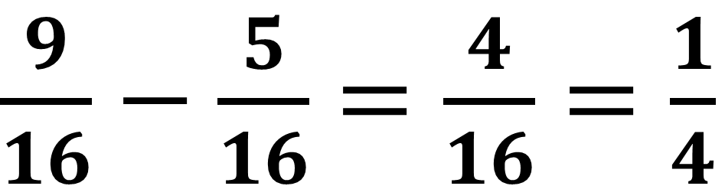










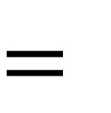






$\frac{9}{16}−\frac{5}{16}$ $=\frac{4}{16}$ $=\frac{1}{4}$
$$\frac{1}{16}$$
$$\frac{1}{16}$$
$$\frac{1}{16}$$
$$\frac{1}{16}$$
$$\frac{1}{16}$$
$$\frac{1}{16}$$
$$\frac{1}{16}$$
$$\frac{1}{16}$$
$$\frac{1}{16}$$
$$−$$
$$\frac{1}{16}$$
$$\frac{1}{16}$$
$$\frac{1}{16}$$
$$\frac{1}{16}$$
$$\frac{1}{16}$$
$$=$$
$$\frac{1}{16}$$
$$\frac{1}{16}$$
$$\frac{1}{16}$$
$$\frac{1}{16}$$
$$\frac{1}{4}$$
Notes:
Point out the 9/16, 5/16, and 4/16, and how 4/16 is the same as 1/4.

Slide 6
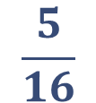

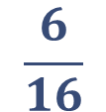

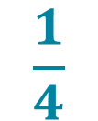
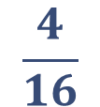

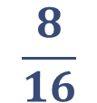

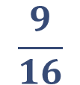
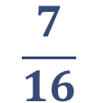

$$\frac{5}{16}$$
$$\frac{7}{16}$$
$$\frac{9}{16}$$
$$\frac{6}{16}$$
$$\frac{4}{16}$$
$$\frac{1}{4}$$
$$\frac{8}{16}$$
$$\frac{1}{16}$$
$$\frac{1}{16}$$
$$\frac{1}{16}$$
$$\frac{1}{16}$$
$$\frac{1}{16}$$
Notes:
Point out, using the number line, how 9/16 - 5/16, = 4/16, and how 4/16 is the same as 1/4.
Have students correct their answers (if necessary) on their handout.

Slide 7
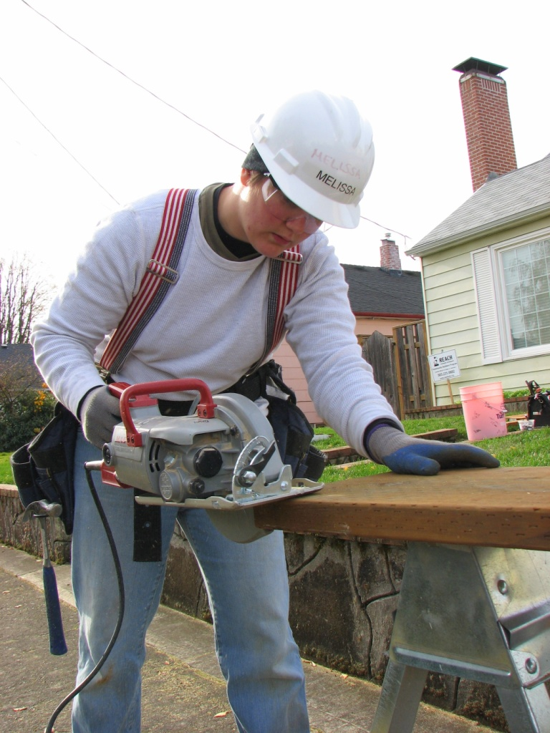
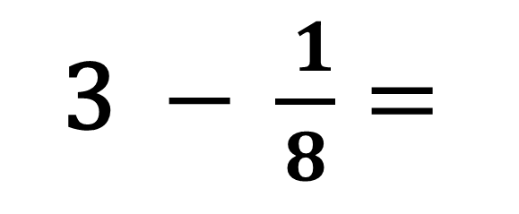
3$− \frac{ 1}{8}=$
Notes:
Ask students how they would solve this.

Slide 8
When subtracting a fraction from a whole number, borrow a 1 from the whole number, then rename it as a fraction.
Notes:
Say that, when subtracting a fraction from a whole number, they should borrow a 1 from the whole number then rename it as a fraction.

Slide 9
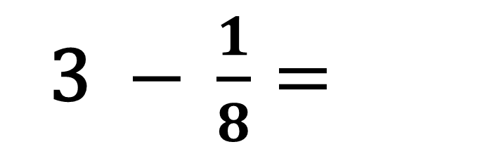
3$− \frac{1}{8}=$
one whole
one whole
one whole
Notes:
Point out the three wholes.

Slide 10
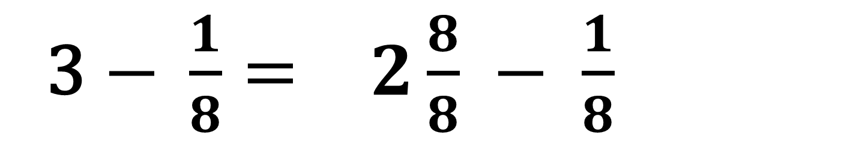
3$− \frac{1}{8}= 2\frac{8}{8} − \frac{1}{8}$
one whole
one whole
$$\frac{1}{8}$$
$$\frac{1}{8}$$
$$\frac{1}{8}$$
$$\frac{1}{8}$$
$$\frac{1}{8}$$
$$\frac{1}{8}$$
$$\frac{1}{4}$$
$$\frac{1}{8}$$
$$\frac{1}{8}$$
$$\frac{1}{4}$$
Notes:
Show how a one was borrowed from the 3, and renamed to a fraction (8/8).
Point out that the 8/8 is still the same amount as one whole, even after being renamed.

Slide 11
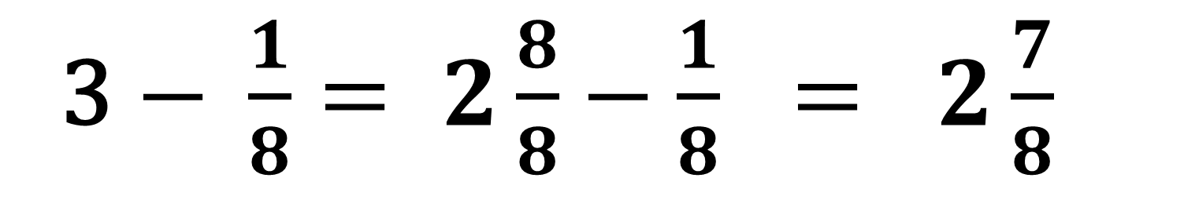
3$− \frac{1}{8}= 2\frac{8}{8}−\frac{1}{8} = 2\frac{7}{8}$
one whole
one whole
$$\frac{1}{8}$$
$$\frac{1}{8}$$
$$\frac{1}{8}$$
$$\frac{1}{8}$$
$$\frac{1}{8}$$
$$\frac{1}{4}$$
$$\frac{1}{8}$$
$$\frac{1}{8}$$
$$\frac{1}{4}$$
Notes:
Show how the answer was determined.
Have students correct their answers (if necessary) on their handout.

Slide 12
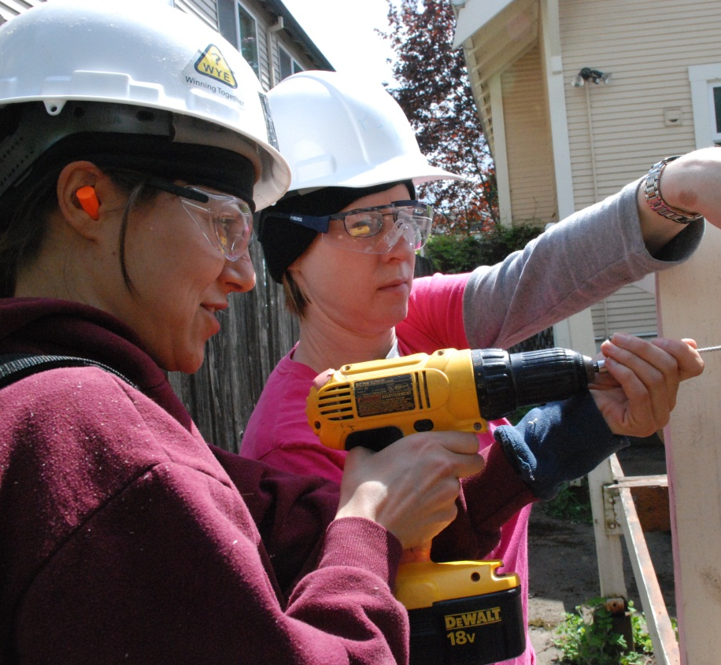
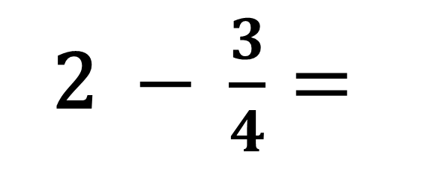
2 $− \frac{3}{4}=$
one whole
Notes:
Have students use their fraction strips to find the answer and write it on their handout.

Slide 13
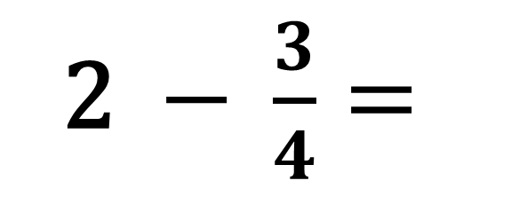
2 $− \frac{3}{4}=$
one whole
one whole
one whole
Notes:
Point out the two wholes.

Slide 14
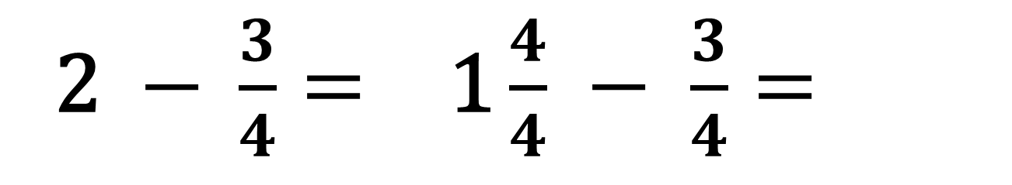
2 $− \frac{3}{4}= \text{1}\frac{4}{4} − \frac{3}{4}=$
one whole
$$\frac{1}{4}$$
$$\frac{1}{4}$$
$$\frac{1}{4}$$
$$\frac{1}{4}$$
one whole
Notes:
Show how a one was borrowed from the 2, and renamed to a fraction.
Point out that the 4/4 is still the same amount as one whole, even after being renamed.

Slide 15
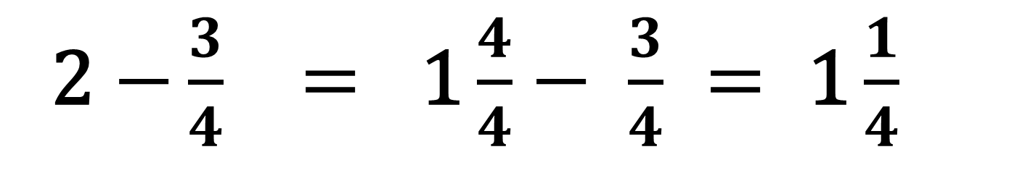
2$−\frac{3}{4} = \text{1}\frac{4}{4}− \frac{3}{4} = \text{1}\frac{1}{4}$
one whole
$$\frac{1}{4}$$
one whole
Notes:
Show how the answer was determined.
Have students correct their answers (if necessary) on their handout.

Slide 16
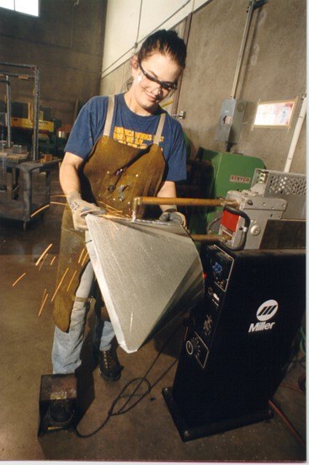
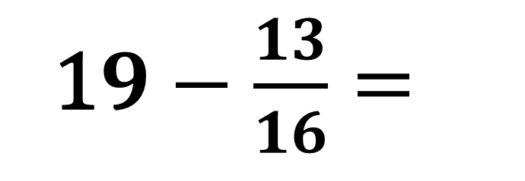
1$9−\frac{13}{16}=$
Notes:
Have students find the answer then write it on their handout.

Slide 17
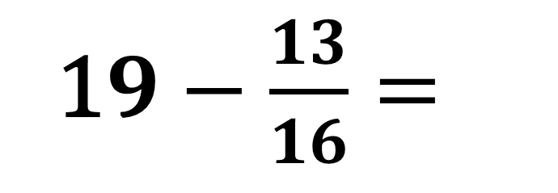
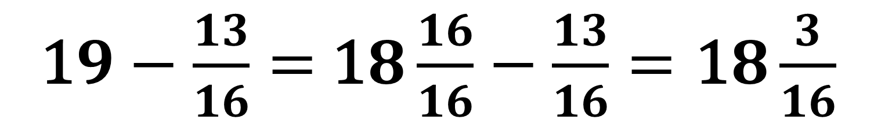
1$9−\frac{13}{16}=$
1$9−\frac{13}{16}=$1$8\frac{16}{16}−\frac{13}{16}=\text{1}8\frac{3}{16}$
Notes:
Show how the answer was determined.
Have students correct their answers (if necessary) on their handout.

Slide 18
Weight in = 45 ¾ tons
Weight out = 23 ¼ tons
Notes:
Say that, to find the amount of scrap they dumped at the transfer station, they need to subtract the mixed numbers.

Slide 19
Subtract whole numbers first,
borrow if necessary,
subtract the fractions,
then combine.
Notes:
Say that, when subtracting mixed numbers, they should subtract the whole numbers first, borrow if necessary, subtract the fractions, then combine.

Slide 20
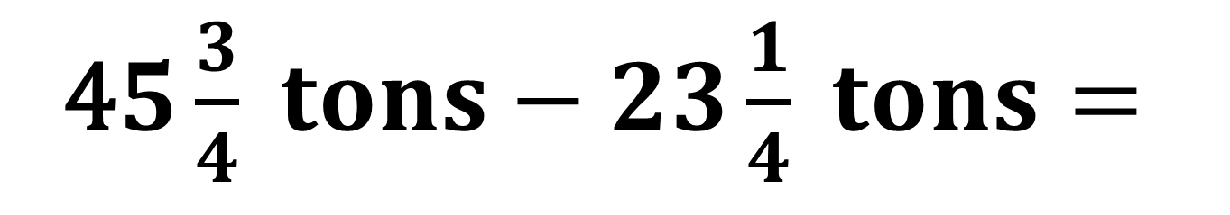
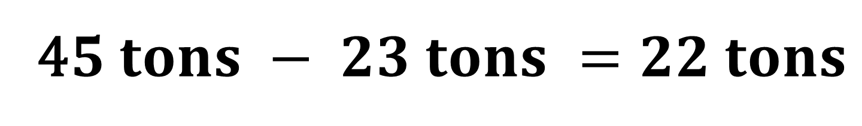
Weight in = 45 ¾ tons
Weight out = 23 ¼ tons
4$5\frac{3}{4} tons−23\frac{1}{4} tons=$
4$5 tons − 23 tons =22 tons$
Notes:
Say to subtract the whole numbers first.

Slide 21
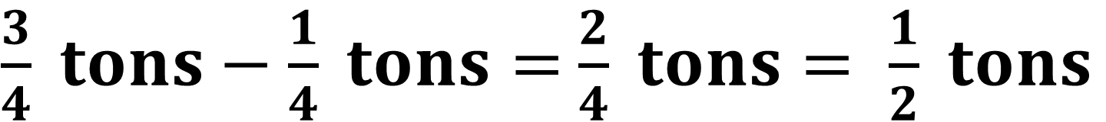
Weight in = 45 ¾ tons
Weight out = 23 ¼ tons
4$5\frac{3}{4} tons−23\frac{1}{4} tons=$
$\frac{3}{4} tons−\frac{1}{4} tons=$ $\frac{2}{4} tons= \frac{1}{2} tons$
Notes:
Say to subtract the fractions next since it isn’t necessary to borrow.
Show how the 1/2 was determined.

Slide 22
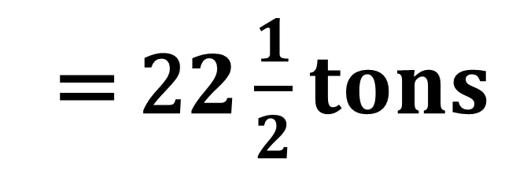
Weight in = 45 ¾ tons
Weight out = 23 ¼ tons
Weight of scrap left at the dump
= 2$2\frac{1}{2}tons$
Notes:
Show where the 22 1/2 came from.

Slide 23

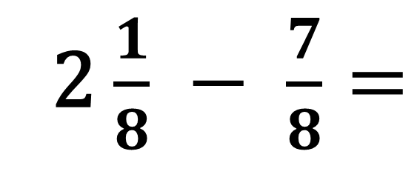
2 $\frac{1}{8} − \frac{7}{8}=$
Notes:
Have students use their fraction strips to find the answer, then write it on their handout.

Slide 24
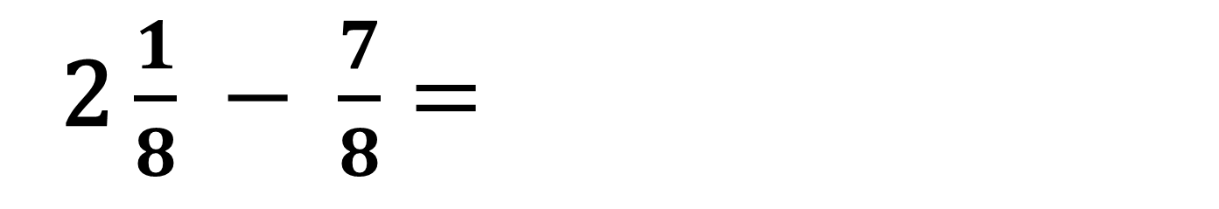

2 $\frac{1}{8} − \frac{7}{8}=$
one whole
one whole
$$\frac{1}{8}$$
$$−$$
$$\frac{1}{4}$$
$$\frac{1}{4}$$
$$\frac{1}{8}$$
$$\frac{1}{8}$$
$$\frac{1}{8}$$
$$\frac{1}{8}$$
$$\frac{1}{8}$$
$$\frac{1}{4}$$
$$\frac{1}{8}$$
$$\frac{1}{8}$$
$$\frac{1}{4}$$
Notes:
Show how the fraction strips represent the equation.

Slide 25
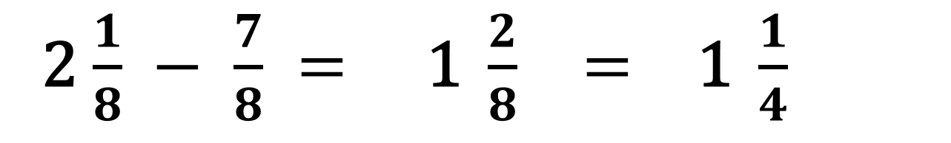

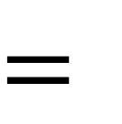
2 $\frac{1}{8} − \frac{7}{8} = \text{1} \frac{2}{8} = \text{1 }\frac{1}{4}$
one whole
$$\frac{1}{8}$$
$$\frac{1}{8}$$
$$\frac{1}{8}$$
$$\frac{1}{8}$$
$$\frac{1}{8}$$
$$\frac{1}{8}$$
$$\frac{1}{4}$$
$$\frac{1}{8}$$
$$\frac{1}{8}$$
$$\frac{1}{4}$$
$$\frac{1}{8}$$
$$\frac{1}{4}$$
$$\frac{1}{4}$$
$$−$$
$$\frac{1}{8}$$
$$\frac{1}{8}$$
$$\frac{1}{8}$$
$$\frac{1}{8}$$
$$\frac{1}{8}$$
$$\frac{1}{4}$$
$$\frac{1}{8}$$
$$\frac{1}{8}$$
$$\frac{1}{4}$$
$$=$$
one whole
$$\frac{1}{8}$$
$$\frac{1}{4}$$
$$\frac{1}{8}$$
Notes:
Point out that it is necessary to borrow a one because it is impossible to subtract 7/8 from 1/8.
Show how one was borrowed and renamed eighths, how the answer was determined, CLICK
and how 2/8 is simplified to 1/4

Slide 26
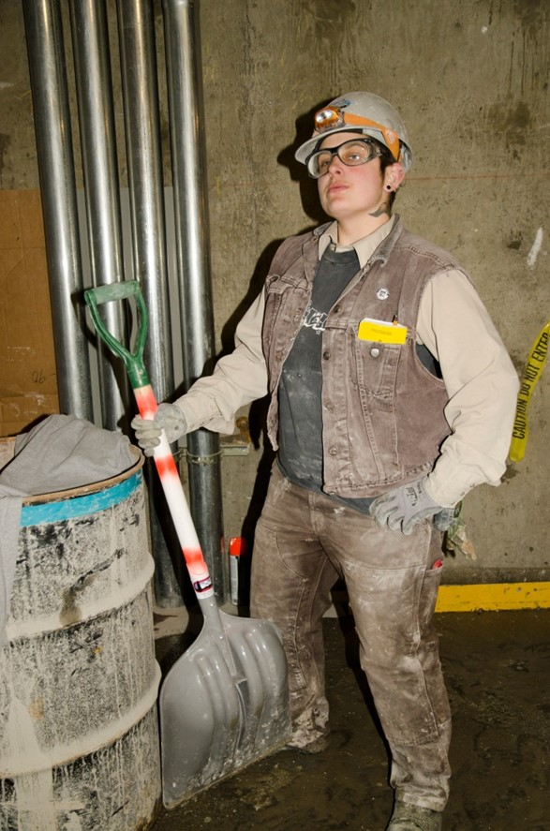
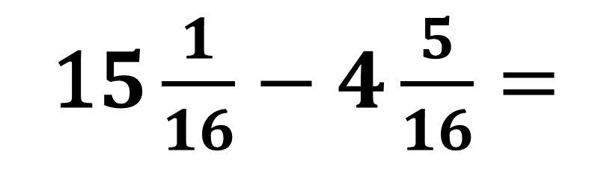
1$5\frac{1}{16}−4\frac{5}{16}=$
Notes:
Have students find the answer and write it on their handout.

Slide 27
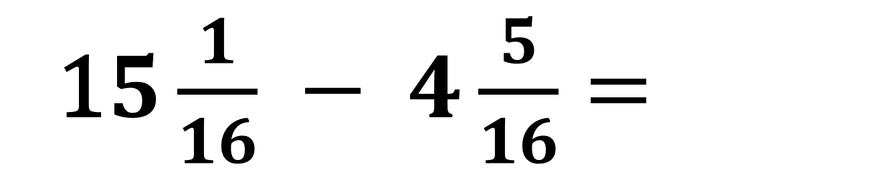
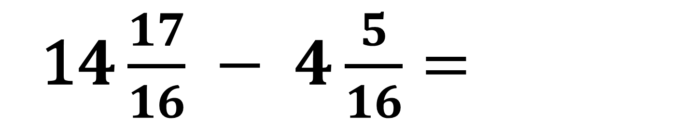
1$5\frac{1}{16} − 4\frac{5}{16}=$
1$4\frac{17}{16} − 4\frac{5}{16}=$
Notes:
Point out that it was necessary to borrow one from the 15 and rename it because it isn’t possible to subtract 5/16 from 1/16.

Slide 28
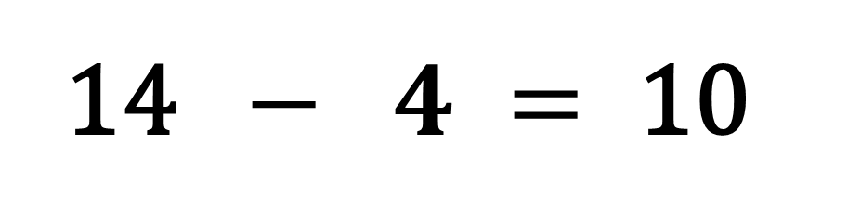
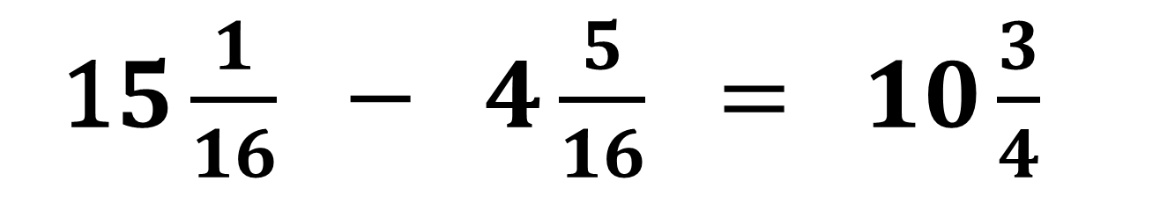
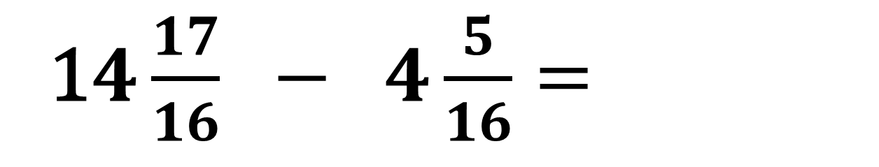
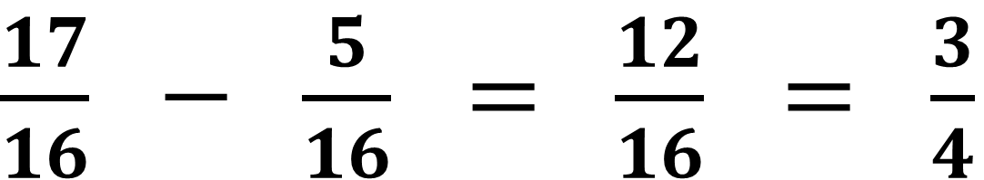
1$4\frac{17}{16} − 4\frac{5}{16}=$
14 $− 4 = \text{10}$
$\frac{17}{16} − \frac{5}{16} = \frac{12}{16}$ $= \frac{3}{4}$
1$5\frac{1}{16} − 4\frac{5}{16} = 10\frac{3}{4}$
Notes:
Show where the 10 and 3/4 came from.
Have students correct their answers (if necessary) on their handout.

Slide 29
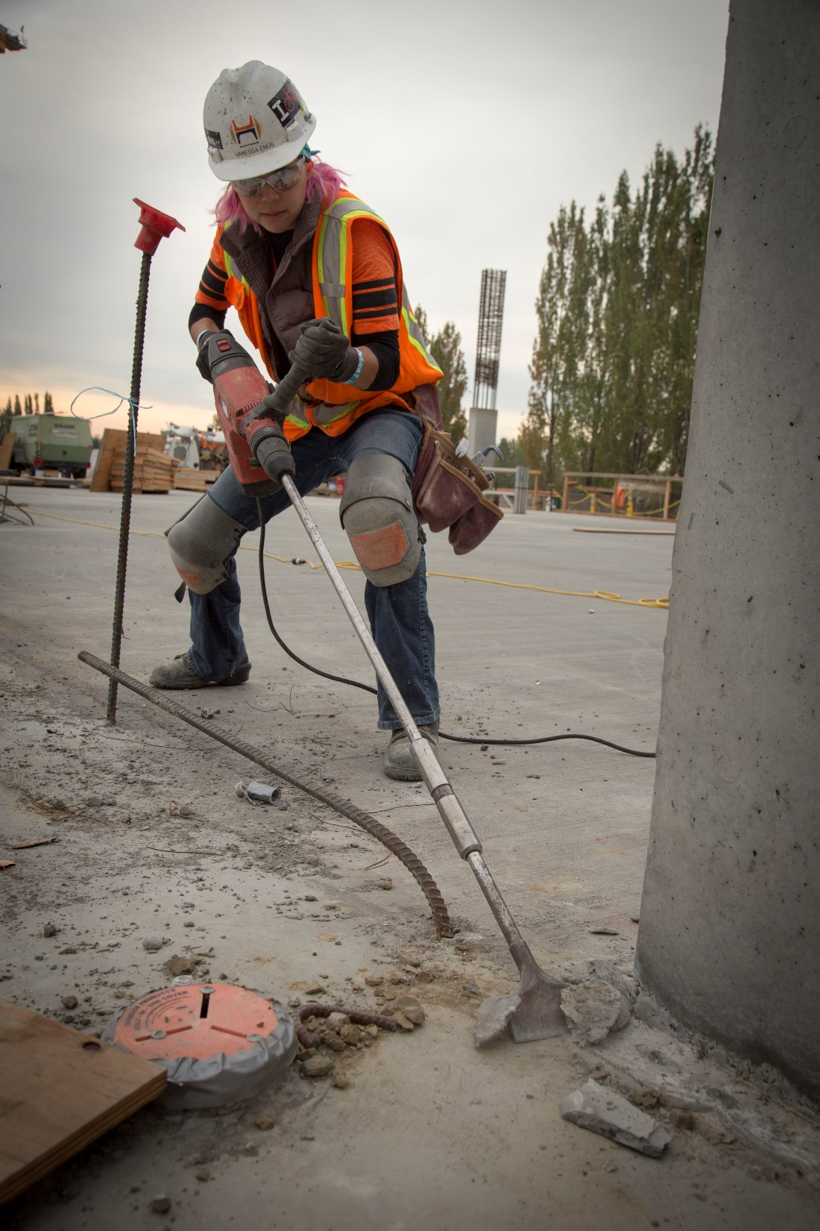
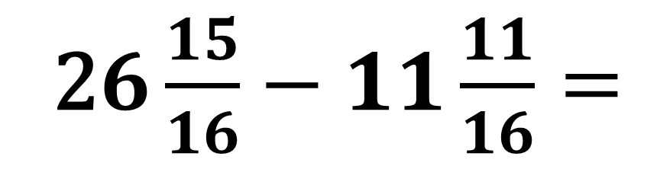
2$6\frac{15}{16}−11\frac{11}{16}=$
Notes:
Have students find the answer and write it on their handout.

Slide 30
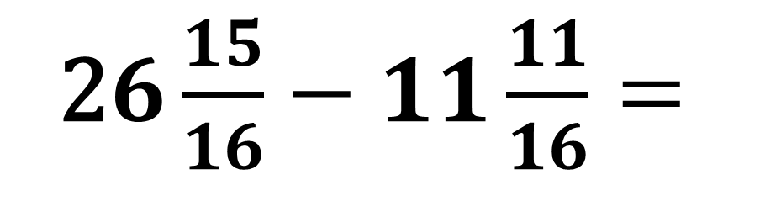
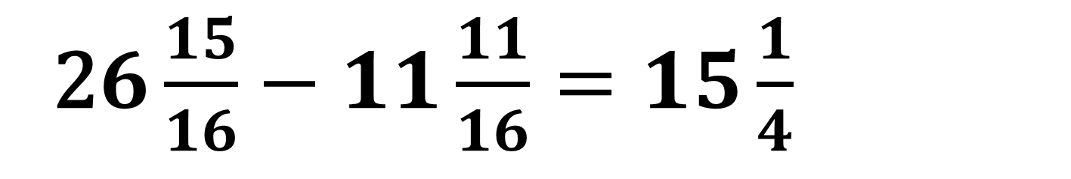
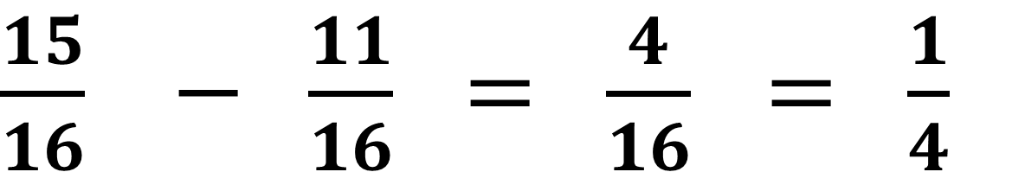

2$6\frac{15}{16}−11\frac{11}{16}=$
2$6 − 11 = \text{1}5$
$\frac{15}{16} − \frac{11}{16} = \frac{4}{16}$ $= \frac{1}{4}$
2$6\frac{15}{16}−11\frac{11}{16}=15\frac{1}{4}$
Notes:
Show how the answer was determined.
Have students correct their answers (if necessary) on their handout.

Slide 31
Like with addition, fractions must have the same bottom number to subtract them.
Notes:
Say that, like with addition, fractions have to have the same bottom number in order to subtract them.

Slide 32


$$\frac{1}{2} − \frac{1}{4} =$$
Notes:
Ask students how they would solve this.

Slide 33
If the bottom number of one (or more) of the fractions divides evenly into the bottom number of another fraction, rename the fraction(s) so they have the larger bottom number.
Notes:
Say to remember that, if the bottom number of one (or more) of the fractions divides evenly into the bottom number of another fraction, they should rename the fractions so they all have the larger bottom number.

Slide 34



$$\frac{1}{4}$$
$\frac{2}{4}$ - $\frac{1}{4} =$
$\frac{1}{2}$ $\frac{1}{4} =$
-
$$\frac{1}{4}$$
$$\frac{1}{2}$$
$$\frac{1}{4}$$
$$\frac{1}{4}$$
=
$$\frac{1}{4}$$
Notes:
Ask students how they would solve this. CLICK
Say that you are not changing the amount, you are only renaming 1/2 as 2/4 so you now have all of the same thing (fourths)
Say that now you have all fourths so you can subtract them.
Show that, when 1/2 is renamed 2/4, both the top and bottom number changed.
Say that whenever renaming a fraction in this way, both the top and bottom number have to change.
Point out that 1/2 and 2/4 are the same amount but because 2/4 has the same bottom number as 1/4, the fractions can be subtracted.

Slide 35


$$\frac{3}{16} − \frac{1}{8} =$$
Notes:
Have students use their fraction strips to find the answer, then write it on their handout.

Slide 36




$$\frac{3}{16} − \frac{1}{8}=$$
$$\frac{3}{16}−\frac{2}{16}=\frac{1}{16}$$
$$\frac{1}{8}$$
$$\frac{1}{8}$$
is the same as
$$\frac{1}{4}$$
$$\frac{2}{16}$$
$$\frac{1}{16}$$
$$\frac{1}{16}$$
Notes:
Say that to subtract 1/8 from 3/16 they need to have the same bottom number.
Show that 1/8 is the same amount as 2/16 and, now that both fractions have the same bottom number, CLICK
you can subtract the fractions.
Point out that, when 1/8 is renamed 2/16, both the top and bottom number changed.
Say that whenever renaming a fraction in this way, both the top and bottom number have to change.

Slide 37


$$\frac{7}{8} − \frac{3}{4} =$$
Notes:
Have students use their fraction strips to find the answer, then write it on their handout.

Slide 38

$\frac{7}{8} − \frac{3}{4} =$ $\frac{7}{8} − \frac{6}{8} =\frac{1}{8}$
Notes:
Show how the answer was determined.
Have students correct their answers (if necessary) on their handout.

Slide 39


$$\frac{11}{16} − \frac{1}{2} =$$
Notes:
Have students use their fraction strips to find the answer, then write it on their handout.

Slide 40

$\frac{11}{16} − \frac{1}{2} =$ $\frac{11}{16} − \frac{8}{16} =\frac{3}{16}$
Notes:
Show how the answer was determined.
Have students correct their answers (if necessary) on their handout.

Slide 41


7$\frac{3}{8} − 3\frac{1}{4}=$
Notes:
Have students find the answer, then write it on their handout.

Slide 42


7$\frac{3}{8} − 3\frac{1}{4}=$
7$\frac{3}{8} − 3\frac{2}{8}= 4\frac{1}{8}$
Notes:
Show how the answer was determined.
Have students correct their answers (if necessary) on their handout.

Slide 43


1$9 \frac{15}{16} −9\frac{1}{2}=$
Notes:
Have students find the answer, then write it on their handout.

Slide 44


1$9 \frac{15}{16} −9\frac{1}{2}=$
1$9 \frac{15}{16} −9\frac{8}{16}=10\frac{7}{16}$
Notes:
Show how the answer was determined.
Have students correct their answers (if necessary) on their handout.

Slide 45


3$1 \frac{1}{4} − 8\frac{15}{16}=$
Notes:
Have students find the answer, then write it on their handout.

Slide 46



3$1 \frac{1}{4} − 8\frac{15}{16}=$
3$1 \frac{4}{16} − 8\frac{15}{16}=$
3$0 \frac{20}{16} − 8\frac{15}{16}=22\frac{5}{16}$
Notes:
Show how the answer was determined.
Have students correct their answers (if necessary) on their handout.

Slide 47


1$3\frac{1}{2} −6\frac{5}{8}=$
Notes:
Have students find the answer, then write it on their handout.

Slide 48



1$3\frac{1}{2} − 6\frac{5}{8}=$
1$3\frac{4}{8} − 6\frac{5}{8}=$
1$2\frac{12}{8} − 6\frac{5}{8} = 6\frac{7}{8}$
Notes:
Show how the answer was determined.
Have students correct their answers (if necessary) on their handout.

Slide 49


You are working on a plumbing job and need a piece of pipe that is .
The pipe you have is .
How much pipe will be left after you cut the piece you need?
$$5\frac{ 7"}{8}$$
$$10\frac{ 1"}{4}$$
Notes:
Have students find the answer, then write it on their handout.

Slide 50



1$0\frac{1}{4} − 5\frac{7}{8}=$
1$0\frac{2}{8} − 5\frac{7}{8}=$
9$\frac{10}{8} − 5\frac{7}{8}=4\frac{3}{8}$
Notes:
Show how the answer was determined.
Have students correct their answers (if necessary) on their handout.

Slide 51
Image Credits
Dump Truck 1b.jpg by John Garrish from Belmont, CA (Dump Truck 1b) [CC BY-SA 2.0] via Wikimedia Commons
LisaSawzallsPortrait898A7268 by Oregon Tradeswomen, Inc.
Tradeswoman by Oregon Tradeswomen, Inc.
Tradeswoman by Oregon Tradeswomen, Inc.
Tradeswoman by Oregon Tradeswomen, Inc.
Tradeswoman by Oregon Tradeswomen, Inc.
Tradeswoman by Oregon Tradeswomen, Inc.
Tradeswoman by Oregon Tradeswomen, Inc.
VanessaChippingWide898A6337 by Oregon Tradeswomen, Inc.

Slide 52
Image Credits
Tradeswoman by Oregon Tradeswomen, Inc.
Tradeswoman by Oregon Tradeswomen, Inc.
Tradeswoman by Oregon Tradeswomen, Inc.
Jalaine Wiring Flash Landscape898A6140CMYK by Oregon Tradeswomen, Inc.
Tradeswoman by Oregon Tradeswomen, Inc.
Olivia Works Medium Landscape_98A5946 by Oregon Tradeswomen, Inc.
Tradeswoman by Oregon Tradeswomen, Inc.
Tradeswoman by Oregon Tradeswomen, Inc.

