Slide 1
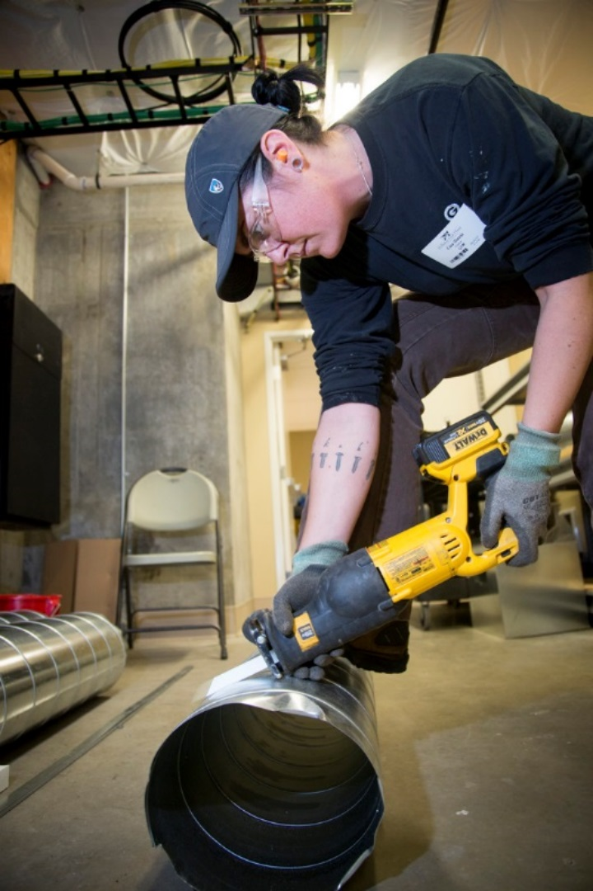

If you have to cut a
$9^{′} 4\frac{ 7"}{8}$
piece of duct into four
equal pieces, how long
will each piece be?
Notes:
Ask students how they would solve this problem.
On the board, show how the feet would be converted to inches.
Say that you could change the mixed number to a fraction before dividing, but there is an easier way to find the answer, using a calculator.
Say that that is what they will learn in this module.

Slide 2
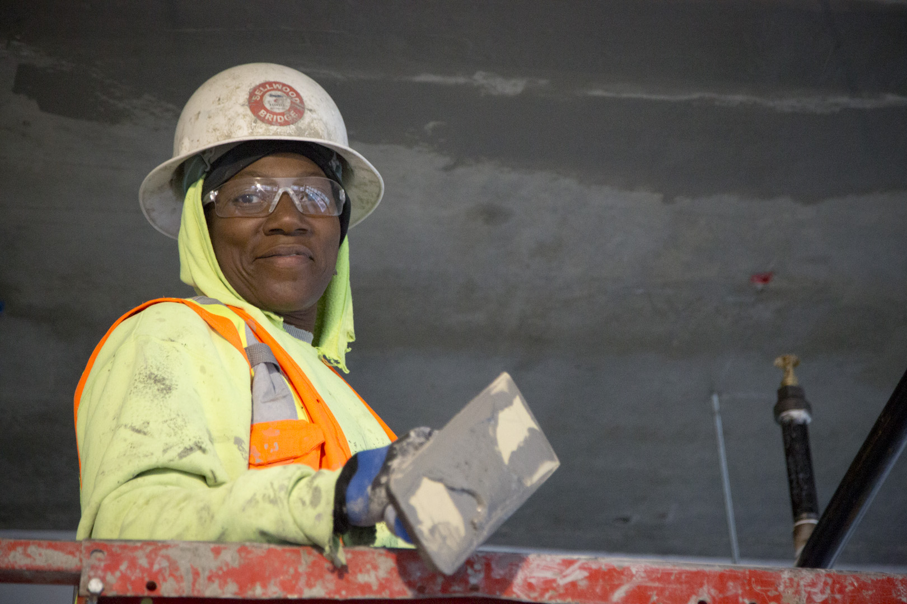
At the end of this module, you should be able to convert between measurements in fractions and decimals.
Notes:
Review the objective.

Slide 3
Hola
= Hello
Gracias
= Thank you
Amiga
= Friend
Notes:
Ask students what these Spanish words mean in English CLICK
Say that, just as Hola and Hello are two ways of saying the same thing, fractions and decimals are just two ways of saying an amount.

Slide 4



$$\frac{1}{4}$$
$$\frac{3}{4}$$
$$\frac{1}{2}$$
Notes:
Have students fill in 1/4, 1/2, and 3/4 on the blank number line in their handout. CLICK
Say to remember that a fraction is an amount of something and that amount is equal to the top number of the fraction divided by the bottom number.
Point out the 1/2.
Have students use their calculators to divide 1 by 2 and write the answer above the 1/2 mark on their number line.

Slide 5




$$.5$$
$$\frac{1}{4}$$
$$\frac{3}{4}$$
$$\frac{1}{2}$$
Notes:
Point out that 1/2 and .5 are the same amount.
Say that .5 is the decimal way of saying 1/2.
Have students use their calculators to divide 1 by 4 and 3 by 4 and write the answer above the 1/4 and 3/4 marks on their number line.

Slide 6





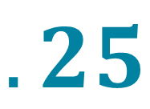
$$.25$$
$$.5$$
$$.75$$
$$\frac{1}{4}$$
$$\frac{3}{4}$$
$$\frac{1}{2}$$
Notes:
Point out that 1/4 and .25 are the same amount and 3/4 and .75 are the same amount.
Say that a fraction and a decimal are just different ways of stating an amount and that, when adding, subtracting, multiplying, or dividing fractions, sometimes it is easier to use decimals.

Slide 7
If you have to cut a
$9^{′} 4\frac{ 7"}{8}$
piece of duct into four
equal pieces, how long
will each piece be?
Notes:
Say that, for example, it would be easier to solve a problem like this working with decimals instead of fractions.

Slide 8
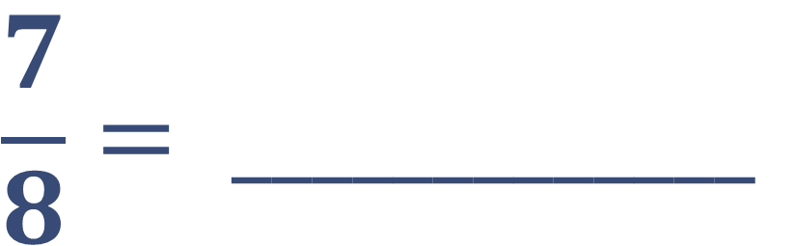

To convert a fraction to a decimal, divide the top number by the bottom number.
$$\frac{7}{8}= _____________$$
$$.825$$
Notes:
Have students calculate the decimal equivalent of 1/8. CLICK

Slide 9
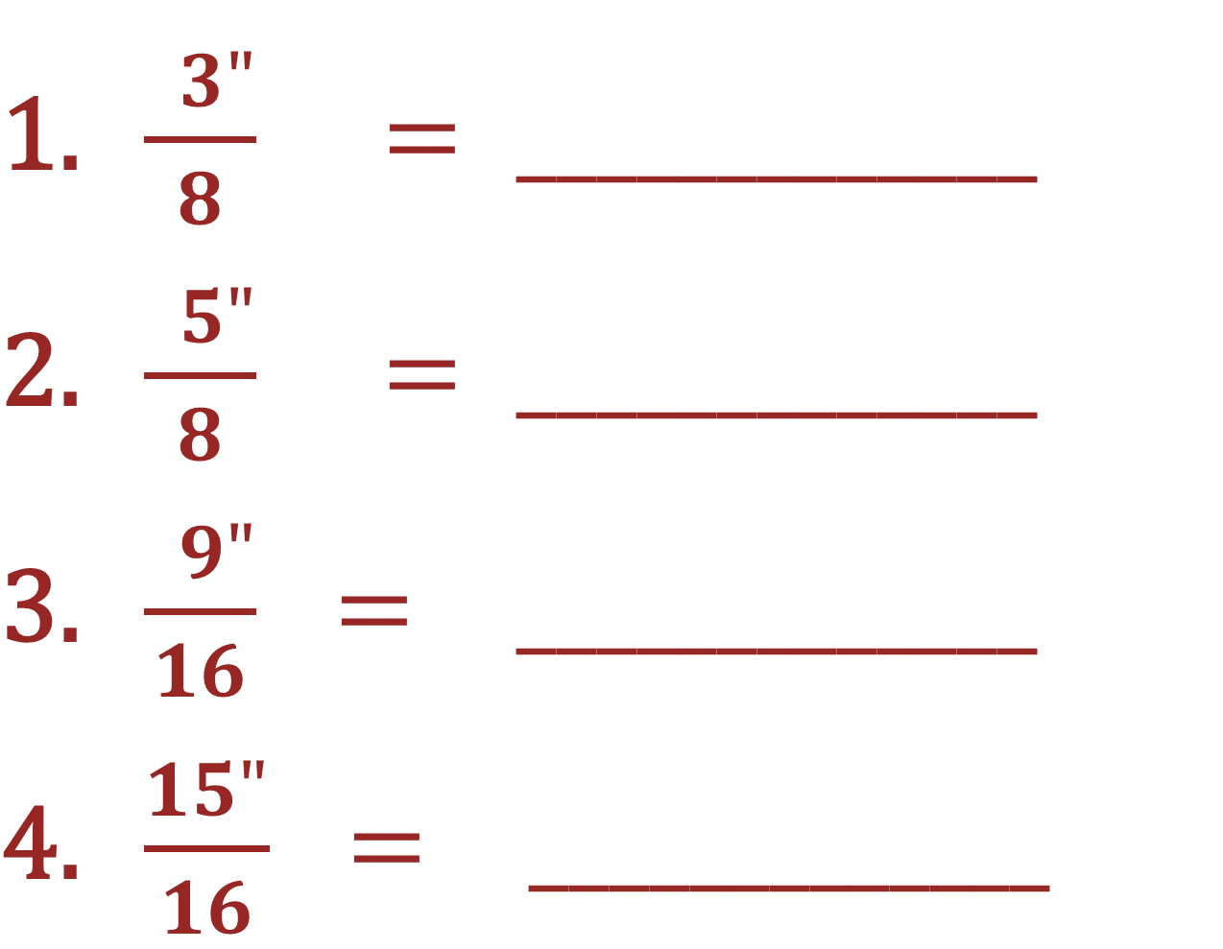
$\frac{ 3"}{8} = _____________$
$\frac{ 5"}{8} = _____________$
$\frac{ 9"}{16} = _____________$
$\frac{15"}{16} = _____________$
Notes:
Have students convert these fractions to decimals and write the answers on their handouts.

Slide 10
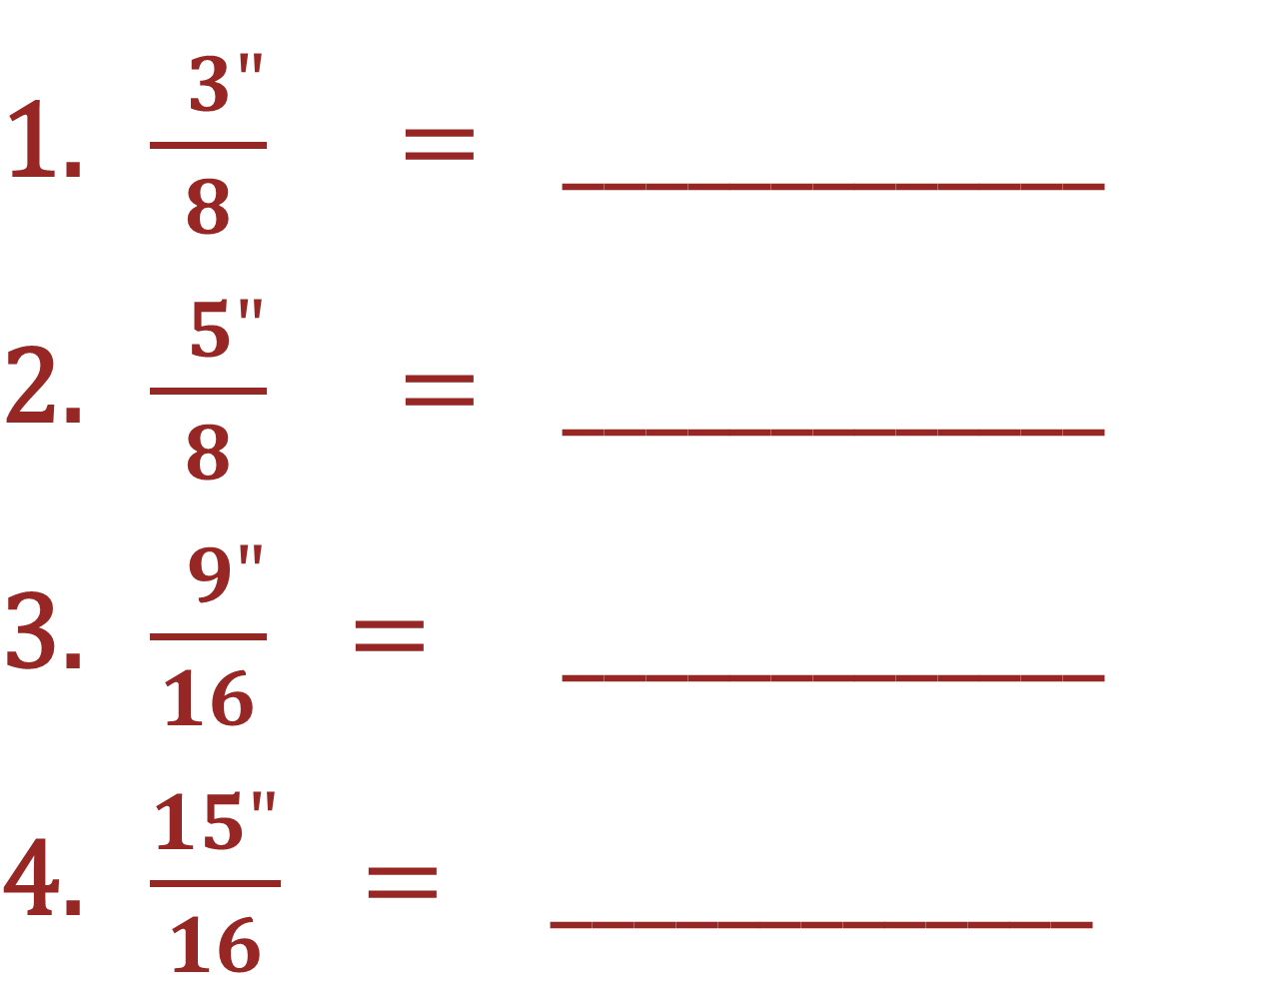




$\frac{ 3"}{8} = _____________$
$\frac{ 5"}{8} = _____________$
$\frac{ 9"}{16} = _____________$
$\frac{15"}{16} = _____________$
$$.325$$
$$.625$$
$$.5625$$
$$.9375$$
Notes:
Have students correct their answers (if necessary) on their handout.

Slide 11
To convert measurements in feet and inches to decimals:
Convert feet to inches.
Add the converted feet to the existing inches.
Convert the fraction to a decimal.
Add the decimal to the inches.
Notes:
Review the steps for converting measurements to decimals.

Slide 12
To convert feet to inches, ______________ the number of feet by ___.
Notes:
Ask students what they need to do to convert feet to inches.
Have students fill in the blanks on their handout.

Slide 13

$6^{′}4\frac{ 3"}{8}= _____________$
${25}^{′} \frac{ 15"}{16}= _____________$
${10}^{′} 2\frac{ 1"}{4}= _____________$
$1^{′} 6\frac{ 1"}{2}= _____________$
Notes:
Invite students to the board to demonstrate how to convert these measurements from feet, inches, and fractions to decimals. Have them show each step.

Slide 14



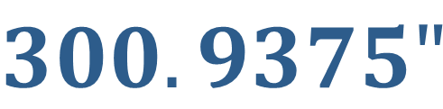

$6^{′}4\frac{ 3"}{8}= _____________$
${25}^{′} \frac{ 15"}{16}= ____________$
${10}^{′} 2\frac{ 1"}{4}= _____________$
$1^{′} 6\frac{ 1"}{2}= _____________$
$$76.375"$$
$$300.9375"$$
$$122.25"$$
$$18. 5"$$

Slide 15
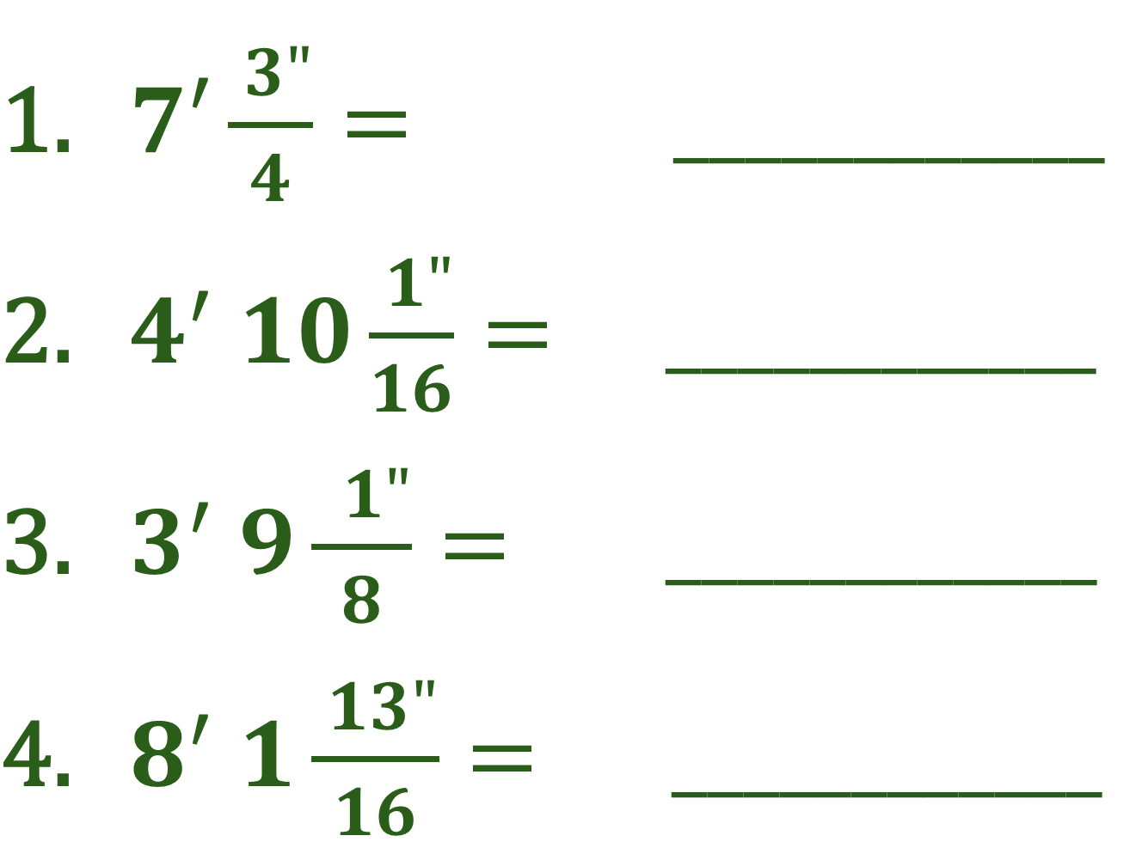
$7′\frac{ 3"}{4}= ____________$
$4^{′} 10\frac{ 1"}{16}= ____________$
$3^{′} 9\frac{ 1"}{8}= ____________$
$8^{′} 1\frac{ 13"}{16}= ____________$
Notes:
Have students convert these measurements to decimals and write the answers on their handouts.

Slide 16
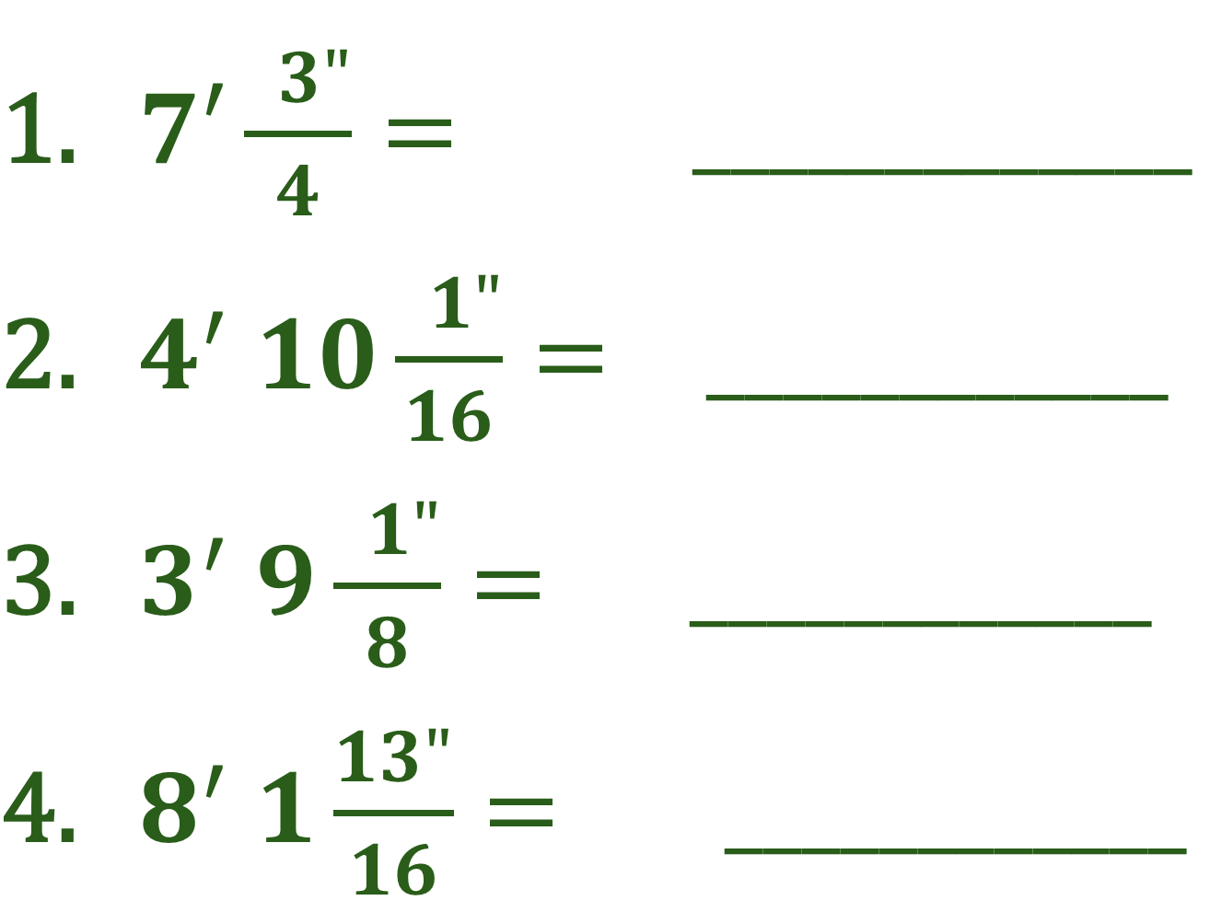

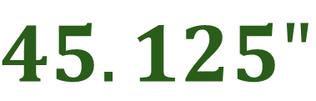
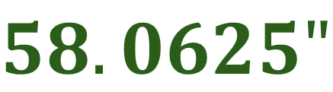

$7′\frac{ 3"}{4}= _____________$
$4^{′} 10\frac{ 1"}{16}= ____________$
$3^{′} 9\frac{ 1"}{8}= ____________$
$8^{′} 1\frac{13"}{16}= ____________$
$$7.75"$$
$$58.0625"$$
$$45.125"$$
$$97.8125"$$
Notes:
Have students correct their answers (if necessary) on their handout.

Slide 17
If you have to cut a
$9^{′} 4\frac{ 7"}{8}$
piece of duct into four
equal pieces, how long
will each piece be?
Notes:
Say that you are going to demonstrate how to convert measurements using this example.
Say that the examples in this module will be with division but they can also convert fractions to decimals when adding, subtracting, or multiplying fractions.
Draw an image on the board that illustrates what the problem is asking,

Slide 18
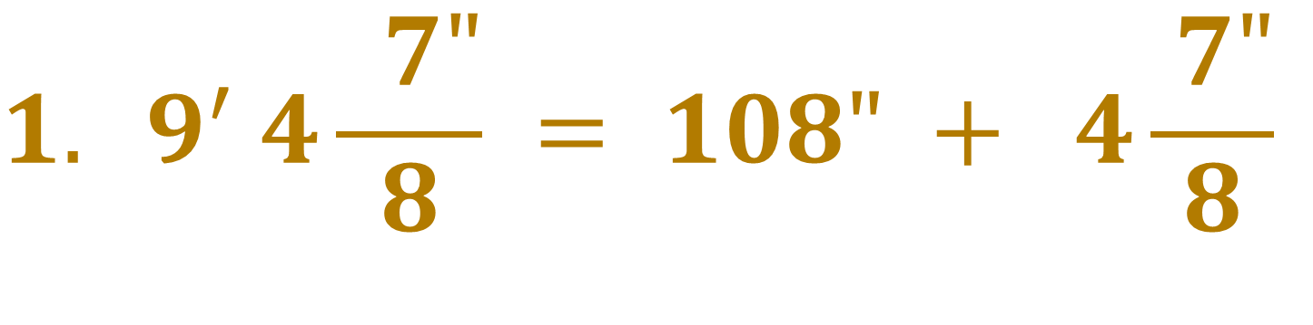
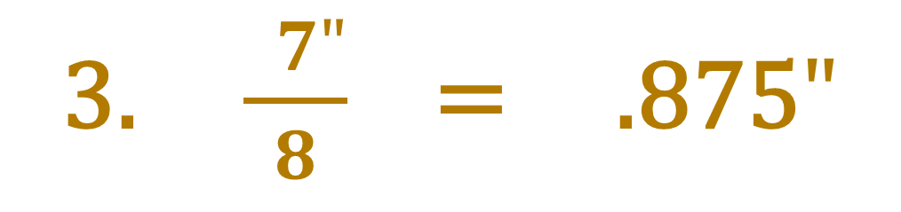
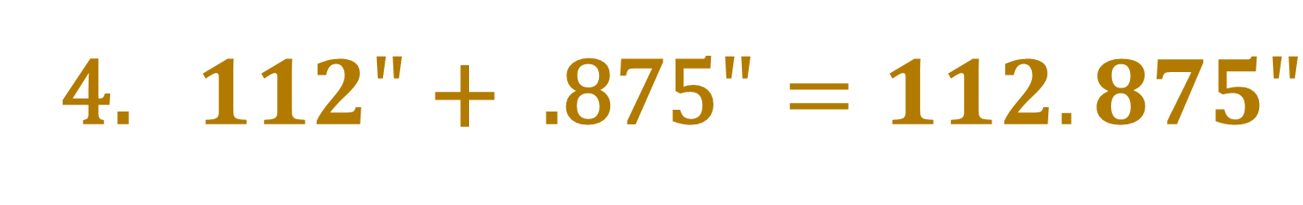
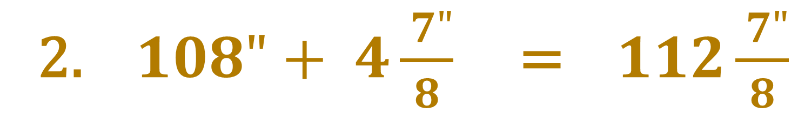
$${1. 9}^{′} 4\frac{ 7"}{8} = 108" + 4\frac{ 7"}{8}$$
2. $108"+ 4\frac{ 7"}{8}$ = $112\frac{ 7"}{8}$
3. $\frac{ 7"}{8}$ = .875$"$
4. $112" \text{+ }\text{ .875}"=112.875"$
Notes:
Point out that the 9’ 4 7/8” came from the problem on the previous slide.
Show how the feet were converted to inches. CLICK
Show how the converted feet were added to the existing inches. CLICK
Show how the fraction was converted to a decimal. CLICK
Show how the decimal was added to the inches.

Slide 19

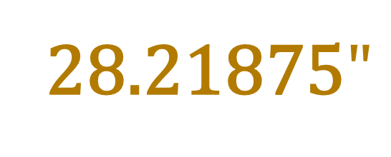

If you have to cut a piece of duct into four equal pieces, how long will each piece be?
$9^{′} 4\frac{ 7"}{8}$
112.875$"$÷ 4 =
28.21875$"$
Notes:
Point out where the 112.875 and the 4 came from.
Have students calculate the answer and write it on their handout. CLICK
Point out the answer.
Have students correct their answers (if necessary) on their handout.

Slide 20



How many pieces of wire can you get from a
$$2^{′} 2\frac{ 3"}{4}$$
piece that is
${23}^{′} 4\frac{ 5"}{16}$
?
Notes:
Invite a student to draw an image on the board that illustrates what the problem is asking,

Slide 21
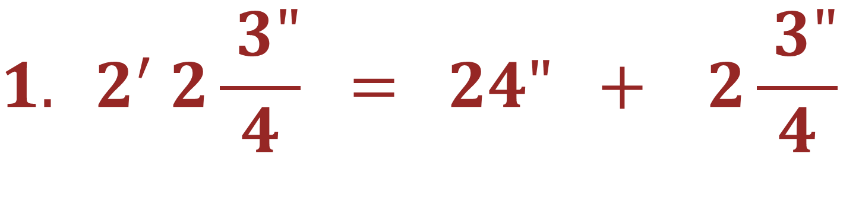

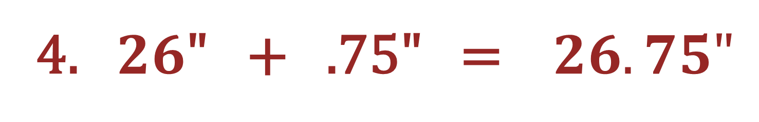
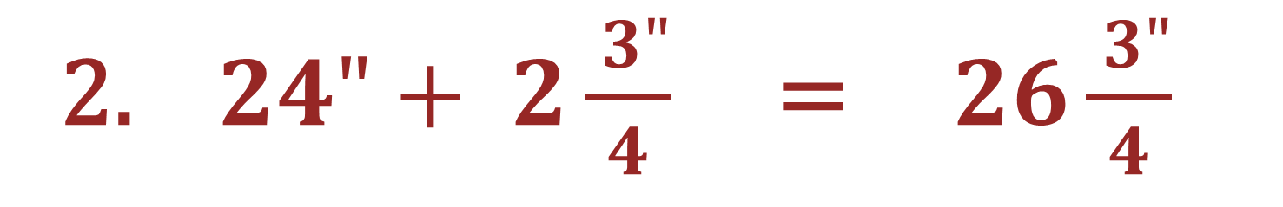
$${1. 2}^{′} 2\frac{ 3"}{4} = 24" + 2\frac{ 3"}{4}$$
2. $24"+ 2\frac{ 3"}{4}$ = $26\frac{ 3"}{4}$
3. $\frac{ 3"}{4}$ = .75$"$
4. $26\text{" }\text{+ }\text{ .75"} \text{=} 26.75"$
Notes:
Show how the feet were converted to inches. CLICK
Show how the converted feet were added to the existing inches. CLICK
Show how the fraction was converted to a decimal. CLICK
Show how the decimal was added to the inches.

Slide 22
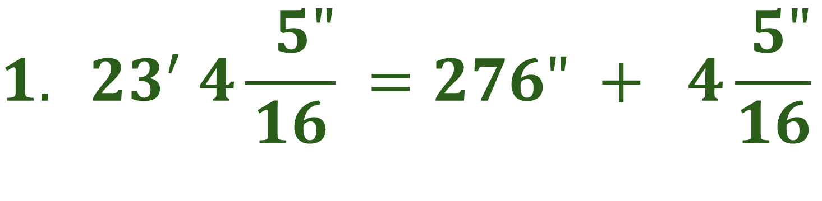
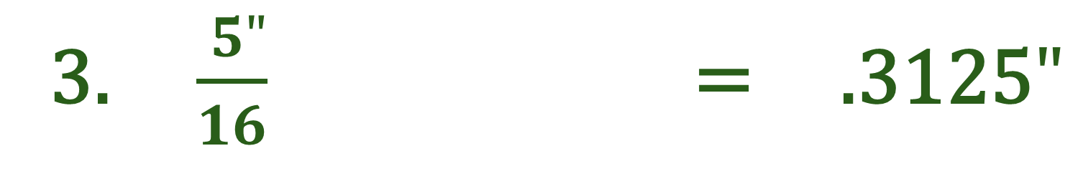
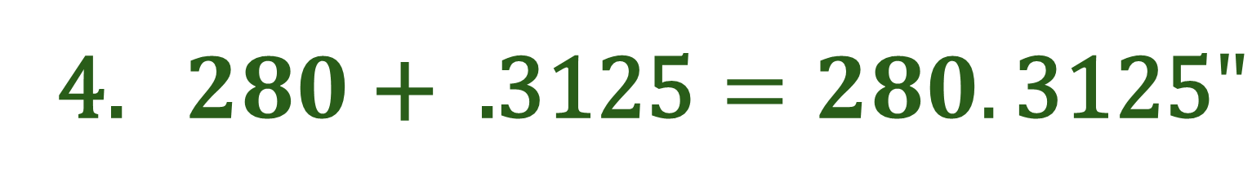
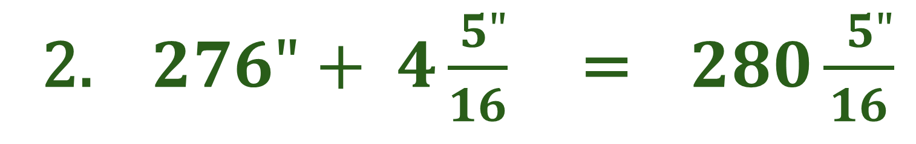
$${1. 23}^{′} 4\frac{ 5"}{16} =276" + 4\frac{ 5"}{16}$$
2. $276"+ 4\frac{ 5"}{16}$ = $280\frac{ 5"}{16}$
3. $\frac{ 5"}{16}$ = .3125$"$
4. $280 \text{+} \text{.3125}=280.\text{3125}"$
Notes:
Show how the feet were converted to inches. CLICK
Show how the converted feet were added to the existing inches. CLICK
Show how the fraction was converted to a decimal. CLICK
Show how the decimal was added to the inches.

Slide 23
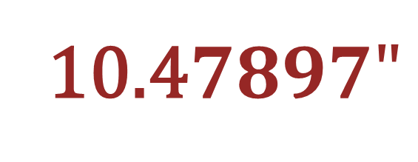

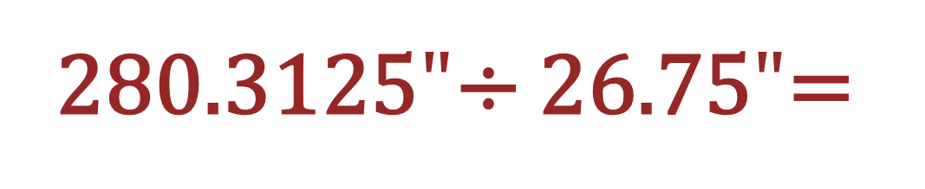
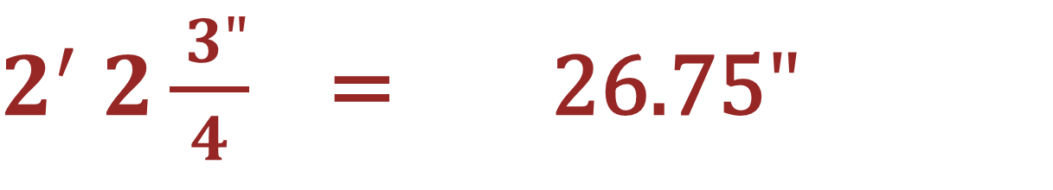
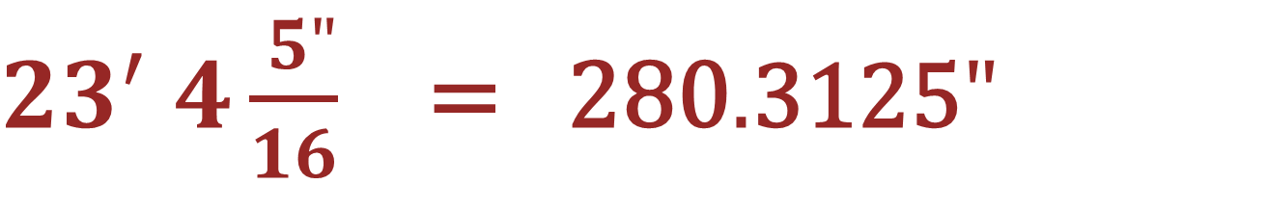
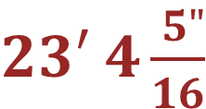
How many pieces of wire can you get from a piece that is ?
$$2^{′} 2\frac{ 3"}{4}$$
$23′ 4\frac{ 5"}{16}$
10 pieces
${23}^{′} 4\frac{ 5"}{16}$ = 280$.\text{3125}"$
$2^{′} 2\frac{ 3"}{4}$ = 26.75$"$
280.3125$"$÷ 26.75$"$=
10.4$7897"$
Notes:
Show where 280$.\text{3125}$ came from.
Show where 26.75 came from.
Have students calculate the answer and write it on their handout. CLICK
Point out that the answer would be 10 pieces.
Have students correct their answers (if necessary) on their handout.

Slide 24

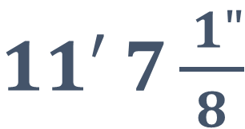
Your boss asks you to cut a board long into three equal pieces. How
$11′ 7\frac{ 1"}{8}$
long should each piece be?
Notes:
Have students draw an image that illustrates what they think the problem is asking, then solve the problem and write the answer on their handout.

Slide 25
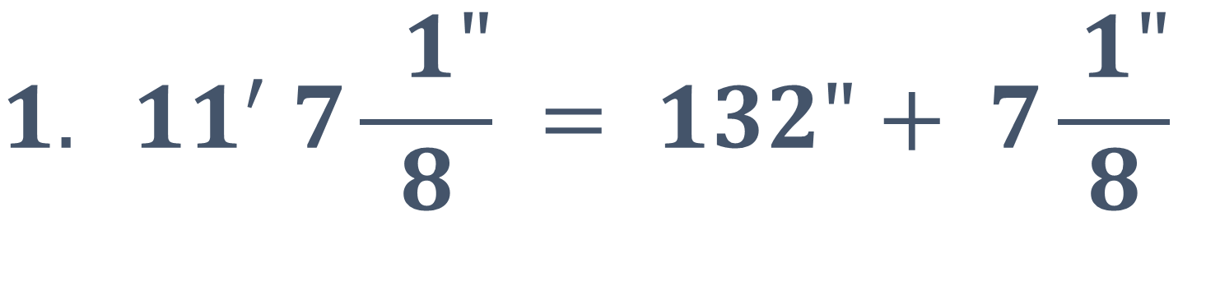
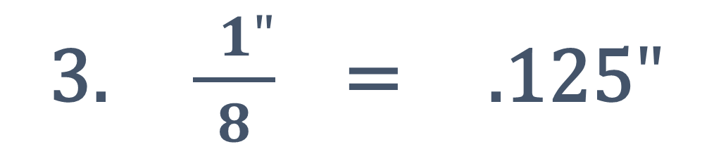
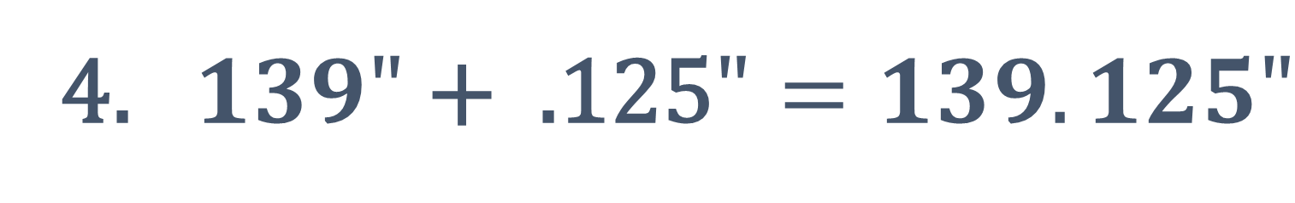
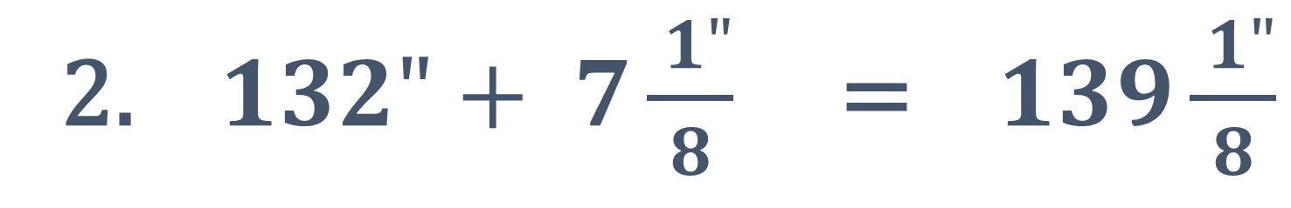
$${1. 11}^{′} 7\frac{ 1"}{8} = 132"+ 7\frac{ 1"}{8}$$
2. $132"+ 7\frac{ 1"}{8}$ = $139\frac{ 1"}{8}$
3. $\frac{ 1"}{8}$ = .125$"$
4. $139" \text{+ }\text{ .125}"=139.125"$
Notes:
Point out that the 11’ 7 1/8” came from the problem on the previous slide.
Show how the feet were converted to inches. CLICK
Show how the converted feet were added to the existing inches. CLICK
Show how the fraction was converted to a decimal. CLICK
Show how the decimal was added to the inches.

Slide 26
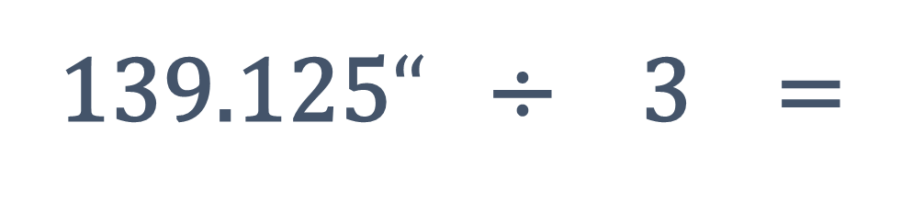
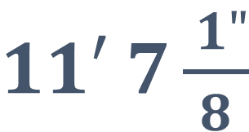
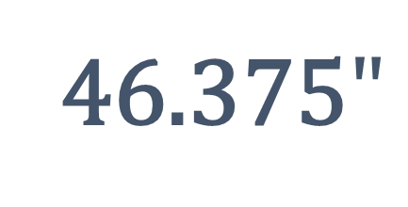
Your boss asks you to cut a board long into three equal pieces. How long should each piece be?
$11′ 7\frac{ 1"}{8}$
139.125$“$ ÷ 3 =
46.375$"$
Notes:
Show where the 139.125 and the 3 came from.
Have students calculate the answer and write it on their handout. CLICK
Point out the answer.
Have students correct their answers (if necessary) on their handout.
Ask students how they would measure a piece that is 46.375” long.
Say that, although it is often easier to do calculations with decimals, the answer needs to be converted back to feet, inches, and fractions in order to work with it in the field, like when using a measuring tape.

Slide 27
To convert a decimal to a fraction, multiply the decimal by 16 and place the answer over 16.
Notes:
Say that, to convert the decimal part of the measurement back to a fraction, multiply the decimal by 16 to convert it to 16ths of an inch.

Slide 28

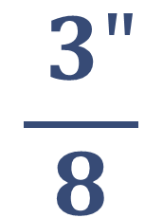

To convert a decimal to a fraction, multiply the decimal by 16 and place the answer over 16.
$$.375" x 16=$$
6
$.375"=$ $\frac{ 6"}{16} =$
$$\frac{ 3"}{8}$$
Notes:
Have students multiply .375 by 16. CLICK
Point out that they only have to convert the numbers to the right of the decimal point. CLICK
Ask students what 6/16ths is equal to when simplified. CLICK

Slide 29



To convert a decimal to a fraction, multiply the decimal by 16 and place the answer over 16.
$$.294" x 16=$$
$$4.704"$$
$.294"=$ $\frac{ 4.704"}{16}$
Notes:
Have students multiply .294 by 16. CLICK
Say that they will often have to round off the answer, like in this example.

Slide 30

To round off your answer, if the number to the right of the decimal point is 5 or higher, round up.
If it is less than 5, round down.
$\frac{ 4.704"}{16}$ = $\frac{ 5"}{16}$
Notes:
Say that, to round off their answer, if the number to the right of the decimal point is 5 or higher, they should round up.
If it is less than 5, they should round down.
Point out that the number to the right of the decimal point is higher than 5 so they should round their answer up.

Slide 31



$.71" =$ ______________
$.40625" =$ ______________
$.530625" =$ ______________
Notes:
Invite students to the board to convert these decimals to fractions. Have them show each step, including rounding and simplifying (if necessary).

Slide 32










$\frac{ 11.36"}{16}$ =
$$\frac{ 11"}{16}$$
$$.71" =$$
$\frac{ 6.5"}{16}$ =
$$\frac{ 7"}{16}$$
$$.40625" =$$
$\frac{ 8.49"}{16}$ =
$\frac{ 8"}{16}$ =
$$\frac{ 1"}{2}$$
$$.530625" =$$

Slide 33




$1. .2375"=$ ________________
$2. .575"= ______________$
$$3. .06875"=______________$$
$$4. .65"= ______________$$
Notes:
Have students convert these decimals to fractions and write the answers on their handouts.

Slide 34














$$1. .2375"=$$
$\frac{ 3.8"}{16}$ =
$\frac{ 4"}{16}$ =
$$\frac{ 1"}{4}$$
$$2. .575"=$$
$\frac{ 9.2"}{16}$ =
$$\frac{ 9"}{16}$$
$$3. .06875"=$$
$\frac{ 1.1"}{16}$ =
$$\frac{ 1"}{16}$$
$$4. .65"=$$
$\frac{ 10.4"}{16}$ =
$\frac{ 10"}{16}$ =
$$\frac{ 5"}{8}$$
Notes:
Have students correct their answers (if necessary) on their handout.

Slide 35
To convert decimal measurements to feet, inches, and fractions:
If there are more than 12 inches, convert inches to feet.
Multiply the decimal by 16 and place the answer over 16.
Notes:
Say that, when using a calculator to add, subtract, multiply, or divide fractions the answer will usually be in inches and decimals, so they will start with inches and decimals.
Review the steps for converting decimals. measurements to feet, inches, and fractions.

Slide 36
To convert decimal measurements to feet, inches, and fractions:
Round off the 16th of an inch (if necessary).
Add the fraction to the feet and inches.
Simplify the fraction (if necessary).
Notes:
Review the steps for converting decimals. measurements to feet, inches, and fractions.

Slide 37
To convert inches to feet, ______________ the number of inches by ___.
Notes:
Ask students what they need to do to convert inches to feet.
Have students fill in the blanks on their handout.

Slide 38



$14.41" =$ ______________
$39.08313" =$ ______________
$8.3625" =$ ______________
Notes:
Invite students to the board to demonstrate how to convert these measurements from decimals to feet, inches, and fractions. Have them show each step, including rounding and simplifying (if necessary).

Slide 39



$$1^{′} 2\frac{ 7"}{16}$$
$14.41" =$ ______________
$$3^{′ }3\frac{ 1"}{16}$$
$39.08313" =$ ______________
$$8\frac{ 3"}{8}$$
$8.3625" =$ ______________

Slide 40

$112.52125"$ = __________
$47. 6075"= \text{__________}$
$54. 55"=$ __________
$21. 71875"=$ __________
Notes:
Have students convert these measurements to feet, inches, and fractions and write the answers on their handouts.

Slide 41





$$9^{′} 4\frac{ 1"}{2}$$
$112.52125"$ =
$47. 6075"=$
$54. 55"=$
$21. 71875"=$
$$3^{′} 11\frac{ 5"}{8}$$
$$4^{′} 6\frac{ 9"}{16}$$
$$1^{′} 9\frac{ 3"}{4}$$
Notes:
Have students correct their answers (if necessary) on their handout.

Slide 42
If you have to cut a
$9^{′} 4\frac{ 7"}{8}$
piece of duct into four
equal pieces, how long
will each piece be?
Notes:
Remind students about this problem and its answer from earlier in the module.
Ask students how they would measure the pieces using a measuring tape.
Invite a student to the board to convert the measurement to feet, inches, and fractions. Have her show each step. (answer = 2’ 4 ¼”)

Slide 43


Your boss asks you to cut a board long into three equal pieces. How long
$11′ 7\frac{ 1"}{8}$
should each piece be?
46.375$"$
Notes:
Remind students about this problem and answer from earlier in the module.
Have students calculate the answer and write it on their handout.

Slide 44





$\text{46.375}"=$ $\text{3′ 10}\text{.375}"$
$$3^{′} 10\frac{ 6"}{16}$$
$\text{3′ 10.375}"=$
$$3^{′} 10\frac{ 6"}{16}=$$
$$3^{′} 10\frac{ 3"}{8}$$
Notes:
Click through the steps of the calculation in the slide, or demonstrate it on the board, explaining each step and showing how each answer was calculated.
Have students correct their answers (if necessary) on their handout.

Slide 45


If you cut a piece of pipe that is
$${10}^{′} 7\frac{ 3"}{4}$$
long into four equal pieces, how long will each piece be?
Notes:
Have students convert the measurement to decimals, calculate the answer, then convert the answer to feet, inches, and fractions and write it on their handout.
Encourage students to begin by drawing an image that illustrates what they think the problem is asking.

Slide 46



$${10}^{′} 7\frac{ 3"}{4} \text{= } \text{127}\frac{ 3"}{4}$$
$\text{127}\frac{ 3"}{4}$ = 127.75$"$
127.75$" ÷ 4 \text{=}\text{ 31.9375}\text{"}$
Notes:
Click through the steps of the calculation in the slide, or demonstrate it on the board, explaining each step and showing how each answer was calculated.
Have students correct their answers (if necessary) on their handout.

Slide 47

$\text{31.9375}\text{"}$ $\text{=} \text{ 2′} \text{7.}\text{9375}"$
$\text{2′ 7.}\text{9375}“$ = $\text{2}\text{′ }\text{7}\frac{ 15"}{16}$
Notes:
Click through the steps of the calculation in the slide, or demonstrate it on the board, explaining each step and showing how each answer was calculated.
Have students correct their answers (if necessary) on their handout.

Slide 48
Image Credits
LisaSawzallsPortrait898A7268 by Oregon Tradeswomen, Inc.
Johnetta Abraham by Oregon Tradeswomen, Inc.
Jalaine Digs Thru Romex by Oregon Tradeswomen, Inc.
ValerieRoofSawing898A5798 by Oregon Tradeswomen, Inc.
plumbing-840835_1920 Public Domain via Pixabay

