Slide 1
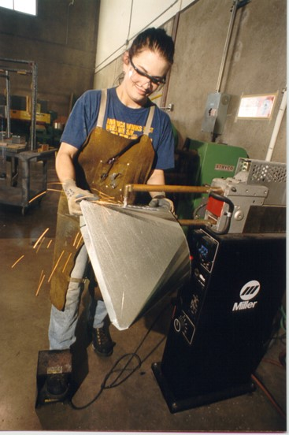
At the end of this module, you should be able to convert between inches and feet.
Notes:
Review the objective.

Slide 2
_____” = _____’ ?
Notes:
Ask students how many inches are equal to one foot. Have students look at their tape measures if necessary.

Slide 3
To convert feet to inches, ______________ the number of feet by ___.
Notes:
Say that, to convert feet to inches, you need to multiply the number of feet by 12.
Have students fill in the blanks on their handout.

Slide 4
$$6^{′} = _______________ "$$
$$6^{′} x 12 =72"$$
Notes:
Show how 6’ = 72”.

Slide 5
$${17}^{′} = _______________ "$$
$${17}^{′} x 12 =204"$$
Notes:
Show, on the board, how 17’ = 204”.

Slide 6
$$5^{′} 3" = _______________ "$$
$$5^{′} x 12 =60"$$
$$60" + 3" =63"$$
Notes:
Click through the steps of the calculation in the slide, or demonstrate it on the board, explaining each step and showing how each answer was calculated.

Slide 7
$${91}^{′} 10" = _______________ "$$
$${91}^{′} x 12 =1,092"$$
$$1,092\text{ +} 10=1,102"$$
Notes:
Click through the steps of the calculation in the slide, explaining each step and showing how each answer was calculated, or invite a student to demonstrate it on the board.

Slide 8
$${36}^{′} 8\frac{ 1"}{4}= _____________ "$$
$${36}^{′} x 12 =432"$$
${432}^{" }$+ $8\frac{ 1"}{4}=440\frac{ 1"}{4}"$
Notes:
Say that, when converting feet and inches to inches only, fractions don’t have to be part of the calculation and can just be carried forward to the final answer.
Click through the steps of the calculation in the slide, explaining each step and showing how each answer was calculated, or invite a student to demonstrate it on the board.
Point out how the 1/4 was brought forward without being included in the calculation.

Slide 9
${15}^{′} 1" = _____________ ′$
$25^{′} 8" = _____________ ′$
${14}^{′} 6\frac{ 1"}{8} = _____________ ′$
$13^{′} 10\frac{ 7"}{16} = _____________ ′$
$5^{′} 9\frac{ 1"}{2}$ = $______________ ′$
Notes:
Ask what they need to do to convert these measurements to inches only.
Have students write the answers on their handouts.

Slide 10
${15}^{′} 1" = 181"$
$25^{′} 8" = 308"$
${14}^{′} 6\frac{ 1"}{8} =174\frac{ 1"}{8}$
$13^{′} 10\frac{ 7"}{16} =166\frac{ 7"}{16}$
$5^{′} 9\frac{ 1"}{2}$ =$69\frac{ 1"}{2}$
Notes:
Have students correct their answers (if necessary) on their handout.
Point out how the fractions were brought forward without being included in the calculations.

Slide 11
To convert inches to feet, ______________ the number of inches by ___.
Notes:
Say that, to convert inches to feet, you need to divide the inches by 12.
Have students fill in the blanks on their handout.
On the board, show how to convert students’ measurements of the classroom object (taken at the beginning of the module) from inches, to feet and inches.

Slide 12
$${48}^{"} = _______________ ′$$
$${48}^{"}÷12 =4′$$
Notes:
Show how 48” = 4’.

Slide 13
$${72}^{"} = _______________ ′$$
$${72}^{"}÷12 =6′$$
Notes:
Show how 72” = 6’.

Slide 14
$${25}^{"} = _______________ ′$$
$${42}^{"} = _______________ ′$$
Notes:
Ask how many feet 25” is equal to.
Write the answer on the board, pointing out that 1” is left over.
Ask how many feet 42” is equal to.
Write the answer on the board, pointing out that 6” are left over.

Slide 15
$24" = ____________ ′$
$36" = ____________ ′$
$19" = ____________ ′$
$29" = ____________ ′$
$38" = ____________ ′$
Notes:
Ask students what they need to do to convert these measurements to feet and inches.
Have students write the answers on their handouts.

Slide 16
$24" = 2′$
$36" = 3′$
$19" = 1′ 7"$
$29" = 2′ 5"$
$38" = 3′ 2"$
Notes:
Have students correct their answers (if necessary) on their handout.
Say that, for some conversions from inches to feet, especially with small measurements, it can be easy to quickly make the conversion in their head.
Say that knowing their division and multiplication tables by memory can help them quickly do these kinds of conversions without a calculator.

Slide 17
$$165" = ____________ ′$$
$$165" ÷ 12 =13.75′$$
$$13^{′} x 12 =156"$$
$$165" − 156" =9"$$
$$13′ + 9" =13′ 9"$$
Notes:
Say that, for other measurements, it can be faster and easier to use a calculator to convert inches to feet.
Click through the steps of the calculation in the slide, or demonstrate it on the board, explaining each step and showing how each answer was calculated.

Slide 18
$$317" = ____________ ′$$
$$317"÷12=26.41666667′$$
$$26′ x 12 =312"$$
$$317" − 312" =5"$$
$$26′ +5" =26′ 5"$$
Notes:
Click through the steps of the calculation in the slide, or demonstrate it on the board, explaining each step and showing how each answer was calculated, or invite a student to demonstrate it on the board.

Slide 19
$$230\frac{ 1"}{2}= ______________ ′$$
$$230"÷12=19.16666667′$$
$$19′ x 12 =228"$$
$$230" − 228" =2$$
$$19^{′} +2" =19^{′} 2\frac{ 1"}{2}$$
Notes:
Say that, when converting inches to feet, fractions don’t have to be part of the calculation and can just be carried forward to the final answer.
Click through the steps of the calculation in the slide, or invite a student to demonstrate it on the board.
Point out how the 1/2 was brought forward without being included in the calculation.

Slide 20
$97" = ___________ ′$
$113" = ___________ ′$
$277\frac{ 5"}{8} = ___________ ′$
$451\frac{ 1"}{16} = ____________ ′$
$194\frac{ 3"}{4} = ____________ ′$
Notes:
Have students write the answers on their handouts.

Slide 21
$97" = 8′ 1"$
$113" =9′ 5"$
$277\frac{ 5"}{8}= 23^{′} 1\frac{5"}{8}$
$451\frac{ 1"}{16}= 37^{′} 7\frac{1"}{16}$
$194\frac{ 3"}{4}= 16^{′} 2\frac{3"}{4}$
Notes:
Have students correct their answers (if necessary) on their handout.
Point out how the fractions were brought forward without being included in the calculations.

Slide 22
$$3^{′} 3"$$
$$19′ 8"$$
Notes:
Ask students how they would determine the perimeter of this trench.

Slide 23
$$19′$$
$$8"$$
$${19}^{′}$$
$$8"$$
$$3′$$
$$3"$$
$$3^{′}$$
$$3"$$
Notes:
Show students how to align the feet and inches.

Slide 24
$${44}^{′}$$
$$22"$$
Convert inches to feet + inches
$${45}^{′}$$
$$10"$$
Notes:
Show students how the 44’ 22” was determined.
Show students how the inches were converted to feet.
Have students write down, on their handout, how many inches 45’ 10” is equal to.

Slide 25
$$45^{′} 10"=550"$$
Notes:
Have students correct their answers (if necessary) on their handout.

Slide 26
$$8^{′} 9\frac{ 5"}{8}$$
$$2^{′} 7\frac{ 1"}{8}$$
Notes:
Ask students how they would determine the perimeter of this slab of marble.

Slide 27
$$\frac{ 5"}{8}$$
$$8^{′}$$
$$9"$$
$$\frac{ 5"}{8}$$
$$8^{′}$$
$$9"$$
$$\frac{ 1"}{8}$$
$$2^{′}$$
$$7"$$
$$\frac{ 1"}{8}$$
$$2^{′}$$
$$7"$$
Notes:
Show students how to align the feet, inches, and fractions.

Slide 28
$$\frac{ 12"}{8}$$
$${20}^{′}$$
$$32"$$
Change improper to proper fraction
$$\frac{ 4"}{8}$$
$33"$
Convert inches to feet
$$\frac{ 4"}{8}$$
$${22}^{′}$$
$$9"$$
$$\frac{ 1"}{2}$$
Simplify
$${22}^{′}$$
$$9"$$
Notes:
Show students how the 20’ 32 12/8” was determined.
Click through the steps of the calculation in the slide, or demonstrate it on the board, explaining each step and showing how each answer was calculated.
Show students how to change improper fractions to proper fractions.
Then convert inches to feet.
Then simplify fractions if necessary.
Have students write down, on their handout, how many inches 22’ 9 ½” is equal to.

Slide 29
$$22^{′} 9\frac{ 1"}{2} = 273\frac{ 1"}{2}$$
Notes:
Have students correct their answers (if necessary) on their handout.
Point out how the ½” was carried forward into the final answer.

Slide 30
$$4^{′} 8\frac{ 3"}{4}$$
$$5^{′} 11\frac{ 1"}{16}$$
Notes:
Ask students how they would determine the perimeter of this shape.

Slide 31
$$\frac{ 3"}{4}$$
$$4^{′}$$
$$8"$$
$$\frac{ 3"}{4}$$
$$4^{′}$$
$$8"$$
$$\frac{ 1"}{16}$$
$$5^{′}$$
$$11"$$
$$\frac{ 1"}{16}$$
$$5^{′}$$
$$11"$$
Notes:
Show students how to align the feet, inches, and fractions.

Slide 32
$$\frac{ 26"}{16}$$
$${18}^{′}$$
$$38"$$
Change improper to proper fraction
$$\frac{ 10"}{16}$$
$39"$
Convert inches to feet
$$\frac{ 10"}{16}$$
$${21}^{′}$$
$$3"$$
$$\frac{ 5"}{8}$$
Simplify
$${21}^{′}$$
3$"$
Notes:
Show students how the 18’ 38 26/16” was determined.
Click through the steps of the calculation in the slide, or demonstrate it on the board, explaining each step and showing how each answer was calculated.
Show students how to change improper fractions to proper fractions.
Then convert inches to feet.
Then simplify fractions if necessary.
Have students write down, on their handout, how many inches 21’ 3 5/8” is equal to.

Slide 33
$$21^{′} 3\frac{ 5"}{8} = 255\frac{ 5"}{8}$$
Notes:
Have students correct their answers (if necessary) on their handout.
Point out how the 5/8” was carried forward into the final answer.

Slide 34
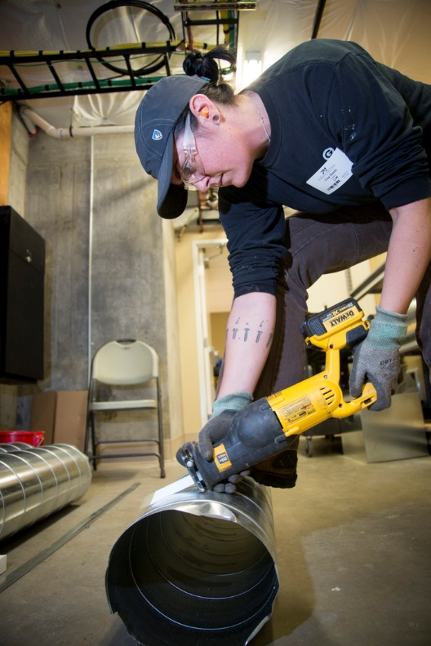
Working on an HVAC job, you cut a piece of duct from a piece that is
$$7^{′} 9"$$
${10}^{′} 2“$.
How long is the remaining piece?
Notes:
Have students draw an image, on their handout, that illustrates what they think the problem is asking.
Invite a student to the board to draw the image she created.

Slide 35
$${10}^{′} 2"$$
$${ − 7}^{′} 9"$$
Notes:
Ask students what they will need to do to subtract the inches.

Slide 36
$$9′ 14"$$
$${ − 7}^{′} 9"$$
$$2^{′} 5"$$
Notes:
Show students how 10’ 2” was converted to 9’ 14” and how the final answer was calculated.
Have students write down, on their handout, how many inches 2’ 5” is equal to.

Slide 37
$$2^{′} 5" = 29"$$
Notes:
Have students correct their answers (if necessary) on their handout.

Slide 38
Working on a remodeling job, you have a piece of wood trim long. If a coworker cuts a piece from it, how long is the remaining piece?
$${11}^{′} 6\frac{ 1"}{4}$$
$$3^{′} 8\frac{ 9"}{16}$$
Notes:
Have students draw an image, on their handout, that illustrates what they think the problem is asking, then solve this problem.

Slide 39
$$\frac{ 1"}{4}$$
$${11}^{′}$$
$$6"$$
$$−$$
$$\frac{ 9"}{16}$$
$$3^{′}$$
$$8"$$
Notes:
Ask students what they will need to do to subtract the fractions.

Slide 40
$$\frac{ 4"}{16}$$
$${11}^{′}$$
$$6"$$
$$−$$
$$\frac{ 9"}{16}$$
$$3^{′}$$
$$8"$$
Notes:
Show students how 1/4 was renamed 9/16.

Slide 41
$$\frac{ 20"}{16}$$
$${11}^{′}$$
$$5"$$
$$−$$
$$\frac{ 9"}{16}$$
$$3^{′}$$
$$8"$$
Notes:
Show students how 6 4/16 was renamed 5 20/16.
Ask students what they will need to do to subtract the (whole) inches.

Slide 42
$$\frac{ 20"}{16}$$
$${10}^{′}$$
$$17"$$
$$−$$
$$\frac{ 9"}{16}$$
$$3^{′}$$
$$8"$$
Notes:
Show students how 11’ 5” was renamed 10’ 17”.

Slide 43
$$\frac{ 20"}{16}$$
$${10}^{′}$$
$$17"$$
$$−$$
$$\frac{ 9"}{16}$$
$$3^{′}$$
$$8"$$
$$\frac{ 11"}{16}$$
$$7^{′}$$
$$9"$$
Notes:
Show students how the final answer was calculated.
Have students write down, on their handout, how many inches 7’ 9 11/16” is equal to.

Slide 44
$$7^{′} 9\frac{ 11"}{16} = 93\frac{ 11"}{16}$$
Notes:
Have students correct their answers (if necessary) on their handout.

Slide 45
While framing a house, you need a board that is long. If you cut the piece you need from a board long, how long is the remaining piece?
$4^{′} 11\frac{ 7"}{8}$
$8^{′} 2\frac{ 1"}{2}$
Notes:
Have students work in pairs to find the answer and write it in feet and inches, and inches only.
Have students start by drawing an image, on their handout, that illustrates what they think the problem is asking.

Slide 46
$$\frac{ 1"}{2}$$
$$8^{′}$$
$$2"$$
$$−$$
$$\frac{ 7"}{8}$$
$$4^{′}$$
$$11"$$
Notes:
Show students how to solve the problem using the following slides, on the board, or invite a student to demonstrate it on the board.
Ask students what they will need to do to subtract the fractions.

Slide 47
$$\frac{ 4"}{8}$$
$$8^{′}$$
$$2"$$
$$−$$
$$\frac{ 7"}{8}$$
$$4^{′}$$
$$11"$$
Notes:
Show students how 1/2 was renamed 4/8.

Slide 48
$$\frac{ 12"}{8}$$
$$8^{′}$$
$$1"$$
$$−$$
$$\frac{ 7"}{8}$$
$$4^{′}$$
$$11"$$
Notes:
Show students how 2 4/8 was renamed 1 12/8.
Ask students what they will need to do to subtract the (whole) inches.

Slide 49
$$\frac{ 12"}{8}$$
$$7^{′}$$
$$13"$$
$$−$$
$$\frac{ 7"}{8}$$
$$4^{′}$$
$$11"$$
Notes:
Show students how 8’ 1” was renamed 7’ 13”.

Slide 50
$$\frac{ 12"}{8}$$
$$7^{′}$$
$$13"$$
$$−$$
$$\frac{ 7"}{8}$$
$$4^{′}$$
$$11"$$
$$\frac{ 5"}{8}$$
$$3^{′}$$
$$2"$$
Notes:
Show students how the final answer was calculated.
Have students correct their answers (if necessary) on their handout.

Slide 51
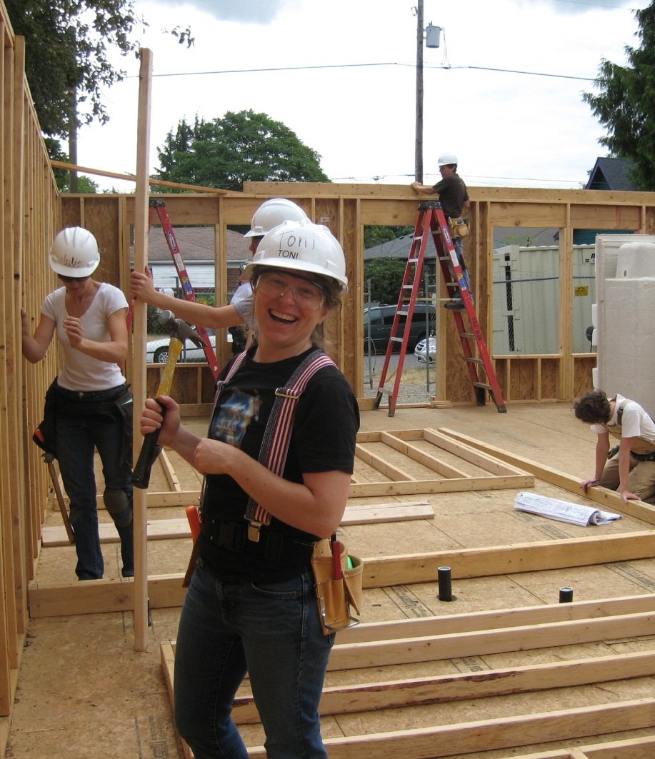
$$3^{′} 2\frac{ 5"}{8} = 38\frac{ 5"}{8}$$
Notes:
Have students correct their answers (if necessary) on their handout.

Slide 52
Image Credits
Tradeswoman by Oregon Tradeswomen, Inc.
Jalaine ArmsCrossed Smile Wider Landscape_98A6282CMYK by Oregon Tradeswomen, Inc.
Tradeswoman by Oregon Tradeswomen, Inc.
RosaSmilesSeeEyes_98A7683CMYK by Oregon Tradeswomen, Inc.
LisaSawzallsPortrait898A7268 by Oregon Tradeswomen, Inc.
VanessaSerious_98A6362 by Oregon Tradeswomen, Inc.
ValerieRoofSawing898A5787 by Oregon Tradeswomen, Inc.
Tradeswomen by Oregon Tradeswomen, Inc.

