Slide 1
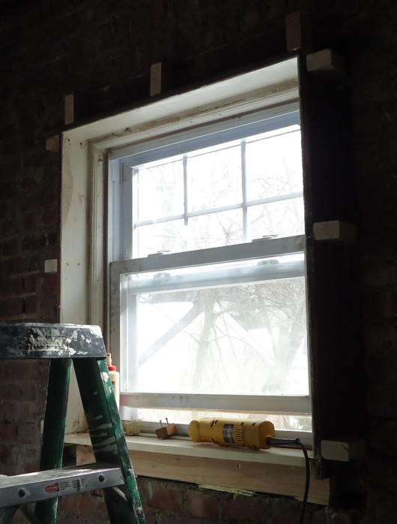
36”
What is the perimeter?
30”
Notes:
Note: Due to the time constraints for this training, and because students will most often use halves, fourths, eighths, and sixteenths, only one method for finding common denominators (for use with denominators that are divisible by one another) is taught in this module is the one.
Ask students what the perimeter of this window would be in inches.
Write out the calculation and answer on the board.

Slide 2
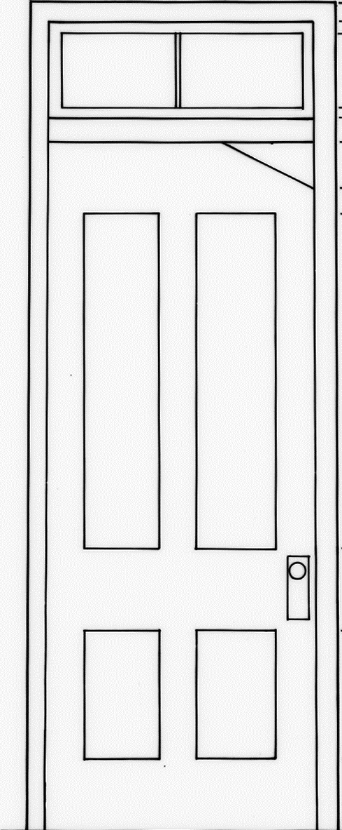
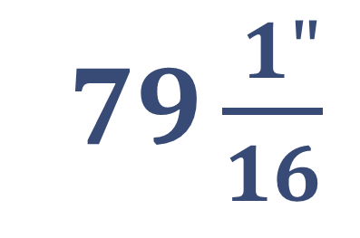
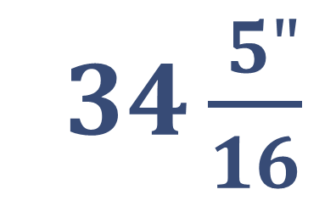
7$9\frac{ 1"}{16}$
3$4\frac{ 5"}{16}$
Notes:
Say that, in construction, materials, spaces, and plans - like this door frame in an old house - often don’t equal whole numbers, so there will be many times when they will need to be able to add fractions.

Slide 3
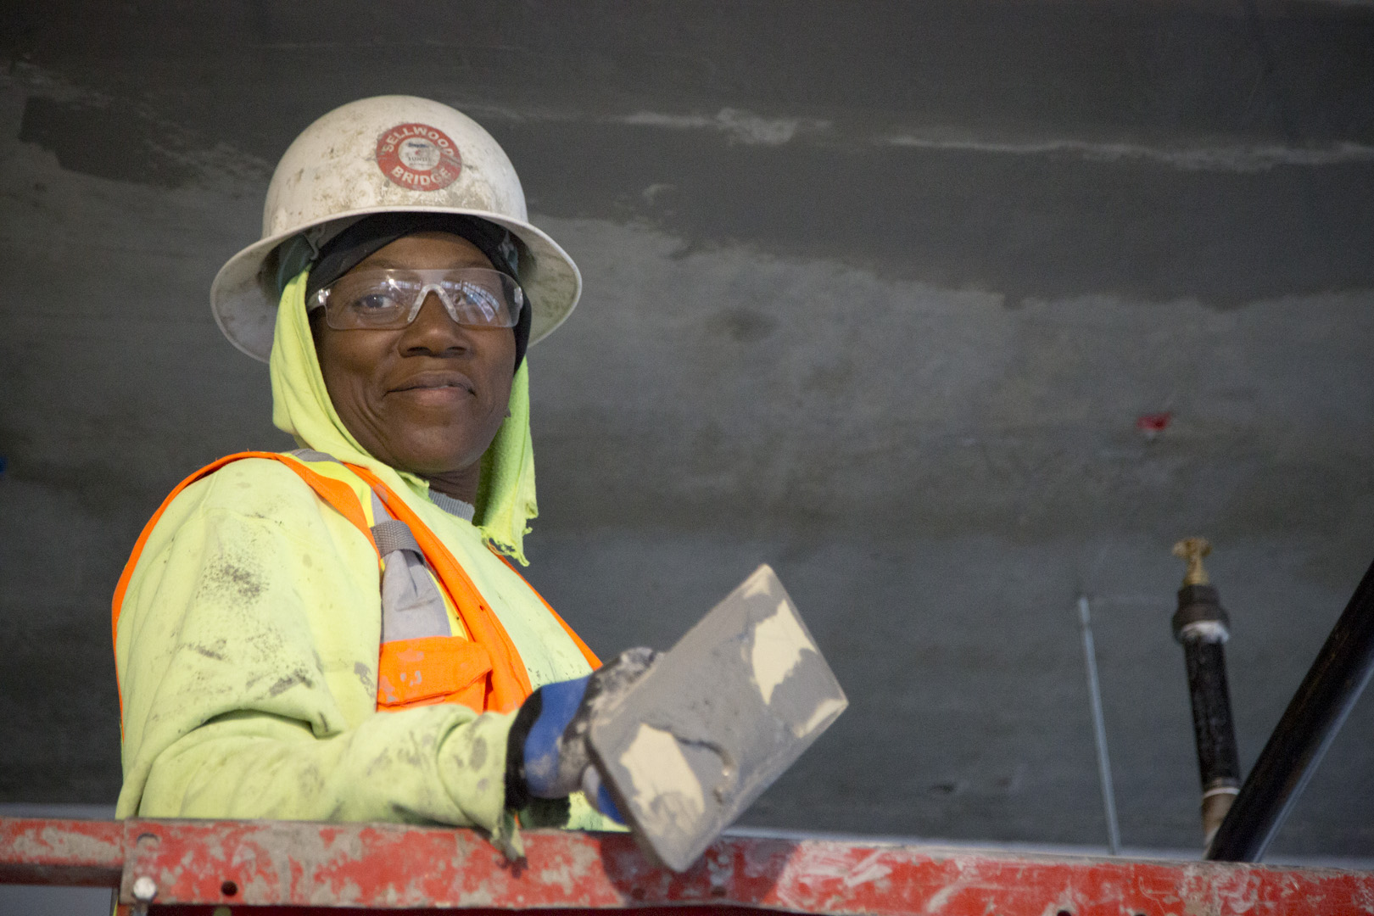
At the end of this module, you should be able to add fractions
Notes:
Review the objective.

Slide 4
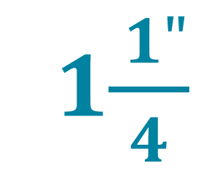
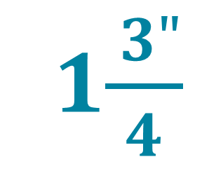
Brownies need:
cups of flour
1$\frac{ 1"}{4}$
Cookies need:
cups of flour
1$\frac{ 3"}{4}$
Total needed:
cups of flour
?
Notes:
Say that they might already be used to adding fractions in everyday life, like determining how much flour they need to make brownies and cookies for a pot luck.

Slide 5
!
Adding fractions is very different than multiplying fractions.
Notes:
Say that adding fractions is very different than multiplying fractions.

Slide 6
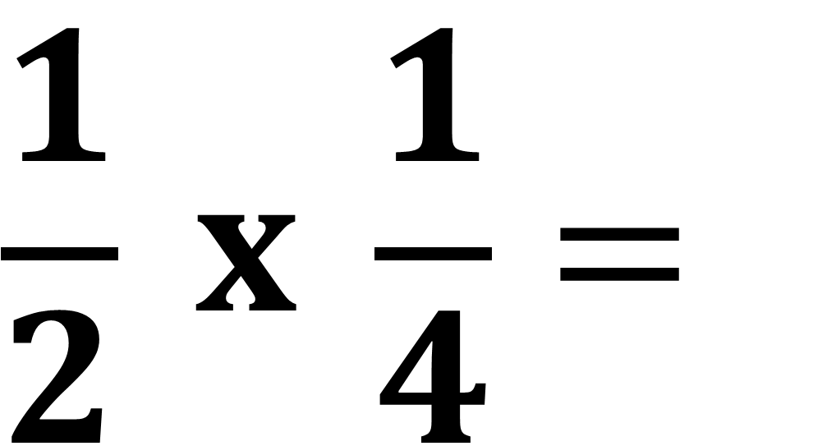

$$\frac{1}{2} x \frac{1}{4}=$$
$$\frac{1}{8}$$
Notes:
Ask what amount you get when you multiply 1/2 x 1/4 CLICK
Point out that, when multiplying fractions, they multiply the top numbers, then multiply the bottom numbers.
Ask whether 1/8 is more or less than 1/2.

Slide 7



$$\frac{1}{8}$$
$$\frac{1}{4}$$
$$\frac{1}{2}$$
Notes:
Have students write in where 1/2, 1/4, and 1/8 are on the number line in their handout. CLICK
Have students correct their answers (if necessary) on their handout.
Point out that 1/8 is less than 1/2.

Slide 8
In construction, multiplying fractions can result in a smaller number.
but
Adding fractions never results in a smaller number.
Notes:
Say to remember that, in construction, multiplying fractions can result in a smaller number, like 1/2 x 1/4 = 1/8.
Ask if adding two positive numbers ever results in a smaller amount. CLICK
Say that, in construction, whenever they are adding fractions, they should always expect the result to be larger than any of the numbers being added.

Slide 9
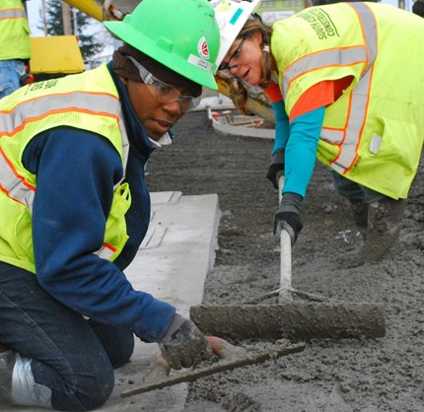
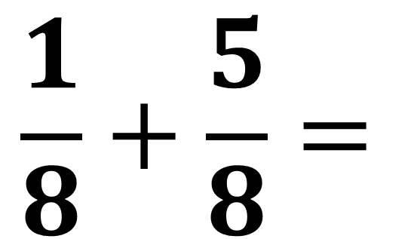
$$\frac{1}{8}+\frac{5}{8}=$$
Notes:
Have students use their fraction strips and the number line in their handout (the image of the slide) to add 1/8 + 5/8.

Slide 10
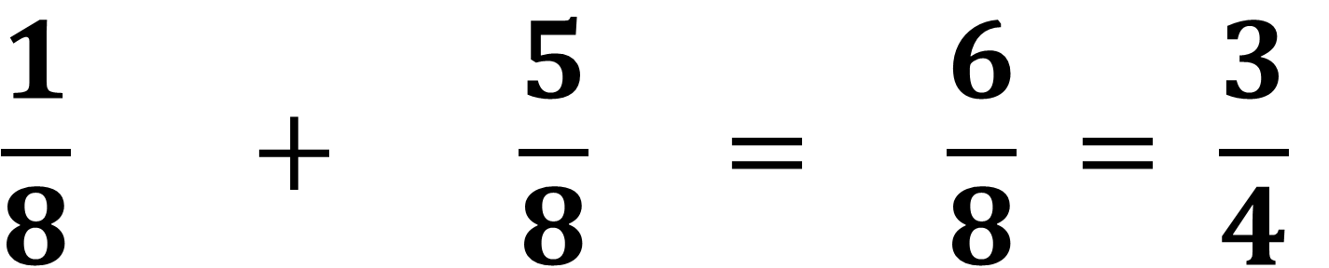
$$\frac{1}{8} + \frac{5}{8} = \frac{6}{8} = \frac{3}{4}$$
$$\frac{1}{8}$$
$$\frac{1}{8}$$
$$\frac{1}{8}$$
$$\frac{1}{8}$$
$$\frac{1}{8}$$
$$\frac{1}{8}$$
Notes:
Point out that 1/8 + 5/8= 6/8 and that 6/8 (which can be simplified to 3/4) and is larger than both 1/8 and 5/8.

Slide 11








$$\frac{6}{8}$$
$$\frac{3}{4}$$
$$\frac{1}{8}$$
$$\frac{1}{8}$$
$$\frac{1}{8}$$
$$\frac{1}{8}$$
$$\frac{1}{8}$$
$$\frac{1}{8}$$
Notes:
Show how 1/8 + 5/8= 6/8 (or 3/4) on the number line as well. CLICK
Point out that 6/8 (or 3/4) is a larger than 1/8.

Slide 12
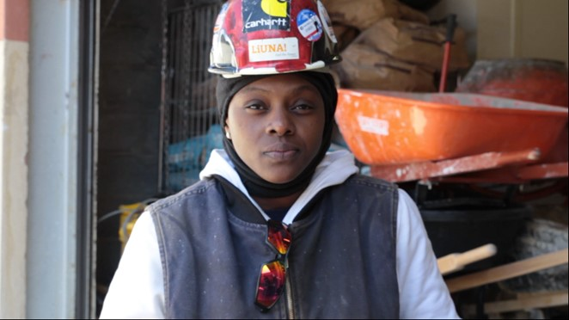
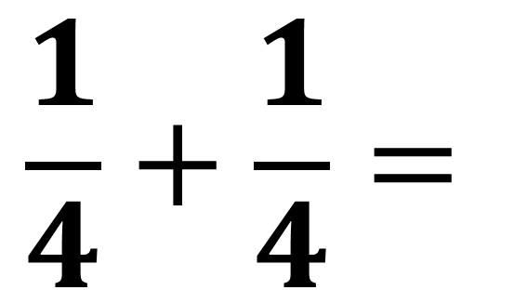
$$\frac{1}{4}+\frac{1}{4}=$$
Notes:
Have students use their fraction strips and the number line in their handout (the image of the slide) to add 1/4 + 1/4.

Slide 13



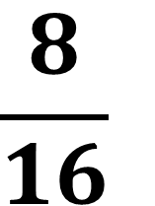


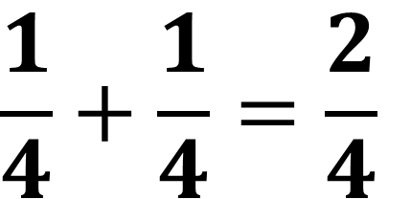



$$\frac{1}{4}+\frac{1}{4}=\frac{2}{4}$$
$$\frac{1}{4}$$
$$\frac{1}{4}$$
$$\frac{1}{2}$$
$$\frac{1}{2}$$
$$\frac{4}{8}$$
$$\frac{1}{8}$$
$$\frac{1}{8}$$
$$\frac{1}{8}$$
$$\frac{1}{8}$$
$$\frac{8}{16}$$
$$\frac{1}{16}$$
$$\frac{1}{16}$$
$$\frac{1}{16}$$
$$\frac{1}{16}$$
$$\frac{1}{16}$$
$$\frac{1}{16}$$
$$\frac{1}{16}$$
$$\frac{1}{16}$$
Notes:
Show how 1/4 + 1/4 equals 2/4, which is the same amount as 1/2 when simplified.
Point out that 1/2 is a larger than 1/4.
Point out that students might also have noticed that 1/4 + 1/4 is the same amount as CLICK
4/8ths or CLICK
8/16ths because they are all the same amount.

Slide 14



$$\frac{1}{2}$$
$$\frac{1}{4}$$
$$\frac{1}{4}$$
Notes:
Point how 1/4 + 1/4 = 1/2 on the number line as well CLICK

Slide 15
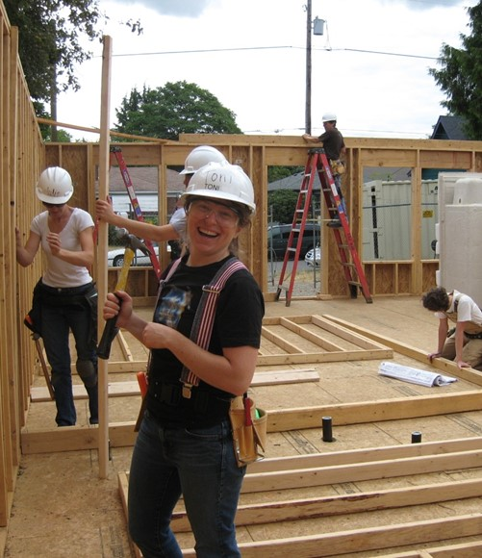
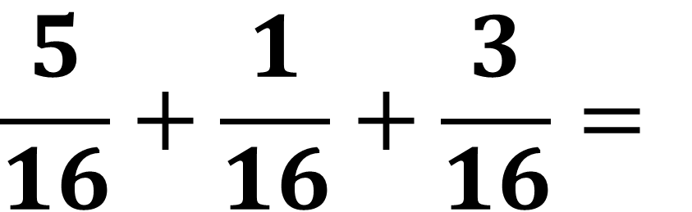
$$\frac{5}{16}+\frac{1}{16}+\frac{3}{16}=$$
Notes:
Have students use their fraction strips and the number line in their handout (the image of the slide) to add these fractions.

Slide 16

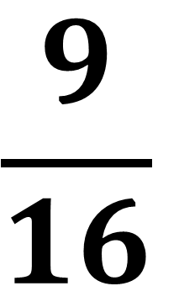
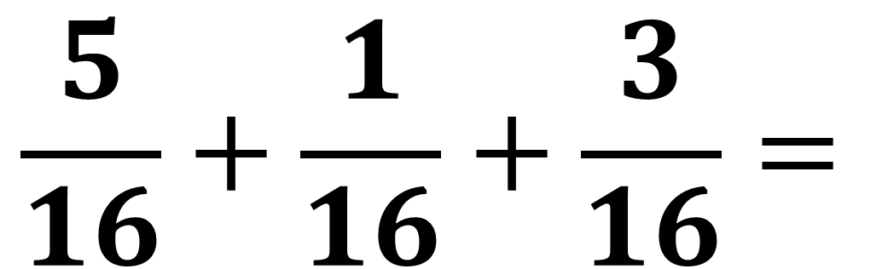








$$\frac{5}{16}+\frac{1}{16}+\frac{3}{16}=$$
$$\frac{9}{16}$$
$$\frac{1}{16}$$
$$\frac{1}{16}$$
$$\frac{1}{16}$$
$$\frac{1}{16}$$
$$\frac{1}{16}$$
$$\frac{1}{16}$$
$$\frac{1}{16}$$
$$\frac{1}{16}$$
$$\frac{1}{16}$$
Notes:
Show how 5/16 + 1/16 + 3/16 = 9/16 and that is larger than 5/16, 1/16, or 3/16.

Slide 17










$$\frac{9}{16}$$
$$\frac{1}{16}$$
$$\frac{1}{16}$$
$$\frac{1}{16}$$
$$\frac{1}{16}$$
$$\frac{1}{16}$$
$$\frac{1}{16}$$
$$\frac{1}{16}$$
$$\frac{1}{16}$$
$$\frac{1}{16}$$
Notes:
Point how 5/16 + 1/16 + 3/16 = 9/16 on the number line as well CLICK

Slide 18
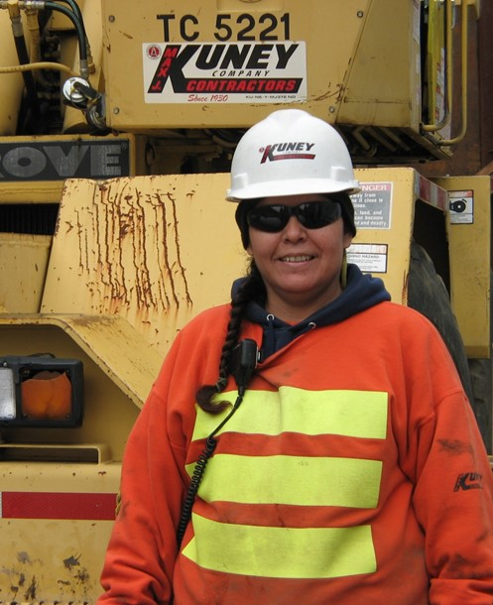
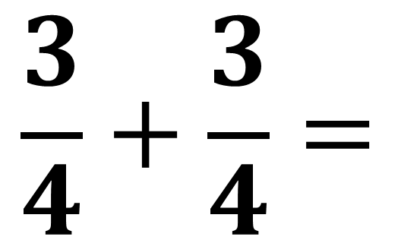
$$\frac{3}{4}+\frac{3}{4}=$$
Notes:
Have students use their fraction strips to add 3/4 + 3/4 and write their answer on their handout.

Slide 19
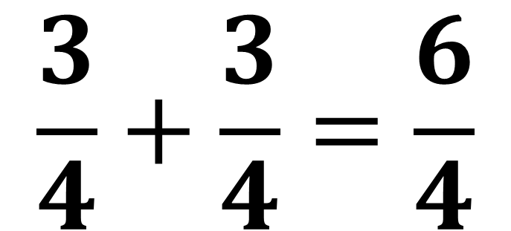
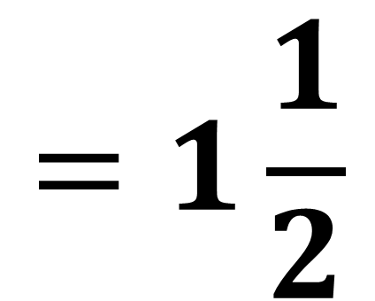
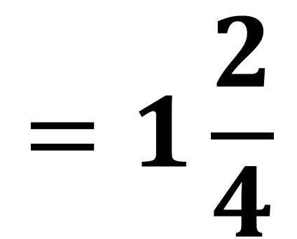
$$\frac{3}{4}+\frac{3}{4}=\frac{6}{4}$$
$$=1\frac{2}{4}$$
$$=1\frac{1}{2}$$
$$\frac{1}{4}$$
$$\frac{1}{4}$$
$$\frac{1}{4}$$
$$\frac{1}{4}$$
$$\frac{1}{4}$$
$$\frac{1}{4}$$
$$\frac{1}{4}$$
$$\frac{1}{4}$$
$$\frac{1}{4}$$
$$\frac{1}{4}$$
$$\frac{1}{4}$$
$$\frac{1}{4}$$
$$\frac{1}{4}$$
Notes:
Point out the six fourths and how it is larger than 3/4.
Ask how 6/4 would be written as a mixed number. CLICK
Point out the one whole and two fourths represented by the fraction strips.
Ask how 1 2/4 would be simplified. CLICK
Have students correct their answer (if necessary) on their handout.

Slide 20
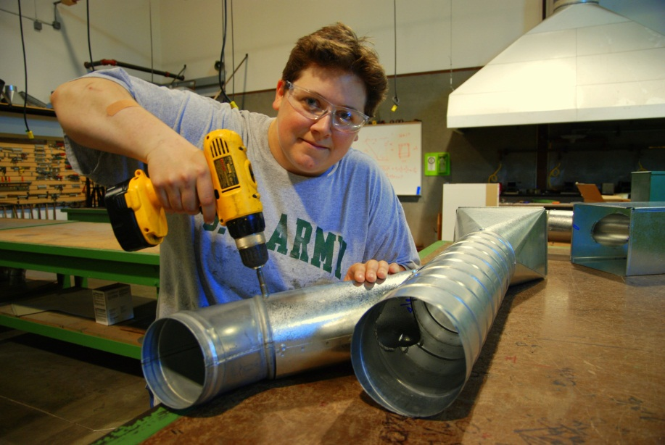
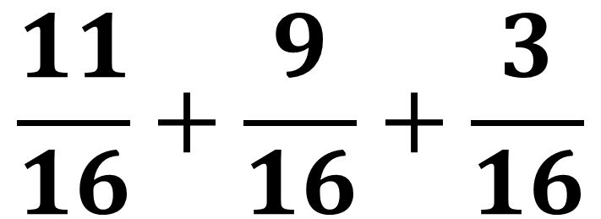
$$\frac{11}{16}+\frac{9}{16}+\frac{3}{16}$$
Notes:
Have students use their fraction strips to add 11/16 + 9/16 + 3/16 and write their answer on their handout.

Slide 21




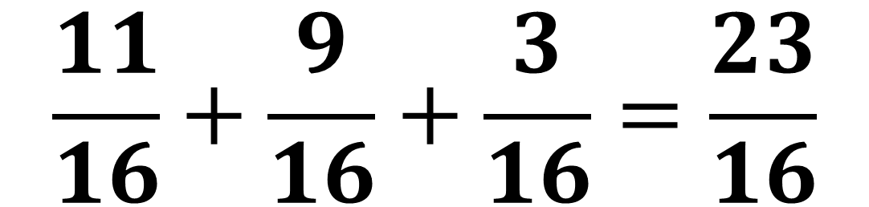


























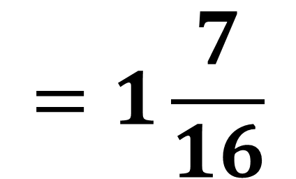






$$\frac{11}{16}+\frac{9}{16}+\frac{3}{16}=\frac{23}{16}$$
$$=1\frac{7}{16}$$
$$\frac{1}{16}$$
$$\frac{1}{16}$$
$$\frac{1}{16}$$
$$\frac{1}{16}$$
$$\frac{1}{16}$$
$$\frac{1}{16}$$
$$\frac{1}{16}$$
$$\frac{1}{16}$$
$$\frac{1}{16}$$
$$\frac{1}{16}$$
$$\frac{1}{16}$$
$$\frac{1}{16}$$
$$\frac{1}{16}$$
$$\frac{1}{16}$$
$$\frac{1}{16}$$
$$\frac{1}{16}$$
$$\frac{1}{16}$$
$$\frac{1}{16}$$
$$\frac{1}{16}$$
$$\frac{1}{16}$$
$$\frac{1}{16}$$
$$\frac{1}{16}$$
$$\frac{1}{16}$$
$$\frac{1}{16}$$
$$\frac{1}{16}$$
$$\frac{1}{16}$$
$$\frac{1}{16}$$
$$\frac{1}{16}$$
$$\frac{1}{16}$$
$$\frac{1}{16}$$
$$\frac{1}{16}$$
$$\frac{1}{16}$$
$$\frac{1}{16}$$
$$\frac{1}{16}$$
$$\frac{1}{16}$$
$$\frac{1}{16}$$
$$\frac{1}{16}$$
$$\frac{1}{16}$$
$$\frac{1}{16}$$
$$\frac{1}{16}$$
$$\frac{1}{16}$$
$$\frac{1}{16}$$
$$\frac{1}{16}$$
$$\frac{1}{16}$$
$$\frac{1}{16}$$
$$\frac{1}{16}$$
$$\frac{1}{16}$$
$$\frac{1}{16}$$
$$\frac{1}{16}$$
$$\frac{1}{16}$$
$$\frac{1}{16}$$
$$\frac{1}{16}$$
$$\frac{1}{16}$$
$$\frac{1}{16}$$
$$\frac{1}{16}$$
$$\frac{1}{16}$$
$$\frac{1}{16}$$
$$\frac{1}{16}$$
$$\frac{1}{16}$$
$$\frac{1}{16}$$
$$\frac{1}{16}$$
$$\frac{1}{16}$$
Notes:
Point out the 23 sixteenths and how it is larger than either 11/16, 9/16 or 3/16.
Ask how 23 sixteenths would be written as a mixed number. CLICK
Point out the one whole and seven sixteenths. Have students compare the sixteen sixteenths to their whole fraction strip.
Have students correct their answer (if necessary) on their handout.

Slide 22
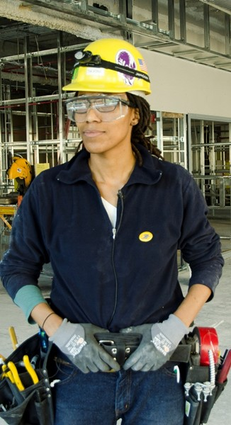
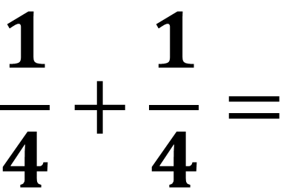
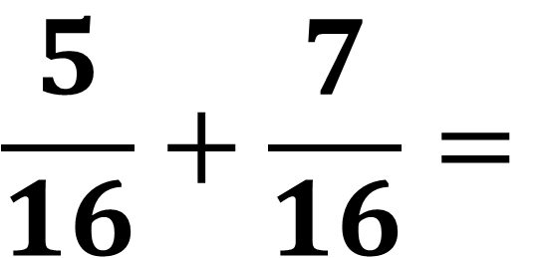
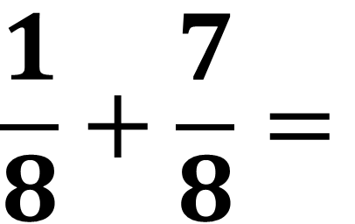
$$\frac{1}{4}+\frac{1}{4}=$$
$$\frac{1}{8}+\frac{7}{8}=$$
$$\frac{5}{16}+\frac{7}{16}=$$
Notes:
Have students write their answers on their handout, simplifying the answer if necessary. Encourage them to use their fraction strips to visualize the fractions

Slide 23
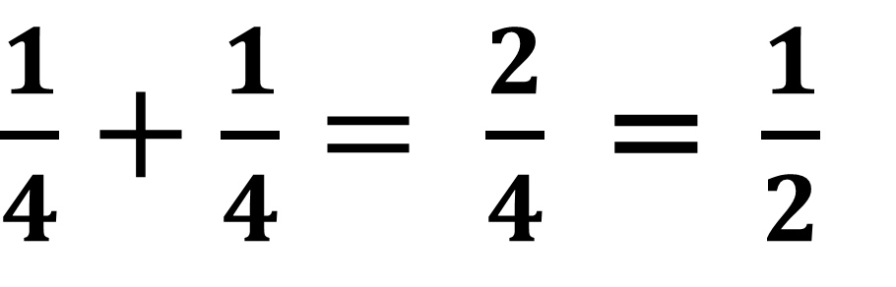
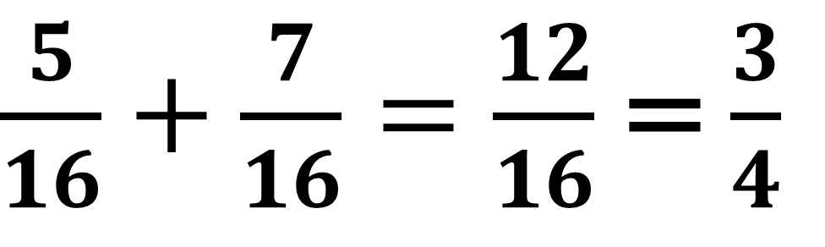
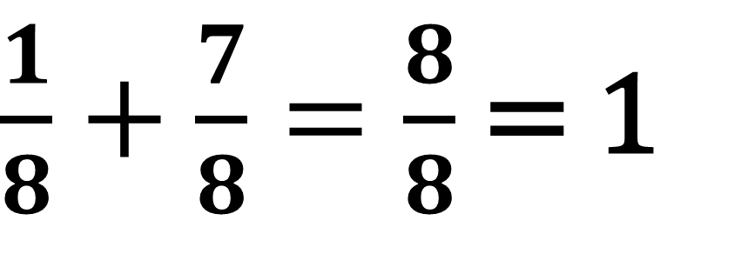
$\frac{1}{4}+\frac{1}{4}= \frac{2}{4}$ = $\frac{1}{2}$
$\frac{1}{8}+\frac{7}{8}=\frac{8}{8}$ = 1
$\frac{5}{16}+\frac{7}{16}=\frac{12}{16}$ = $\frac{3}{4}$
Notes:
Have students correct their answers (if necessary) on their handout.

Slide 24
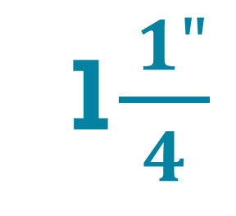
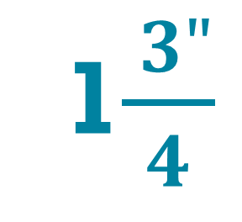
Brownies need:
cups of flour
1$\frac{ 1"}{4}$
Cookies need:
cups of flour
1$\frac{ 3"}{4}$
Total needed:
cups of flour
?
Notes:
Say that when adding mixed numbers, they only need to add the whole numbers first, then add the fractions.

Slide 25
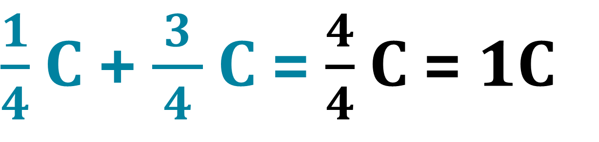
Add whole numbers first,
then the fractions,
then combine.
1 C + 1C = 2C
$\frac{1}{4}$ C + $\frac{ 3 }{4}$ C = $\frac{4}{4}$ C = 1C
Total needed:
of flour
2 C + 1C = 3C
Notes:
Show where the whole cups came from. CLICK
Show where the quarter cups came from. CLICK
Point out the importance of including the units

Slide 26
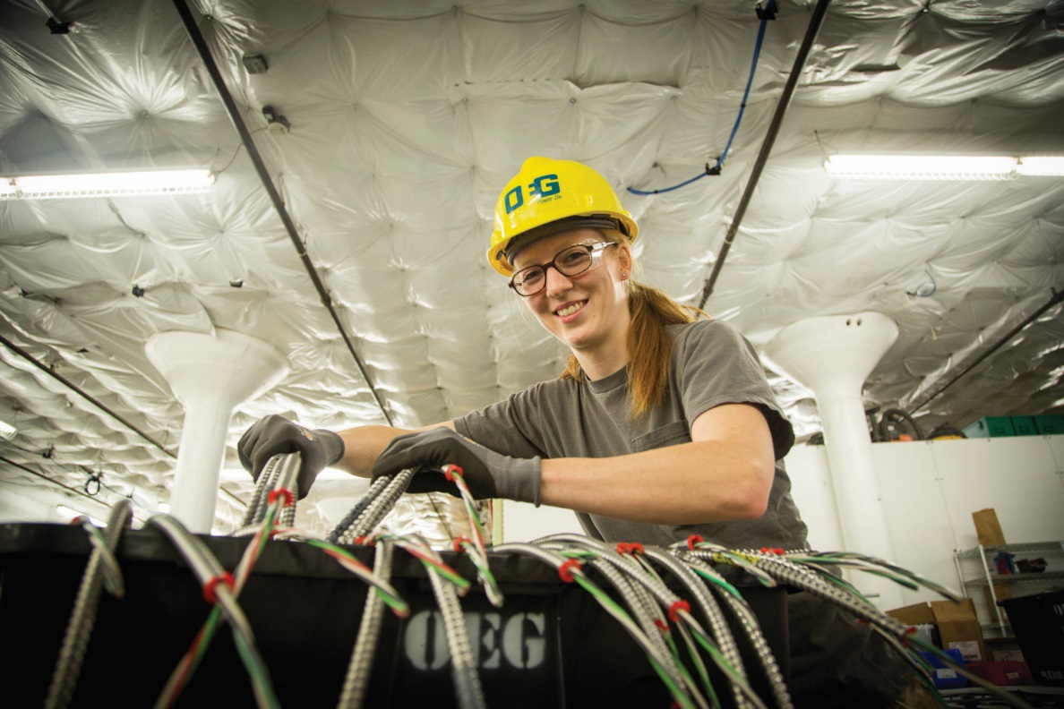
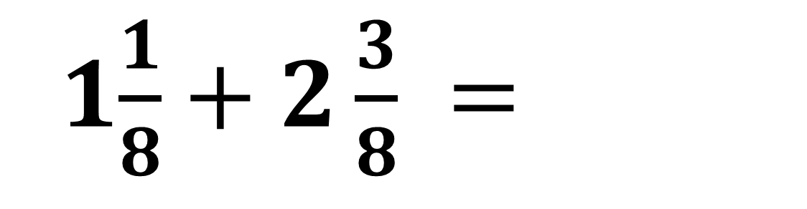
1$\frac{1}{8}+2\frac{3}{8} =$
Notes:
Have students use their fraction strips to add these fractions and write their answer on their handout, simplifying the answer if necessary.

Slide 27
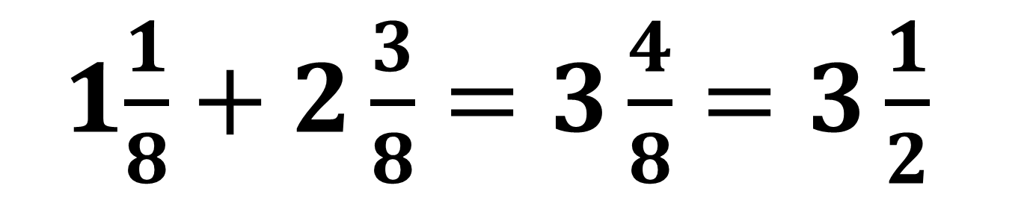
1$\frac{1}{8}+2\frac{3}{8}=3\frac{4}{8}=3\frac{1}{2}$
one whole
one whole
one whole
$$\frac{1}{8}$$
$$\frac{1}{8}$$
$$\frac{1}{8}$$
$$\frac{1}{8}$$
Notes:
Point out the three wholes and four eighths, and how it simplifies to 3 1/2.
Have students correct their answer (if necessary) on their handout.
Note: One common mistake that students might make when adding mixed numbers is to give the whole numbers the same denominator as the fractions.

Slide 28
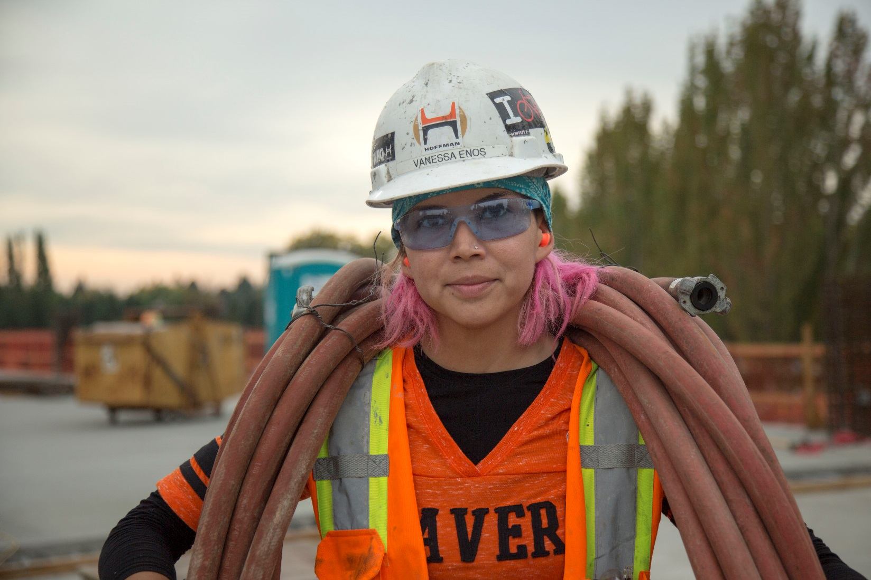
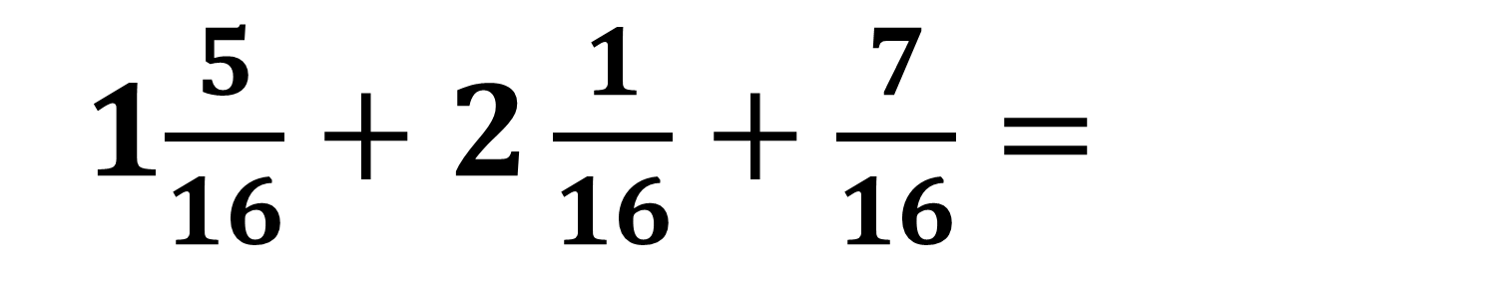
1$\frac{5}{16}+2\frac{1}{16}+\frac{7}{16}=$
Notes:
Have students use their fraction strips to add these fractions and write their answer on their handout.

Slide 29



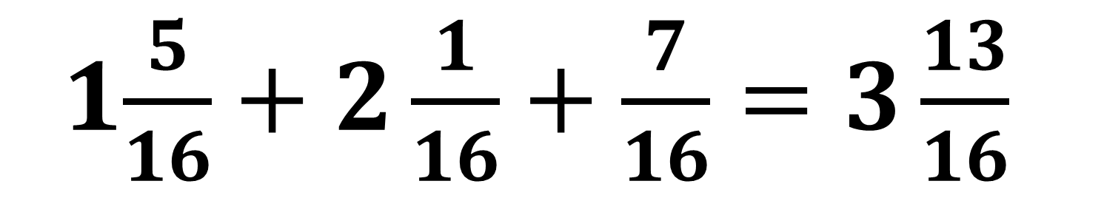













1$\frac{5}{16}+2\frac{1}{16}+\frac{7}{16}=3\frac{13}{16}$
one whole
one whole
one whole
$$\frac{1}{16}$$
$$\frac{1}{16}$$
$$\frac{1}{16}$$
$$\frac{1}{16}$$
$$\frac{1}{16}$$
$$\frac{1}{16}$$
$$\frac{1}{16}$$
$$\frac{1}{16}$$
$$\frac{1}{16}$$
$$\frac{1}{16}$$
$$\frac{1}{16}$$
$$\frac{1}{16}$$
$$\frac{1}{16}$$
$$\frac{1}{16}$$
$$\frac{1}{16}$$
$$\frac{1}{16}$$
$$\frac{1}{16}$$
$$\frac{1}{16}$$
$$\frac{1}{16}$$
Notes:
Point out the three wholes and 13 sixteenths.
Have students correct their answer (if necessary) on their handout.

Slide 30
7$9\frac{ 1"}{16}$
3$4\frac{ 5"}{16}$
Notes:
Have students calculate the perimeter of this door frame and write their answer on their handout.

Slide 31
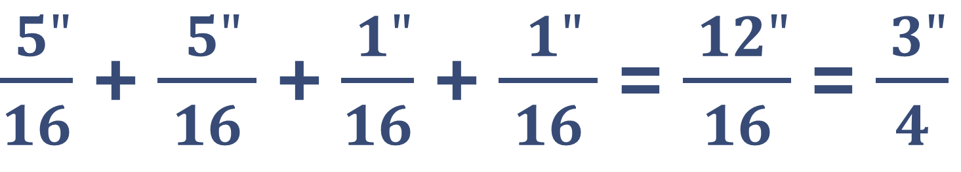

Add whole numbers first,
then the fractions,
then combine.
34” + 34” + 79” + 79” = 226”
$\frac{ 5"}{16}$ + $\frac{ 5" }{16}$ + $\frac{ 1"}{16}$ + $\frac{ 1" }{16}$ = $\frac{ 12"}{16}$ = $\frac{ 3"}{4}$
Perimeter =226$\frac{ 3"}{4}$
Notes:
Show how the whole number was calculated. CLICK
Show how the fraction was calculated. CLICK
Point out the importance of including the units

Slide 32
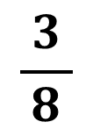
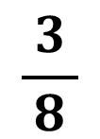
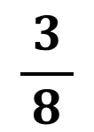
Three pieces of 3/8” thick plywood are stacked on each other. What is the total thickness of the three pieces?
$$\frac{ 3 }{8}$$
$$\frac{ 3 }{8}$$
$$\frac{ 3 }{8}$$
Notes:
Have students use their fraction strips to add these fractions and write their answer on their handout, simplifying the answer if necessary.

Slide 33
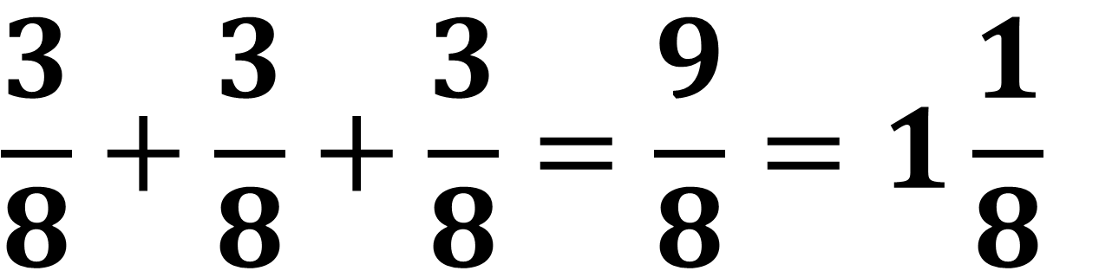



$$\frac{3}{8}+\frac{3}{8}+\frac{3}{8}=\frac{9}{8}=1\frac{1}{8}$$
$$\frac{ 3 }{8}$$
$$\frac{ 3 }{8}$$
$$\frac{ 3 }{8}$$
Notes:
Have students correct their answer (if necessary) on their handout.

Slide 34
Notes:
Practice adding fractions and mixed numbers with common denominators
Include word problems when revisit perimeter and area with fractions

Slide 35

How many screwdrivers do you have?
?
+
=
Notes:
Ask, if they put two pliers and three screwdrivers in their tool belt, how many screwdrivers would they have?

Slide 36

$$\frac{1}{4} + \frac{1}{2} =$$
Notes:
Say that, just as you can’t add pliers and screwdrivers, you can’t add fractions if their bottom numbers are different. CLICK

Slide 37

When multiplying fractions you can just multiply the bottom numbers, then then top numbers, even if they are different.
$\frac{3}{4}$ x $\frac{5}{8} =\frac{15}{32}$
Notes:
Point out that, adding fractions is different than multiplying fractions. In multiplication, you can just multiply the bottom numbers, then then top numbers, even if they are different.

Slide 38

$$\frac{3}{4} + \frac{5}{8} =$$
Notes:
Say that you cannot do that when adding fractions. CLICK

Slide 39

How many of those things there are
$$\frac{1}{4}$$
What is being counted
Notes:
Say to remember that the bottom number tells you what is being counted and the top number tells you how many of those things there are.

Slide 40

$$\frac{1}{4}$$
There is one
Fourth
Notes:
Say that the fraction 1/4 means that there is one fourth

Slide 41

$$\frac{1}{2}$$
There is one
Half
Notes:
Say that the fraction 1/2 means that there is one half

Slide 42

Not the same things!
$$\frac{1}{4}$$
$$\frac{1}{2}$$
Notes:
Say that, just as pliers and screwdrivers are both tools, but are different kinds of tools, CLICK
halves and fourths are both amounts, but different kinds of amounts.
Ask what needs to happen in order to add fractions with different bottom numbers.

Slide 43




$$\frac{1}{4}$$
$$\frac{3}{4}$$
$$\frac{1}{2}$$
$$\frac{2}{4}$$
Notes:
Point out, using the number line, that 2/4 is the same as 1/2.

Slide 44



$\frac{1}{4}$ + $\frac{2}{4} =$
$\frac{1}{4}$ + $\frac{1}{2} =$
$$\frac{3}{4}$$
+
$$\frac{1}{4}$$
$$\frac{1}{4}$$
$$\frac{1}{2}$$
$$\frac{1}{4}$$
=
$$\frac{1}{4}$$
$$\frac{1}{4}$$
$$\frac{1}{4}$$
Notes:
Say that you are not changing the amount, you are only renaming 1/2 as 2/4 so you now have all of the same thing (fourths) CLICK
Say that now you have all fourths so you can add them. CLICK
Show that, when 1/2 is renamed 2/4, both the top and bottom number changed.
Say that whenever renaming a fraction in this way, both the top and bottom number have to change.
Point out that 1/2 and 2/4 are the same amount but because 2/4 has the same bottom number as 1/4, the fractions can be added.

Slide 45


$$\frac{3}{4}+\frac{5}{8}=$$
Notes:
Have students use their fraction strips to add these fractions and write their answer on their handout.

Slide 46







$$\frac{5}{8}$$
$$\frac{7}{8}$$
$$\frac{1}{8}$$
$$\frac{3}{8}$$
$$\frac{2}{8}$$
$$\frac{3}{4}$$
$$\frac{4}{8}$$
$$\frac{6}{8}$$
Notes:
Show , using the number line, that 6/8 is the same as 3/4.

Slide 47




$$\frac{3}{4}+\frac{5}{8}=$$
$\frac{6}{8}+\frac{5}{8}=\frac{11}{8}$ = 1$\frac{3}{8}$
$$\frac{3}{4}$$
$$\frac{1}{4}$$
$$\frac{1}{4}$$
$$\frac{1}{4}$$
is the same as
$$\frac{1}{4}$$
$$\frac{6}{8}$$
$$\frac{1}{8}$$
$$\frac{1}{8}$$
$$\frac{1}{8}$$
$$\frac{1}{8}$$
$$\frac{1}{8}$$
$$\frac{1}{8}$$
Notes:
Say that to add 3/4 and 5/8 they need to have the same bottom number. CLICK
Show that 3/4 is the same amount as 6/8 and, now that both fractions (5/8 and 6/8) have the same bottom number, CLICK
you can add the fractions.
Point out that, when 3/4 is renamed 6/8, both the top and bottom number changed.
Say that whenever renaming a fraction in this way, both the top and bottom number have to change.

Slide 48


$$\frac{1}{2}+\frac{1}{8}+\frac{3}{16}=$$
Notes:
Have students use their fraction strips to add these fractions and write their answer on their handout.

Slide 49







$$\frac{2}{16}$$
$$\frac{6}{16}$$
$$\frac{10}{16}$$
$$\frac{14}{16}$$
$$\frac{4}{16}$$
$$\frac{12}{16}$$
$$\frac{1}{2}$$
$$\frac{8}{16}$$
Notes:
Show , using the number line, that 8/16 is the same as 1/2.

Slide 50




$$\frac{1}{2}+\frac{1}{8}+\frac{3}{16}=$$
$$\frac{1}{2}$$
$$\frac{1}{4}$$
$$\frac{1}{4}$$
$$\frac{1}{4}$$
$$\frac{1}{2}$$
is the same as
$$\frac{1}{4}$$
$$\frac{8}{16}$$
$$\frac{1}{16}$$
$$\frac{1}{16}$$
$$\frac{1}{16}$$
$$\frac{1}{16}$$
$$\frac{1}{16}$$
$$\frac{1}{16}$$
$$\frac{1}{16}$$
$$\frac{1}{16}$$
Notes:
Point out that 1/2 is the same amount as 8/16.
Point out that, when 1/2 is renamed 8/16, both the top and bottom number changed.
Say that whenever they are renaming a fraction in this way, both the top and bottom number have to change.

Slide 51



$$\frac{1}{8}$$
$$\frac{6}{16}$$
$$\frac{10}{16}$$
$$\frac{14}{16}$$
$$\frac{4}{16}$$
$$\frac{12}{16}$$
$$\frac{2}{16}$$
$$\frac{8}{16}$$
Notes:
Point out, using the number line, that 2/16 is the same as 1/8.

Slide 52



$$\frac{1}{2}+\frac{1}{8}+\frac{3}{16}=$$
$$\frac{1}{8}$$
$$\frac{1}{4}$$
$$\frac{1}{4}$$
$$\frac{1}{4}$$
$$\frac{1}{8}$$
is the same as
$$\frac{1}{4}$$
$$\frac{2}{16}$$
$$\frac{1}{16}$$
$$\frac{1}{16}$$
Notes:
Point out that 1/8 is the same amount as 2/16.
Point out that, when 1/8 renamed 2/16, both the top and bottom number changed.
Say that whenever they are renaming a fraction in this way, both the top and bottom number have to change.

Slide 53





$$\frac{1}{2} + \frac{1}{8} + \frac{3}{16} =$$
$$\frac{1}{4}$$
$$\frac{1}{4}$$
$$\frac{1}{4}$$
$$\frac{8}{16} + \frac{2}{16}+\frac{3}{16} =\frac{13}{ 16}$$
$$\frac{1}{4}$$
$$\frac{1}{16}$$
$$\frac{1}{16}$$
$$\frac{1}{16}$$
$$\frac{1}{16}$$
$$\frac{1}{16}$$
$$\frac{1}{16}$$
$$\frac{1}{16}$$
$$\frac{1}{16}$$
$$\frac{1}{16}$$
$$\frac{1}{16}$$
$$\frac{1}{16}$$
$$\frac{1}{16}$$
$$\frac{1}{16}$$
Notes:
Show how 1/2 + 1/8 + 3/16 is the same as 8/16 + 2/16 + 3/16, which equals 13/16.
Have students correct their answer (if necessary) on their handout.

Slide 54

How to add fractions with different bottom numbers
Notes:
Say that they will need to be able to add fractions with different bottom numbers without using fraction strips.

Slide 55
To add fractions with different bottom numbers, rename one (or more) of the fractions so they all have the same bottom number.
Notes:
Say that, to add fractions with different bottom numbers, they have to rename one of the fractions (or more if more than two fractions are being added) so that all fractions have the same bottom number.

Slide 56
When you rename a fraction, the amount stays the same!
Notes:
Say that renaming a fraction doesn’t change its amount.

Slide 57


$$\frac{1}{2}$$
$$\frac{1}{2}$$
$$\frac{2}{4}$$
$$\frac{1}{4}$$
$$\frac{1}{4}$$
Notes:
Point out how, in a previous example, 1/2 was renamed 2/4 but the amount stayed the same.

Slide 58
If the bottom number of one (or more) of the fractions divides evenly into the bottom number of another fraction, rename the fraction(s) so they all have the larger bottom number.
Notes:
Say that one way to rename fractions so they all have the same bottom number is to see if one bottom number divides evenly into the other. If it does, the fractions should be renamed so they will all have that (larger) bottom number.
Say that they can use this method with most of the fractions they will work with.
Point out that they have to rename fractions without changing the amount.

Slide 59







$\frac{1}{4}$ + $\frac{1}{2} =$
x
$$2$$
$=$
$$\frac{1}{2}$$
$$\frac{2}{4}$$
x
$$2$$
$$=$$
4
Notes:
Say that, for example, two divides evenly into four so they should rename the 1/2 to fourths. CLICK
Ask what they would have to multiply the two in the 1/2 by to make it fourths. CLICK
Say that, when renaming a fraction like this, they need to do the same thing to the top and bottom number. CLICK
Say that, by multiplying the top and bottom numbers by two, 1/2 is renamed 2/4 without changing the amount. CLICK
Note: It might be helpful to refer students to their fraction strips to confirm that 1/2 and 2/4 are the same amount.

Slide 60


$\frac{1}{4}$ + $\frac{1}{2} =$
$\frac{1}{4}$ + $\frac{2}{4} = \frac{3}{4}$
Notes:
Point out that 1/2 has been renamed 2/4 but they are the same amount.
Say that, now that both fractions have the same bottom number, they can be added.

Slide 61



$\frac{3}{4}$ + $\frac{5}{8} =$
x
$$2$$
$=$
$$\frac{3}{4}$$
$$\frac{6}{8}$$
x
$$2$$
$$=$$
8
Notes:
Ask which of the two fractions should be renamed. CLICK
Ask what they would have to multiply the four in the 3/4 by to make it eighths. CLICK
Say that, when renaming a fraction like this, they need to do the same thing to the top and bottom number. CLICK
Say that, by multiplying the top and bottom numbers by two, 3/4 is renamed 6/8 without changing the amount. CLICK
Note: It might be helpful to refer students to their fraction strips to confirm that 3/4 and 6/8 are the same amount.

Slide 62


$\frac{3}{4}$ +$\frac{5}{8}=$
$\frac{6}{8}$ +$\frac{5}{8}= \frac{11}{8}$ $=$ 1$\frac{3}{8}$
Notes:
Point out that 3/4 has been renamed 6/8 but they are the same amount.
Say that, now that both fractions have the same bottom number, they can be added.

Slide 63





$\frac{1}{2}$ +$\frac{1}{8}\text{+}\frac{3}{16}=$
x
$$8$$
$=$
$$\frac{1}{2}$$
$$\frac{8}{16}$$
x
$$8$$
$$=$$
16
Notes:
Ask which fractions should be renamed. CLICK
Ask what they would have to multiply the two in the 1/2 by to make it sixteenths. CLICK
Say that, when renaming a fraction like this, they need to do the same thing to the top and bottom number. CLICK
Say that, by multiplying the top and bottom numbers by eight, 1/2 is renamed 8/16 without changing the amount. CLICK
Note: It might be helpful to refer students to their fraction strips to confirm that 1/2 and 8/16 are the same amount.

Slide 64


$\frac{1}{2}$ +$\frac{1}{8}\text{+}\frac{3}{16}=$
x
$$2$$
$=$
$$\frac{1}{8}$$
$$\frac{2}{16}$$
x
$$2$$
$$=$$
16
Notes:
Ask what they would have to multiply the eight in the 1/8 by to make it sixteenths. CLICK
Say that, when renaming a fraction like this, they need to do the same thing to the top and bottom number. CLICK
Say that, by multiplying the top and bottom numbers by two, 1/8 is renamed 2/16 without changing the amount. CLICK
Note: It might be helpful to refer students to their fraction strips to confirm that 1/8 and 2/16 are the same amount.

Slide 65


$\frac{1}{2}$ +$\frac{1}{8} \text{+}\frac{3}{16}=$
$\frac{8}{16}$ +$\frac{2}{16}\text{+}\frac{3}{16}=\frac{13}{16}$
Notes:
Point out that 1/2 has been renamed 8/16 but they are the same amount, and that 1/8 has been renamed 2/16 but they are the same amount.
Say that, now that all fractions have the same bottom number, they can be added.

Slide 66

Add whole numbers first, then fractions,
then combine.
3$\frac{9}{16}\text{+}\text{ 22}\frac{3}{4}\text{+ }\text{14}\frac{1}{2}=$
Notes:
Say that, just as with fractions in which the bottom numbers are the same, mixed numbers with different bottom numbers are added by adding the whole numbers first, then the fractions, then combining.

Slide 67


3$\frac{9}{16}\text{+}\text{ 22}\frac{3}{4}\text{+ }\text{14}\frac{1}{2}=$
3$\text{+}\text{ 22 }\text{+ }\text{14}=39$
Notes:
Show how the whole numbers equal 39.

Slide 68




$\frac{9}{16}$ + $\frac{3}{4} \text{+} \frac{1}{2}=$
x
$$4$$
$=$
$$\frac{3}{4}$$
$$\frac{12}{16}$$
x
$$4$$
$$=$$
16
Notes:
Ask which fractions should be renamed. CLICK
Ask what they would have to multiply the four in the 3/4 by to make it sixteenths. CLICK
Say that, when renaming a fraction like this, they need to do the same thing to the top and bottom number. CLICK
Say that, by multiplying the top and bottom numbers by four, 3/4 is renamed 12/16 without changing the amount. CLICK
Note: It might be helpful to refer students to their fraction strips to confirm that 3/4 and 12/16 are the same amount.

Slide 69



$\frac{9}{16}$ + $\frac{3}{4} \text{+} \frac{1}{2}=$
x
$$8$$
$=$
$$\frac{1}{2}$$
$$\frac{8}{16}$$
x
$$8$$
$$=$$
16
Notes:
Ask what they would have to multiply the two in the 1/2 by to make it sixteenths. CLICK
Say that, when renaming a fraction like this, they need to do the same thing to the top and bottom number. CLICK
Say that, by multiplying the top and bottom numbers by eight, 1/2 is renamed 8/16 without changing the amount. CLICK
Note: It might be helpful to refer students to their fraction strips to confirm that 1/2 and 8/16 are the same amount.

Slide 70


$\frac{9}{16}$+$\frac{3}{4}\text{+}\frac{1}{2}=$
$\frac{9}{16}$+$\frac{12}{16}\text{+}\frac{8}{16}=\frac{29}{16}=1\frac{13}{16}$
Notes:
Point out that 3/4 has been renamed 12/16 but they are the same amount, and that 1/2 has been renamed 8/16 but they are the same amount.
Say that, now that all fractions have the same bottom number, they can be added.

Slide 71

$1\frac{13}{16}$ $\text{+}$ 39 = $40\frac{13}{16}$
Notes:
Show where the 1 13/16 and the 39 came from.

Slide 72

$$\frac{1}{4} \text{+} \frac{15}{16} \text{+} \text{9}\frac{7}{8}=$$
Notes:
Have students write out the problem and their answer on their handout.

Slide 73




$\frac{1}{4}$ + $\frac{15}{16} \text{+}\text{ 9}\frac{7}{8}\text{=}$
x
$$4$$
$=$
$$\frac{1}{4}$$
$$\frac{4}{16}$$
x
$$4$$
$$=$$
16
Notes:
Show how 1/4 was renamed 4/16.

Slide 74


$\frac{1}{4}$ + $\frac{15}{16} \text{+}\text{ 9}\frac{7}{8}\text{=}$
x
$$2$$
=
$$\frac{7}{8}$$
$$\frac{14}{16}$$
x
$$2$$
=
16
Notes:
Show how 7/8 was renamed 14/16.

Slide 75


$$\frac{1}{4} \text{+} \frac{15}{16} \text{+} \text{9}\frac{7}{8} =$$
$$\frac{4}{16}\text{+} \frac{15}{16} \text{+}\text{ 9}\frac{14}{16}=$$
Notes:
Show where the lower equation came from.

Slide 76

$\frac{19}{16}\text{+}\text{ 9}\frac{14}{16}=\text{9}\frac{33}{16}$ $=$ $\text{11}\frac{1}{16}$
Notes:
Show where the numbers in the equation came from.
Have students correct their answers (if necessary) on their handout.

Slide 77


$$\text{67}\frac{ 1"}{4} x \text{3}\frac{ 5"}{8}=$$
Notes:
Have students find the perimeter of this kitchen island and write their answer on their handout.

Slide 78


$\text{67" + 67" + 3" + 3"}$ = 140”
Notes:
Show where the whole numbers came from.

Slide 79


$$\frac{ 1"}{4}+\frac{ 1"}{4}+\frac{ 5"}{8}+\frac{ 5"}{8}=$$
$\frac{ 2"}{8}+\frac{ 2"}{8}+\frac{ 5"}{8}+\frac{ 5"}{8}=$ $\frac{ 14"}{8}$ $=$ 1$\frac{ 6"}{8}=$ 1$\frac{ 3"}{4}$
Notes:
Show where the 2/8s came from and how the 1 ¾ was calculated.

Slide 80


$$140" +\text{1}\frac{ 3"}{4}=141\frac{ 3"}{4}$$
Notes:
Have students correct their answers (if necessary) on their handout.

Slide 81



For a tiling job you have the following amounts of grout. What is the total amount of grout you have?
$$\text{2}\frac{3}{4}lbs.$$
$$\text{7}\frac{1}{2}lbs.$$
$$\text{15}\frac{1}{4}lbs.$$
Notes:
Have students find the total amount and write their answer on their handout.

Slide 82

$\text{2}\frac{3}{4}lbs.$ $+$ $\text{7}\frac{1}{2}lbs. +\text{15}\frac{1}{4}lbs. =$
$\text{2} lbs.$ $+$ $\text{7} lbs. +\text{15} lbs. =24 lbs.$
Notes:
Show how the 24 lbs. was determined.

Slide 83



$\text{2}\frac{3}{4}lbs.$ $+$ $\text{7}\frac{1}{2}lbs. +\text{15}\frac{1}{4}lbs. =$
$\frac{3}{4}lbs.$ $+$ $\frac{1}{2}lbs. + \frac{1}{4}lbs. =$
$\frac{3}{4}lbs.$ $+$ $\frac{2}{4}lbs. +\frac{1}{4}lbs.=\frac{6}{4}lbs.$ $=1\frac{1}{2}lbs.$
Notes:
Show where the 2/4 lbs. came from and how the 1 1/2 was determined.

Slide 84


$\text{2} lbs.$ $+$ $\text{7} lbs. +\text{15} lbs. =24 lbs.$
$\frac{3}{4}lbs.$ $+$ $\frac{2}{4}lbs. +\frac{1}{4}lbs.=\frac{6}{4}lbs.$ $=1\frac{1}{2}lbs.$
$24 lbs.+ 1\frac{1}{2}lbs.$ = 25 $\frac{1}{2}lbs.$
Notes:
Show how the total was determined.

Slide 85
Notes:
Practice problems including measuring perimeter of objects in classroom.
Word problems – height of stacked bricks, time to do something – check Kindle and Ontario curriculum
See existing problems in OTI math and measurement book
Adding fractions of gallons of paint or other liquid
Adding drywall to a stud to get total thickness

Slide 86
Image Credits
Kitchen renovation old window frame removed new blocks for new frame.JPG By Tomwsulcer (Own work) [CC0 1.0 Public Domain], via Wikimedia Commons
DETAILS- WINDOW FRAME AND MOLDING, DOOR AND DOOR FRAME, AND STAIRCASE - William Newman House, 716 Second Street, Portsmouth, Scioto County, OH HABS OHIO,73-PORT,5-15.tif Cropped National Park Service [Public domain], via Wikimedia Commons
Johnetta Abraham898A6035 by Oregon Tradeswomen, Inc.
Tradeswoman by Oregon Tradeswomen, Inc.
Tradeswoman by Oregon Tradeswomen, Inc.
Tradeswoman by Oregon Tradeswomen, Inc.
Tradeswoman by Oregon Tradeswomen, Inc.
Tradeswoman by Oregon Tradeswomen, Inc.
Tradeswoman by Oregon Tradeswomen, Inc.

Slide 87
Image Credits
Jalaine Digs Thru Romex Landscape_98A6153CMYK by Oregon Tradeswomen, Inc.
VanessaHosesMS_98A6501 by Oregon Tradeswomen, Inc.
1773623-irwin-vise-grip-pliers-adjustable-wrenches-slip-joint-pliers-primary by Irwin Tools
2051100-irwin-screwdrivers-9-in-1-multi-tool-primary by Irwin Tools
Rosa Safety tape_98A7546CMYK by Oregon Tradeswomen, Inc.
Tradeswoman by Oregon Tradeswomen, Inc.
ErinPortrait898A6898 by Oregon Tradeswomen, Inc.
Kitchen_with_island By Bill Wilson from Oklahoma City, USA (Camden Place 5813 NW 101st OKC OK) CC BY 2.0 via Wikimedia Commons
StephSmilesClose_98A6716 by Oregon Tradeswomen, Inc.
ValerieSmileAtCamera_98A5741 by Oregon Tradeswomen, Inc.

