Slide 1
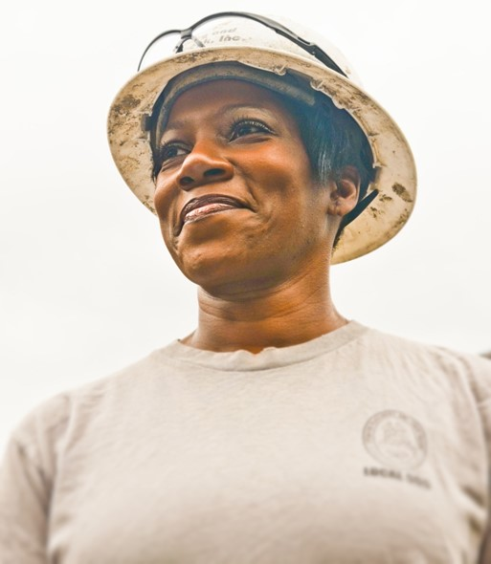
Preparing for Work
Plan ahead for comfort
Observe others

Slide 2
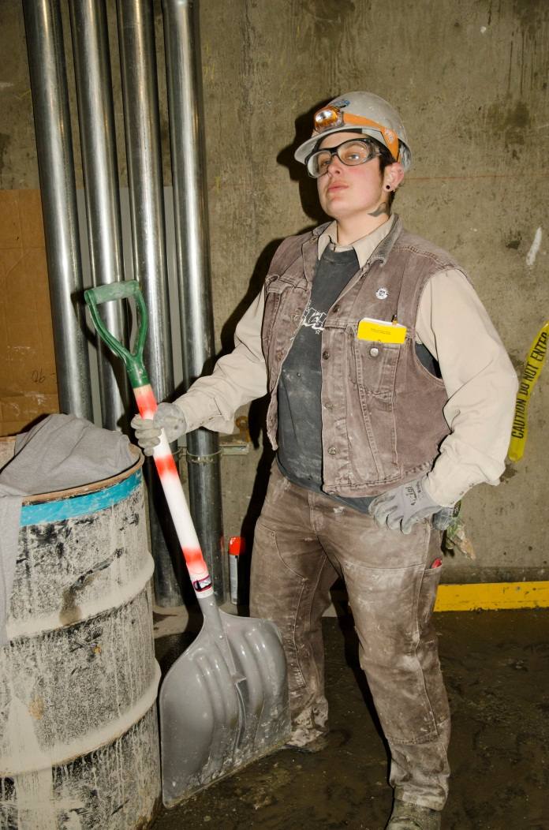
Clothing
Loose fitting, comfortable, heavy duty
Extra change of clothes
Socks: cotton vs wool

Slide 3
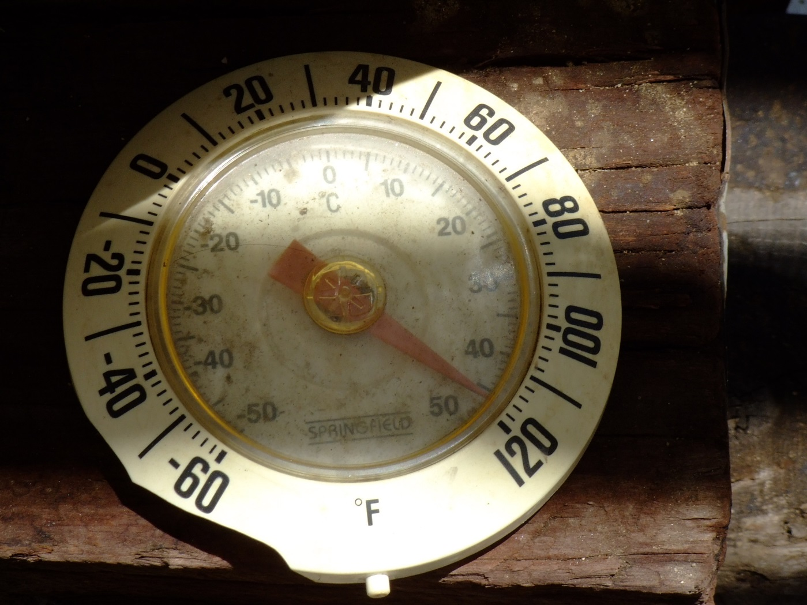
Hot Weather
Cotton
Loose fitting
Non-revealing

Slide 4
Cold Weather
Polypro long johns/wool layered over cotton with a jacket/hooded sweatshirt

Slide 5
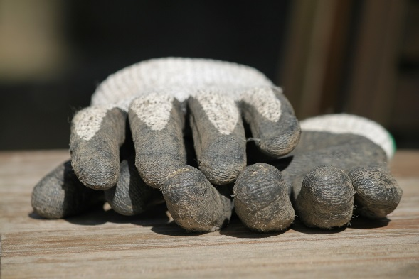
Gloves
Warmth and protection
Too large is dangerous!
Gripping features
Backup pair

Slide 6
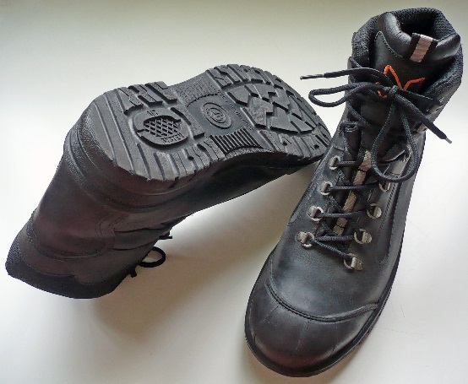
Work Boots or Shoes
Low heeled
Comfortable and sized for larger socks
Steel toed/steel shanked?
Waterproof or backup rubber pair

Slide 7
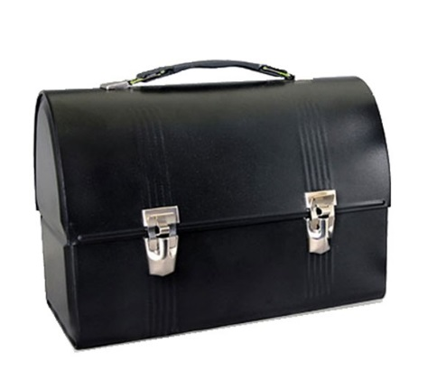
Lunch
Bring enough!
Pack a cooler with a frozen drink
Snacks - energy bars and nuts

Slide 8
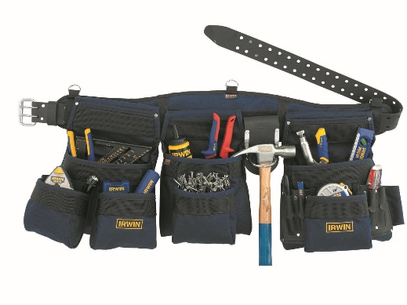
Tools
Bring the basics your first day
Observe to learn what you need
Return borrowed tools promptly

Slide 9
Tools
If you borrow it twice, buy it!
Set aside money each week
Buy quality tools!

Slide 10
Other Considerations
Hand wipes or evaporating cleanser
Sturdy raingear
Small first-aid kit
No contacts if sensitive to dust
Attach keys to clothing

Slide 11
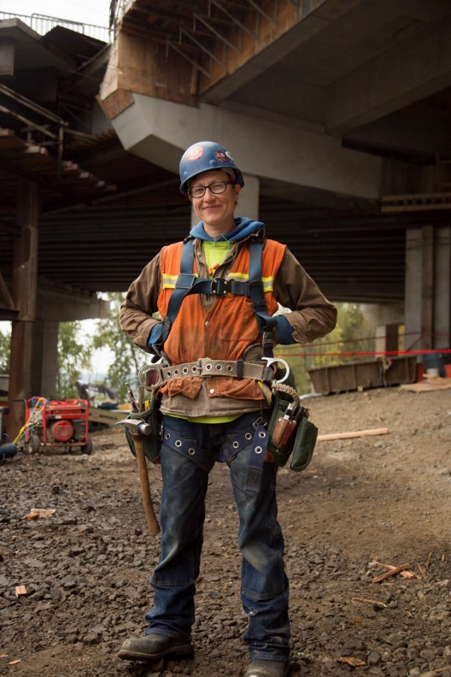
What “On Time” Means
15 minutes early.
Lunch and breaks on a regular schedule.
Work is efficient.

Slide 12
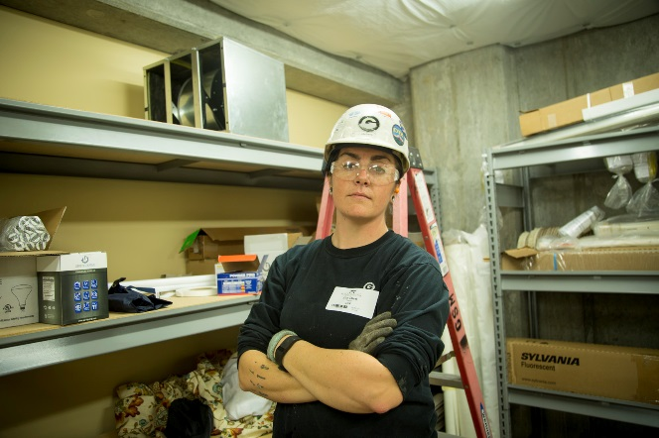
Be Your Best From Day One!
Show up early
Work hard
Do your best
Call OTI if you need a pep talk!

Slide 13
Image Credits
Tradeswoman by Oregon Tradeswomen, Inc.
Tradeswoman by Oregon Tradeswomen, Inc.
Hot by Ray Tsang CC by SA 2.0 via Flicker
Elmira College Moving Truss from Flat Bed CC by 2.0 via Flicker
Work Gloves CC0 Public Domain via Pixabay
S3 safety footwear.jpg by Francis Flinch (Own work) CC BY 3.0 via Wikimedia Commons
Lunch Box by Mike Licht. NotionsCapital.com CC by 2.0 Generic via Flicker
Tool Belt 4031034-irwin-worksite-products-rigs-aprons-and-pouches-feature by Irwin Tools
Tradeswoman by Oregon Tradeswomen, Inc.
LisaArmsCrossed_98A7417 by Oregon Tradeswomen, Inc.

